Slide 1
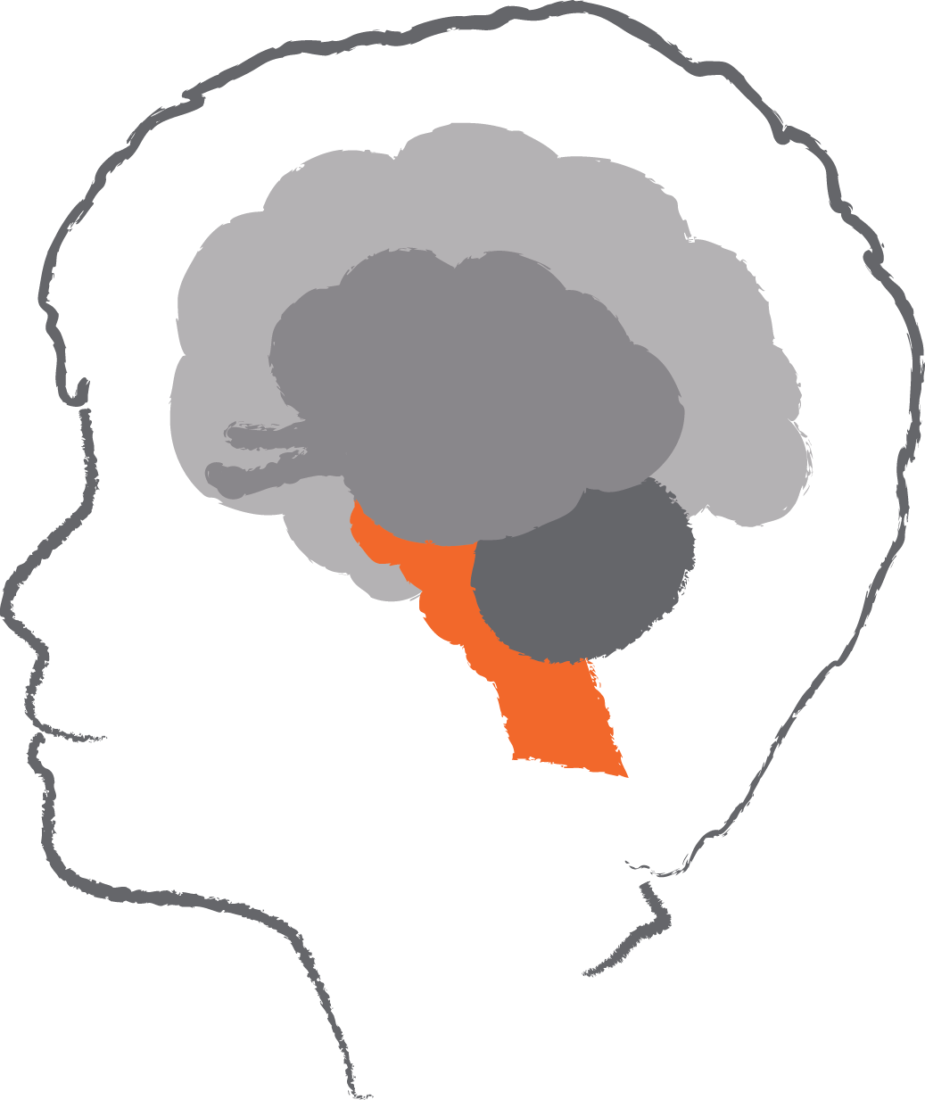
Brainstem - basic life functions
Basic life functions
First part of our brain to develop
This is the most developed brain part at birth
Responsible for our heart beat, breathing, sucking, temperature control, blood pressure
©Australian Childhood Foundation 2018
Notes:
With each section of the brain slide it is good to suggest a strategy that focusses on this area of development.
BRAIN STEM – Basic life functions
Basic Life Functions
First part of our brain to develop
This is the most developed brain part at birth
Responsible for our heart beat, breathing, sucking, temperature control, blood pressure, as well as our sleep cycle
IMPACTS OF TRAUMA
Racing heart
Shortness of breath, shallow, fast breathing
Sleep disturbances and unsettledness
Sucking and swallowing and digestion difficulties
physiological dsyregulation

Slide 2
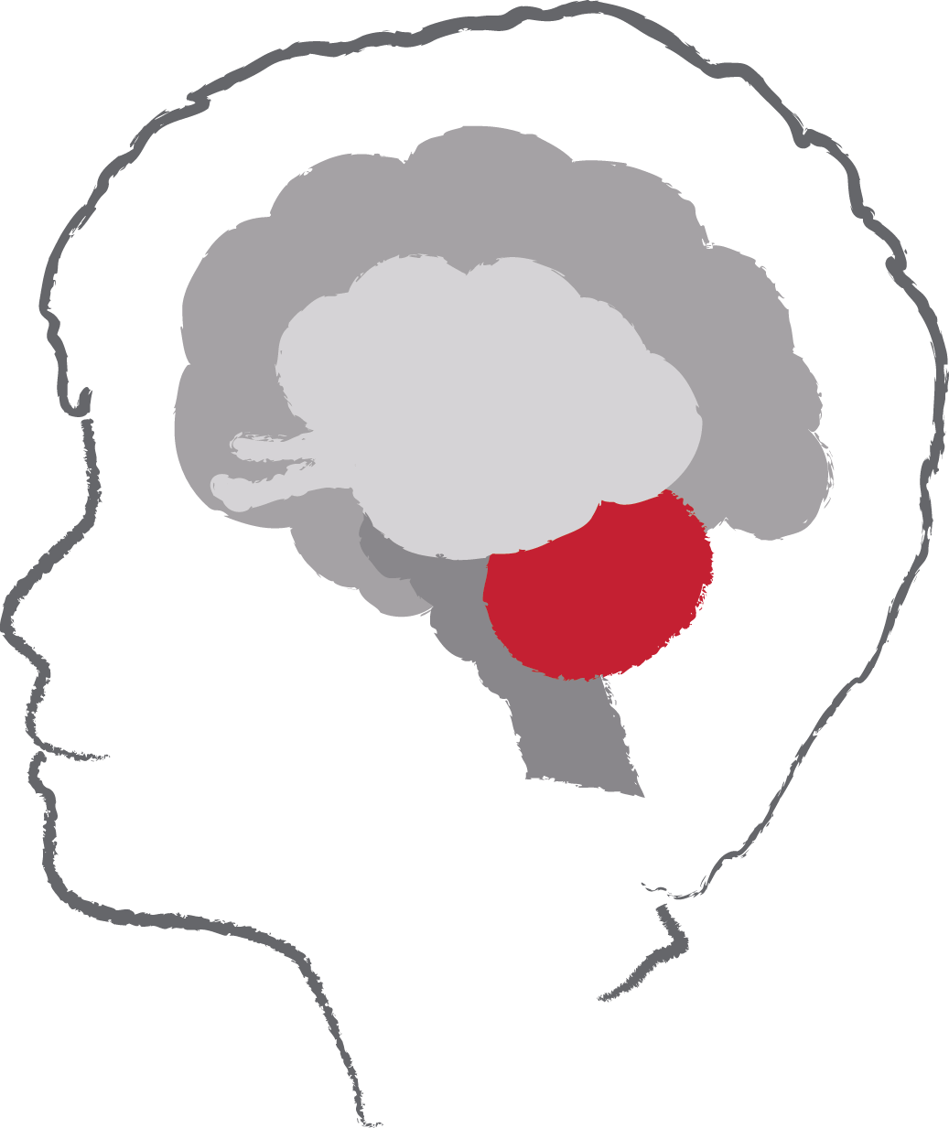
Cerebellum - movement and balance
Helps us to know where our body is in space
Helps us with our posture and balance
Helps us not to fall over and to control our movements
©Australian Childhood Foundation 2018
Notes:
CEREBELLUM – Movement and balance
Helps us to know where our body is in space
Helps us with our posture and balance
Helps us not to fall over and to control our movements
Lack of awareness of their body in space
Lack of coordination and balance
Difficulty in maintaining posture
Difficulty in undertaking tasks that require balance
IMPACT OF TRAUMA
Difficulties with:
where our body is in space
our posture and balance
falling over and to controlling our movements
It is important for being able to perform everyday voluntary (done with purpose and intent) tasks such as walking and writing.

Slide 3
Diencephalon - sorting & sending Centre
This area of the brain develops mainly after birth
It sorts out messages coming into the brain and sends them
It uses hormones to send signals to body
Hormonal signals tell your body what it needs, eg. food, water, love
©Australian Childhood Foundation 2018
Notes:
DIENCEPHALON – Sorting and sending centre
This area of the brain develops mainly after birth
It sorts out messages coming into the brain and sends them
It uses hormones to send signals to body
Hormonal signals tell your body what it needs, eg. food, water, love
IMPACTS OF TRAUMA
becomes overwhelmed and cannot sort the information
is unable to send information to the memory and thinking parts of the brain – that pathway shuts down
it alerts the amygdala which sets of the sensory information response sequence

Slide 4
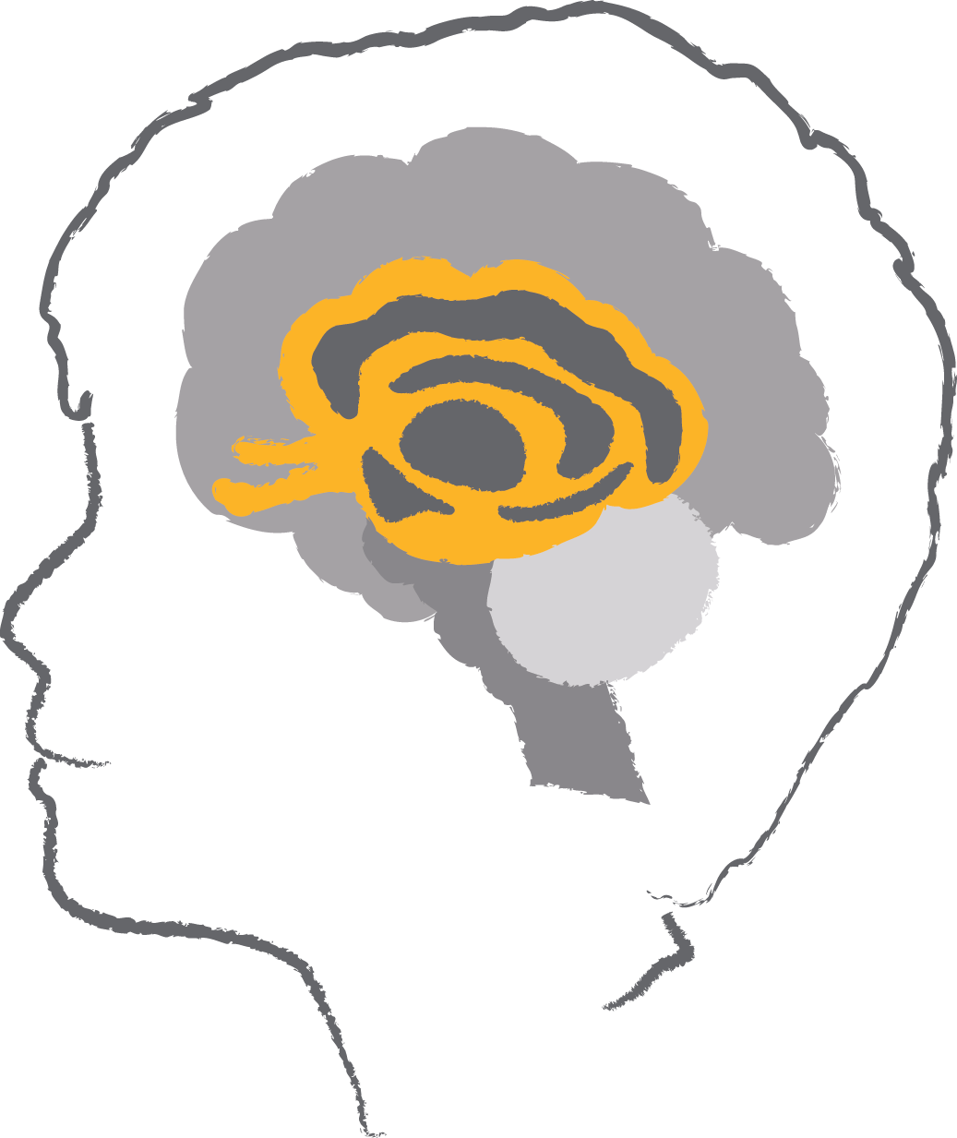
Limbic Lobe - emotional gateway
The part of the brain that helps us attach an emotion to a thought or memory
This part of the brain is particularly involved with the emotions of fear and anger
This area develops mainly after birth
©Australian Childhood Foundation 2018

Slide 5
Amygdala & Hippocampus
Amygdala
the ‘smoke detector’ of the brain
is mature at birth
processes & stores implicit memories
Hippocampus
matures between 2-3yrs of age
provides context to memories & embeds into long-term memory
©Australian Childhood Foundation 2018
Notes:
Amygdala
the ‘smoke detector’ of the brain – responsible for arousal necessary in evaluating threat and danger
it controls Autonomic responses associated with fear and activates quickly when threat is perceived
it is highly responsive to sights and smells and quickly recruits many areas of the brain to deal with threat, prepares the body for danger
is mature at birth and,
processes & stores implicit memories
Hippocampus
matures between 2-3yrs of age
provides context to memories & embeds into long-term memory
sometimes referred to as the memory puzzle sorting centre and is vulnerable to traumatic stress due to how slowly it develops and the density of its cortisol receptors
processes and stores explicit memories
IMPACT OF TRAUMA
Impaired amygdala response in children means that they find it difficult to recognize the emotions that others are attempting to express with their face or their voice
The amygdala and the hippocampus combine together to generalize fear responses to the context in which the original fear response was generated
Eg. Children will not only fear clowns but also not want to go to the circus
When the amygdala (or limbic system) is consistently over reacting in children and young people may have:
over active or under active
reminders and flashbacks of the trauma
emotional reactions that may be interpreted as being “over the top”
difficulty in emotional regulation
difficulty in reading facial expressions
doesn’t function properly and this is why for some people who have experienced trauma, it feels as if the trauma hasn’t ended.
trauma and chronic exposure to stress serves to reduce hippocampal volume up to 25% as a result of high levels of cortisol
working memory, retention and recall capacity is severely impacted

Slide 6
Cerebral Cortex – complex thinking
The largest part of the brain
Associated with higher brain function such as thought and action
Examples of functions:
Reasoning
Logic
Judgement
Voluntary movement
©Australian Childhood Foundation 2018
Notes:
Cerebral Cortex
The largest part of the brain and is 1–5 mm thick
Associated with higher brain function such as thought and action - It plays a key role in memory, attention, perceptual awareness, thought, language, and consciousness
Reasoning
Logic
Judgement
Voluntary Movement
IMPACTS OF TRAUMA
Because of the Amygdala (smoke detector) being alarmed from the Thalamus – (post office), there is messages sent to the Hypothalamus (release of hormones for response)
As a result, the Cortex may shut off and the person is unable to access this part of the brain.
Hence, reasoning and judgement and thinking is impacted.

Slide 7
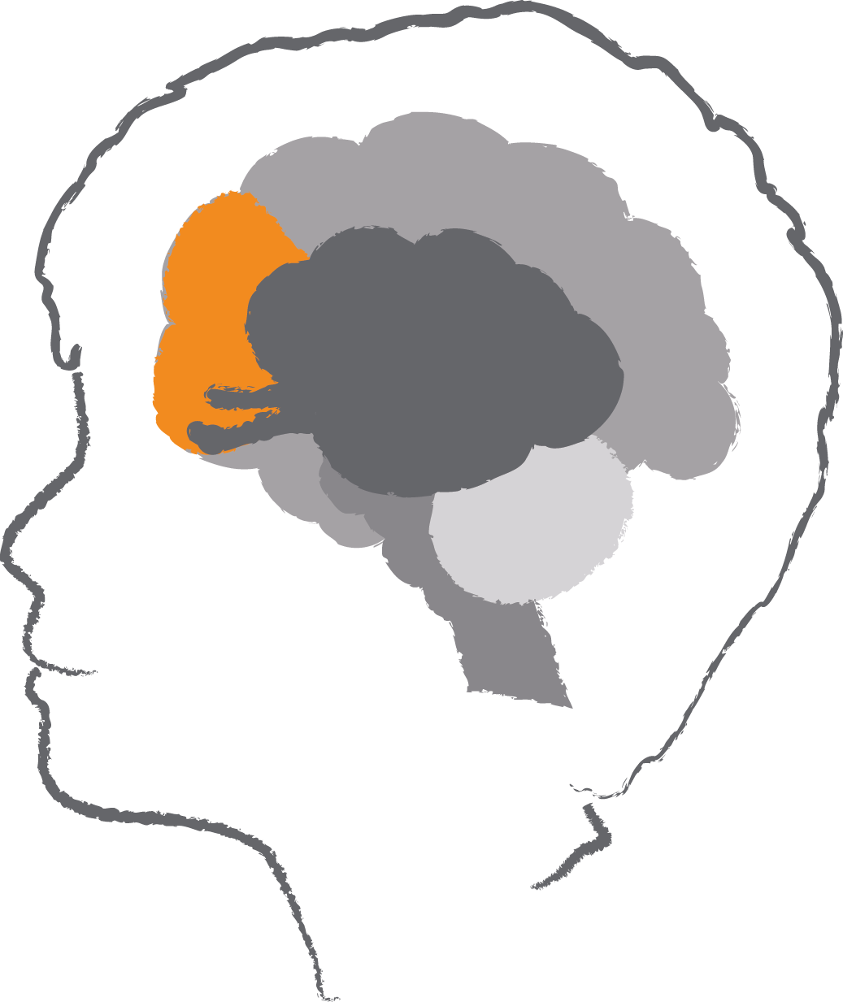
The Prefrontal Cortex- executive function
Final part of the brain to reach maturity in one’s mid to late 20s.
Self awareness
Reasoning and judgement
Foresight and anticipation
Focusing and sustaining attention
Planning organising and prioritising
Decision making
Reflecting
Enthusiasm, motivation and persistence
Impulse control
Working memory
©Australian Childhood Foundation 2018
Notes:
Prefrontal Cortex:
Part of the Frontal Lobe involved in all aspects of planning and working memory
The executive functions of the frontal lobes are:
Foresight and anticipation
Focusing and sustaining attention
Planning organising and prioritising
Decision making
Reflecting
Enthusiasm, motivation and persistence
The pre frontal cortex is also relevant to motor activity and connects the brains motor, perceptual and limbic regions
These connections allow coordination of processing across wide regions of the Central nervous system
Use Dan Siegel’s example of insurance companies and car hire agencies – do not insure or allow people 25yrs or under to hire a car, they know they don’t have developed above skills.
IMPACTS OF TRAUMA
Unable to:
use foresight and anticipation, focus or sustain attention
plan, organise or prioritise or make decisions
reflect or have self-awareness
be enthusiastic, motivated or persist with activities or impulse control

