Slide 1
Understanding and Responding to Trauma
SMART 2021
Notes:
Understanding and Responding to Trauma module
This module was rigorously constructed based on consistent feedback to simplify the SMART session delivered by department trainers to 2-hours. Slides, handouts and resources linked to the SMART Train the Trainer package are not to be altered in any way. You can update the notes section to assist delivery, drawing from Australian Childhood Foundation resources.
Please note the following points about the headings used in the notes page of each session
Key points – these are the main messages and should be included in the training delivery
Background information – this is information for the trainer only and does not need to be shared with the training participants
Please note – these are important information points about a particular slide or content area. They should be reviewed prior to delivering the training to ensure the point is noted and followed as outlined
Activity – these provide suggested activities to be undertaken during the session. Trainers may choose which activities they include in the delivery of the session. There is no expectation that all activities would be completed. The selection is based on the trainers’ assessment on the group needs, the session facilitation, and their own comfort with each activity. We would suggest that additional activities are not used as there is already more content and activity ideas than could be included in any one session.
Additional points – these are additional content points or questions for reflection and can be delivered to the participants in the session or just used for background information for trainers.
Handout – denotes where there is an additional resource available for distribution to participants. Ensuring that there are copies of these available is an important part of preparing for each session.
Optional handout and optional activity – these are included in some sessions and mean that there needs to be some trainer discretion about their use. It is likely that this handout or activity may be too complex or too challenging for most groups and their use needs to be carefully considered. Feel free to discuss their use with other SMART trainers, the department team or the ACF team
Training sessions available within this suite of modules
Once this Foundation session has been delivered, trainers can deliver one or several of the additional modules. Each is developed as a 60 minute presentation but trainers/facilitators may take up to 90 minutes for delivery as there are often a lot of discussion points. These modules may also be helpful to review to build the background knowledge base of trainers. However, trainers may not ‘mix and match’ between sessions. They need to be delivered in the format provided only.
Trainers are expected to familiarise themselves with the modules to be able to suggest a learning pathway that best meets the needs of staff groups with whom they connect and interact. There is no specific sequence or order to the modules once the foundation training has been delivered. However, feel free to discuss the best learning pathway with the department’s SMART team or the Australian Childhood Foundation trainers.
Each session includes content material, activity ideas, additional handouts and each session concludes with reflective questions to support the learning and implementing of trauma responsive practices across the school or site to whom the training is delivered. There are also facilitator notes accompanying each session.
The additional modules, with a brief synopsis and module resources, are:
SMART PRACTICE – strategies in action
This session works through the PRACTICE framework in detail, exploring each of the 8 elements, why each is important, some strategy and activity ideas for each as well as the expected outcomes stemming from the implementation of these strategies. Resources: power point, strategy handout
Neurobiology of self-care and staff wellbeing
This session focuses on building an understanding of how neurobiology helps us to review our own wellbeing in the face of working with traumatised children and young people and then provides resources for enabling self-care and wellbeing practices. Resources: power point, possible indicators of vicarious trauma handout, Professional Quality of Life (ProQoL) handout.
SMART audit tool – supporting trauma responsive school practices
This session focuses on the use of the SMART site audit tool to support schools and other education environments to review what they are currently doing in terms of trauma responsive practices and where they could implement additional strategies, activities, and resources. This review is underpinned by some information on the neurobiology of change as it can be challenging to ask professionals to change their ways of working. Resources: power point, SMART audit tool handout.
Exploring Polyvagal Theory and neurobiology
There is a lot of interest in Polyvagal Theory and its relevance to education environments and there is too much to this theoretical framework to adequately address it in this foundational session. As such, this module has been developed to explore Polyvagal Theory in a bit more detail and link it to other core concepts such as the window of tolerance and the critical nature of safety in relationships. Resources: power point, chapter article.
Establishing and maintaining safe, supportive learning environments
This session pulls together some of the key concepts of all the other sessions into an understanding of what goes into establishing and maintaining safe, supportive learning environments. In some ways it is an integrative session that includes key points but less detail of the areas of content outlined above. Resources: power point, SMART audit tool handout

Slide 3
Success criteria
Built an understanding of developmental, relational, trauma focusing on brain and body functioning;
Explored the implications of trauma on children and young people’s functioning in education environments;
Enhanced practice skills and strategies to enable effective support and healing outcomes; and
Identified areas for further learning and development
Notes:
Background information
Please note the wording of success criteria, as requested by the SMART Train the trainer group.
This package is delivered as a 2 hour session and this is the maximum timeframe for delivery.

Slide 4

Session outline
What do we need to know?
Why is it important?
How do we use our knowledge?
Notes:
Key points
The answers to these key questions provide an overview of the core elements to be included in the session.
This information is also included in slides later in the session – using key questions to be answered as the structure.
What do we need to know?
Neurosequential development
Definition of trauma
The critical importance of relationships to development and survival
The critical importance of safety – and linking this to arousal levels and the window of tolerance
Why is it important?
Trauma has a significant impact on children and young people
Understanding trauma and its impacts helps us to respond effectively and supportively
This knowledge helps us to work to understand the meaning behind children and young people’s behaviour and respond to those needs rather than just the behaviour
How do we use our knowledge?
By reflecting on what we already do as a lot of trauma responsive practice is already in place
Introducing the SMART PRACTICE framework of response
Outlining why self-care is so important
Consider a broader response and the importance of understanding trauma in the context of families and communities

Slide 5
Principles underpinning this session
This session assumes your understanding of child abuse and your mandatory reporting requirements, as per the RAN-EC* training.
Abuse related trauma, also called developmental or relational trauma, includes all forms of child abuse – including sexual abuse, physical abuse, emotional abuse, family violence and neglect, as explored in the Child Protection Curriculum
Discussion and questions are welcome and helpful.
Notes:
Background information
If needed, provide the link to the Responding to Abuse and Neglect – Education and Care training https://www.education.sa.gov.au/working-us/responding-abuse-and-neglect-training
Please note: From Term 2 2021 this training will be called ‘Responding to risk of harm, abuse and neglect – education and care (RRAHN-EC)
If needed, provide the link to the CPC page - https://www.education.sa.gov.au/teaching/curriculum-and-teaching/keeping-safe-child-protection-curriculum/child-protection

Slide 6
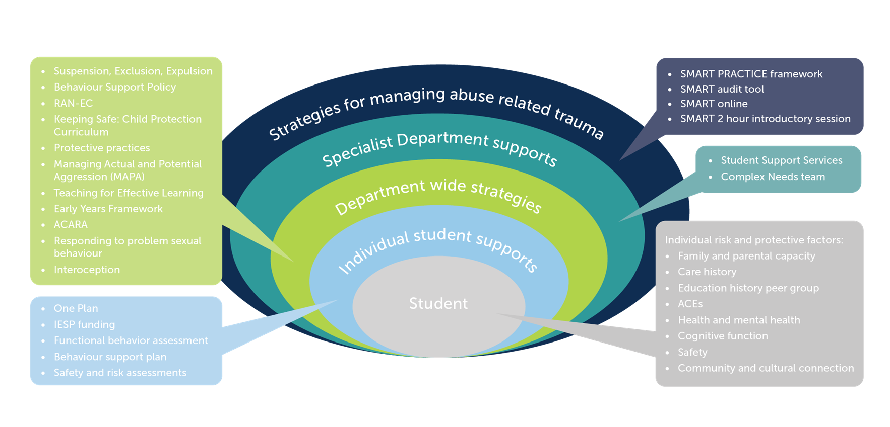
Trauma responsive practice links with other initiatives across South Australia
Notes:
Background information
You might like to just show this slide, hide the rest in the power point and provide the series of 7 slides as an optional handout.
This slide series intends to show how SMART sits across and informs all of the work with students. It is not an additional curriculum or document but rather a way of thinking about how we support students, the culture we create in our schools and how we as adults act.
Key points
Strategies for managing abuse related trauma (SMART): SMART practice supports educators to understand why differentiated learning is needed and how to provide safe and relational classrooms. SMART provides the underpinning knowledge of the impact of relational trauma from a developmental perspective. It provides an understanding of student behaviour and why we need a curious and relational approach to working with all students but particularly those with experiences of trauma. It provides an understanding of how and why we implement whole school and individual strategies utilising a trauma informed lens.
Students feel safer, more supported, more engaged and connected with their schools and more able to learn.
Specialist Department Supports: Specialist practitioners to support pedagogy and differentiated learning to be translated and embedded. These practitioners can help sites to understand and implement department wide strategies, student supports, work with the student and families. Their practice is informed and reflective of SMART framework and practice. The primary specialist supports are:
Student Support Services
Complex Needs team
Department wide strategies: These are department documents that sit across the department and schools and support pedagogy and whole school operation. These documents tell us how we work with students, govern expected educator behaviour and what to do when students need more support. These are not exhaustive but suggestive:
Suspension, Exclusion, Expulsion
Behaviour Support Policy
RAN-EC
Keeping Safe: Child Protection Curriculum
Protective practices
Managing Actual and Potential Aggression (MAPA)
Teaching for Effective Learning
Early Years Framework
ACARA
Interoception
Individual student strategies: These strategies are completed with individual students and intend to reflect the individual needs and strategies that meet these. These are informed by department wide approaches and the developmental trauma informed lens provided by SMART.
SMART supports this work by helping educators and schools see the purpose of a student’s behaviour and to consider and develop strategies and functional change that support students to engage in school. These are not exhaustive but suggestive:
One Plan
IESP funding
Functional behavior assessment
Behaviour support plan
Safety and risk assessments
Student: The student is always our primary focus. Students come to school with a range of individual risk and protective factors which should be considered and informed as possible for intervention informed by SMART and embedded in how department documentation is implemented for each student.
Optional handout
Trauma responsive practice links with initiatives across South Australia

Slide 7
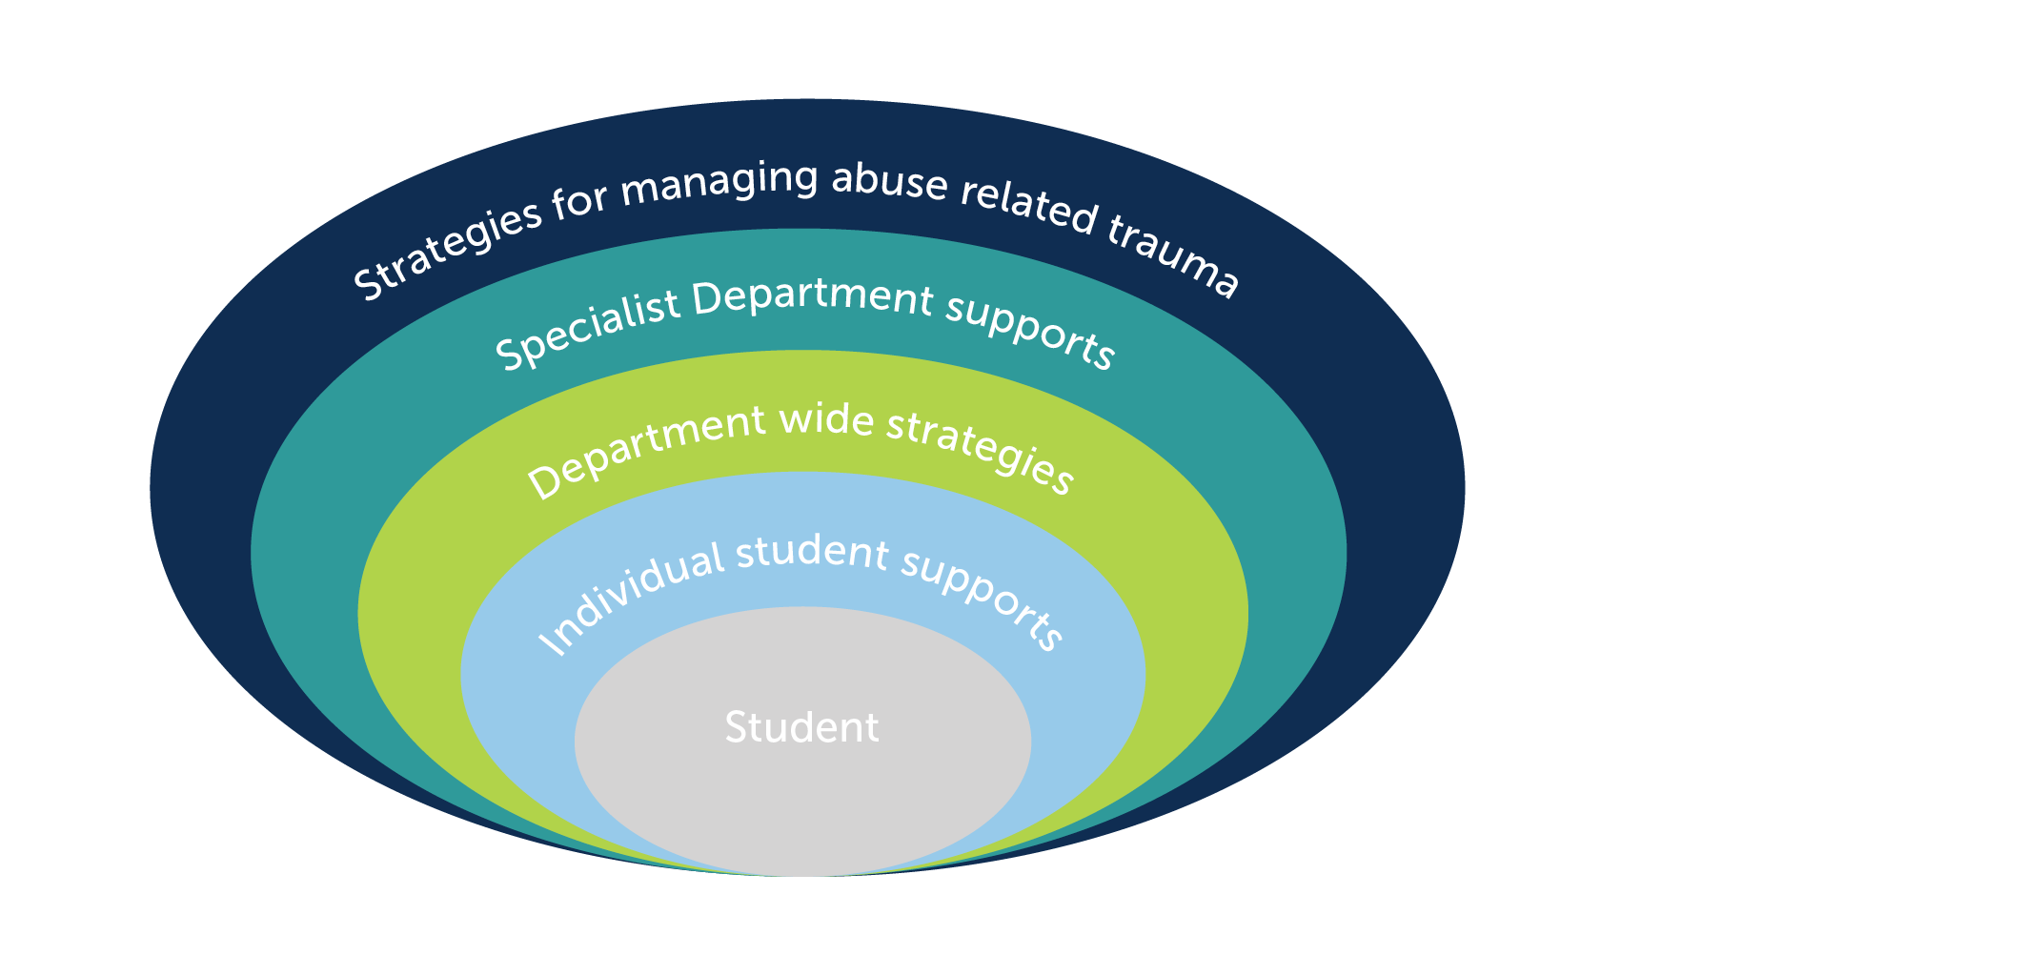

Department for Education initiatives - summary

Slide 8
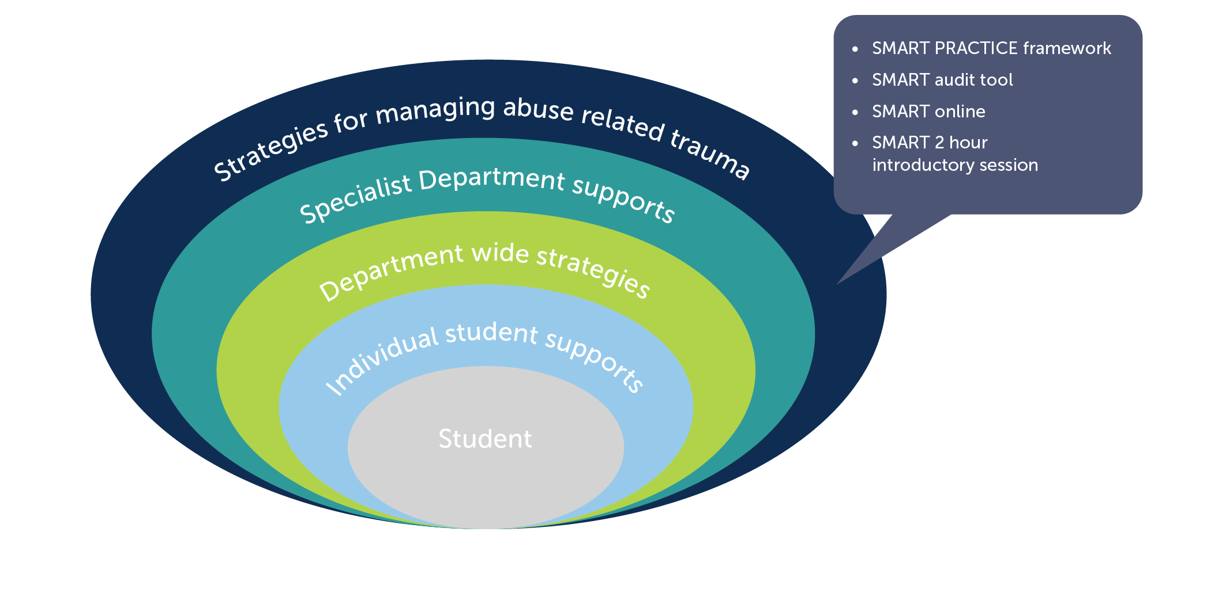
DfE initiatives - SMART
Notes:
Background information
This slide intends to show how SMART sits across and informs all of the work with students. It is not an additional curriculum or document but rather a way of thinking about how we support students, the culture we create in our schools and how we as adults act.
Strategies for managing abuse related trauma (SMART): SMART practice supports educators to understand why differentiated learning is needed and how to provide safe and relational classrooms. SMART provides the underpinning knowledge of the impact of relational trauma from a developmental perspective. It provides an understanding of student behaviour and why we need a curious and relational approach to working with all students but particularly those with experiences of trauma. It provides an understanding of how and why we implement whole school and individual strategies utilising a trauma informed lens.
Students feel safer, more supported, more engaged and connected with their schools and more able to learn.
Specialist Department Supports: Specialist practitioners to support pedagogy and differentiated learning to be translated and embedded. These practitioners can help sites to understand and implement department wide strategies, student supports, work with the student and families. Their practice is informed and reflective of SMART framework and practice. The primary specialist supports are:
Student Support Services
Complex Needs team
Department wide strategies: These are department documents that sit across the department and schools and support pedagogy and whole school operation. These documents tell us how we work with students, govern expected educator behaviour and what to do when students need more support. These are not exhaustive but suggestive:
Suspension, Exclusion, Expulsion
Behaviour Support Policy
RAN-EC
Keeping Safe: Child Protection Curriculum
Protective practices
Managing Actual and Potential Aggression (MAPA)
Teaching for Effective Learning
Early Years Framework
ACARA
Interoception
Individual student strategies: These strategies are completed with individual students and intend to reflect the individual needs and strategies that meet these. These are informed by department wide approaches and the developmental trauma informed lens provided by SMART.
SMART supports this work by helping educators and schools see the purpose of a student’s behaviour and to consider and develop strategies and functional change that support students to engage in school. These are not exhaustive but suggestive:
One Plan
IESP funding
Functional behavior assessment
Behaviour support plan
Safety and risk assessments
Student: The student is always our primary focus. Students come to school with a range of individual risk and protective factors which should be considered and informed as possible for intervention informed by SMART and embedded in how department documentation is implemented for each student.

Slide 9
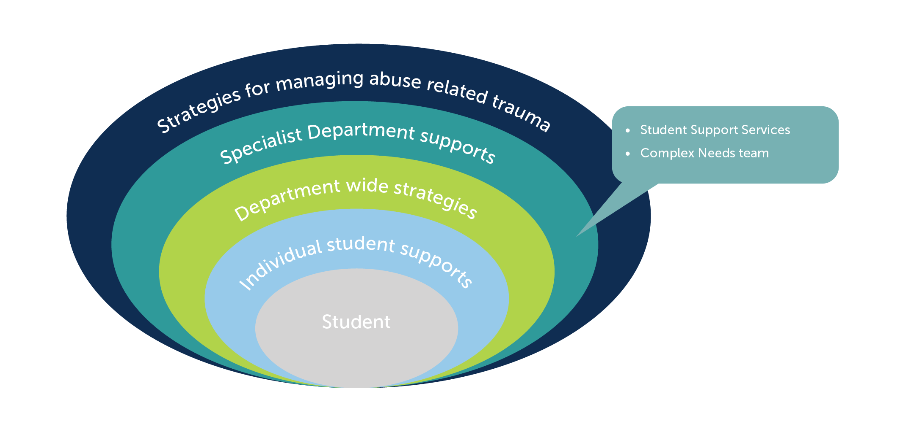
DfE initiatives – Specialist Department supports

Slide 10
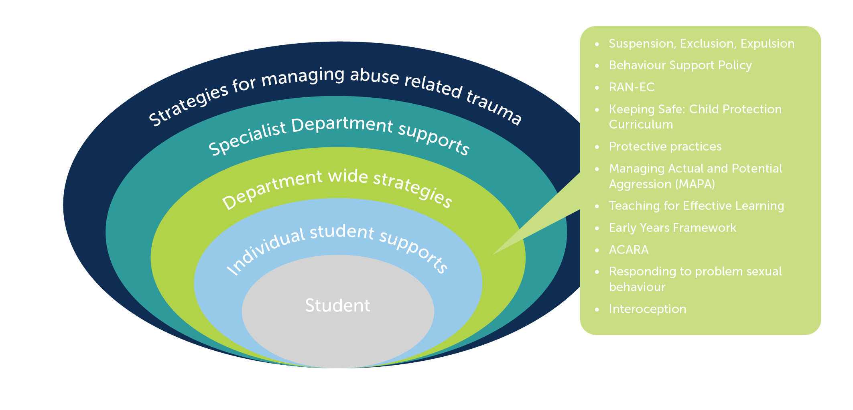
DfE initiatives – Department wide strategies

Slide 11
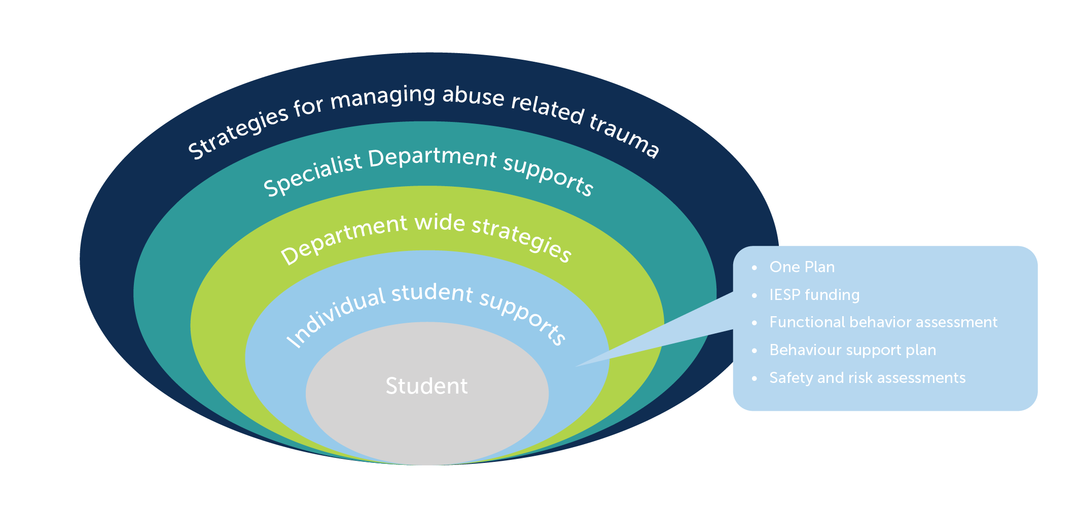
DfE initiatives – Individual student supports

Slide 12
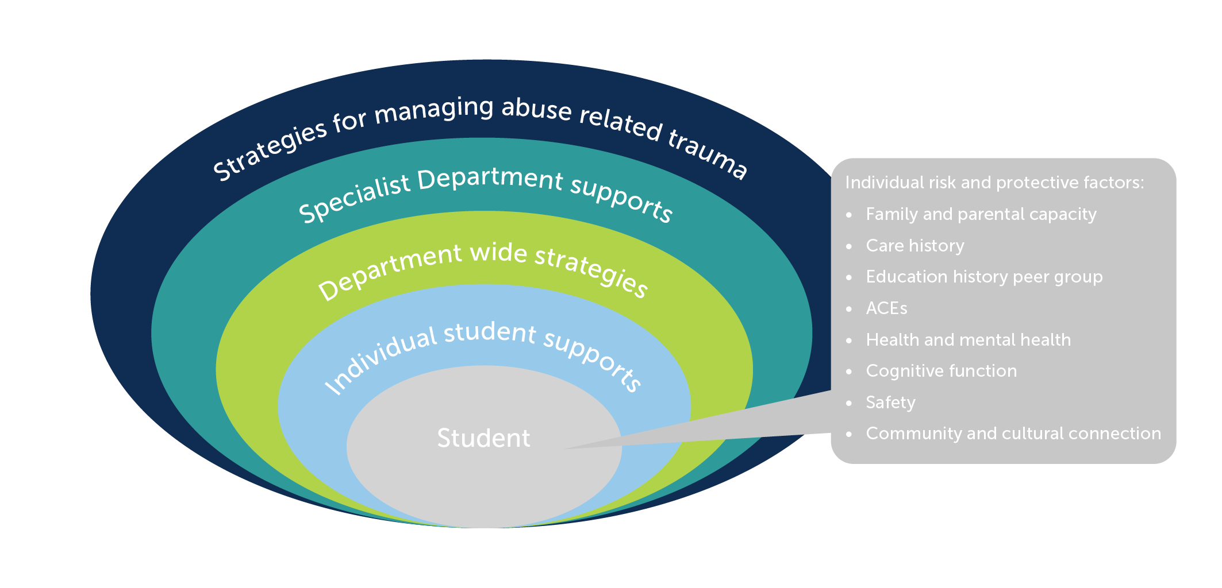
DfE initiatives – Understanding the individual student

Slide 13
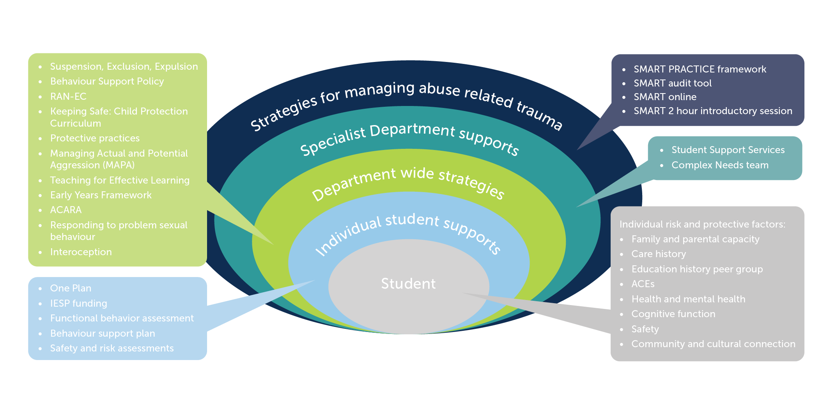
Department for Education initiatives - summary

Slide 14
Your wellbeing
Please know that your emotional safety is paramount during this session.
Talking about trauma can be challenging for us for a range of ways.
Please do whatever you need to do to keep yourself safe during the session.
Notes:
Key points
We need to be clear that talking about trauma can trigger things for people with their own trauma histories and we want to be available to support them as needed.. It is also the case that individuals can find their own ways to care for themselves and that is fine in the context of this training session.
Remind participants that they may want to discuss issues raised with their site leader or access the Employee Assistance Program.

Slide 15
Holding the child in mind
We also want you to keep a focus on the children and young people you work with throughout the session.
At different points we may ask you to bring a child to mind and consider how this information might apply to them.
Notes:
Background information
It is important to continually ask participants to reflect on the relevance of this content in the context of the children and young people in the school or learning centre. They may come into the session already thinking about a particular child or young person and this is an opportunity to invite them to hold that child in mind throughout the session.

Slide 16
Key messages
What do we need to know?
What is trauma?
Our knowledge of the brain and how it develops helps us understand trauma and its impacts.
Safety is essential to our capacity to be in relationships and to learn
Relationships are fundamental to our wellbeing.
Notes:
Background information
These key messages provide a summary of the session content.
You might like to hover here and work from these slides for your content or you might like to quickly outline them and move into the ‘nuts and bolts’ of each statement or question.

Slide 17
Key messages
Why is using a trauma lens important?
Trauma leaves a lasting residue for children and young people.
If we understand trauma, we can provide support and respond effectively.
This knowledge helps us to understand the meaning behind children and young people’s behavior.
As education professionals, we can support recovery, repair and healing – as well as enhance learning.

Slide 18
Key messages
How do we use a trauma lens?
We can reflect on the things we already do that work.
We implement SMART PRACTICE.
We take responsibility for looking after ourselves throughout our practice.
We look after our children, young people, families and our communities.
We can consider further training and implementation.
Notes:
Background information
This may provide an opportunity to direct participants to the option of the SMART PRACTICE additional module in this series.
Equally, the point about taking responsibility for looking after ourselves might provide an opportunity to speak about the self-care additional module.
Finally, the point about reflecting on what you already do is a good segue into discussing the SMART audit tool module.

Slide 19

What do we need to know?

Slide 20

What is trauma?
This Photo by Unknown Author is licensed under CC BY-NC-ND
Notes:
Activity
Give the group times to discuss this question in some detail. This can be done in small groups or pairs.
You might ask:
What is trauma?
What does trauma do?
How is trauma different from stress?
What is different about traumatic experiences that occur early in life?
How can trauma impact a child or young person?
You could ask people to draw or make a model of trauma rather than discuss it if you would prefer.
Record their responses.

Slide 21
What is trauma?
Trauma is any single, ongoing or cumulative experience which:
Is a response to a perceived threat
Overwhelms our capacity to cope
Feels or is outside of our control
Evokes a physiological and psychological set or responses based in fear or avoidance
Notes:
Key points
Explore each of these points in a bit of detail regarding what this might mean for our response to traumatised children and young people.
For example: If trauma is a response to a perceived threat then our responses need to focus on safety to reduce that perception of threat. If trauma overwhelms our capacity to cope then we need to focus on containment and building children’s capacity to cope with life stressors. Of course we would note that no one should have to cope with trauma so that is NOT the goal.
Also, then discuss the difference between simple, complex, relational or developmental trauma.
Background information
Simple trauma – most likely a one off experience of trauma that is not intentional eg: car accident, natural disaster. It is important to note that the word simple can be a little misleading because it makes it sound like it is less impactful but it is still an experience of trauma.
Complex trauma – more likely to be multiple or ongoing experiences and generally is relationally based as these two factors are what add to the complexity. It could be defined as trauma that is directed at me because of who I am, rather than a random occurrence. Examples might include: family violence, child abuse, migration trauma, intergenerational trauma and war trauma
Relational trauma – this is a form of complex trauma that is specifically related to relationally based traumatic experiences. Because relationships are experienced as fundamental to our survival then relationally traumatic experiences are experienced as threatening to our survival and this tells us about the intensity of the response. We would again put child abuse and family violence into this category.
Developmental trauma – this is another form of complex trauma that also has a relational component to it but is trauma that is experienced during infancy, childhood and/or adolescence ie: while we are still developing. This has a significant impact because we rely on those relationships around us to effectively support our development and that being threatened leaves lasting impacts, or residue.

Slide 22
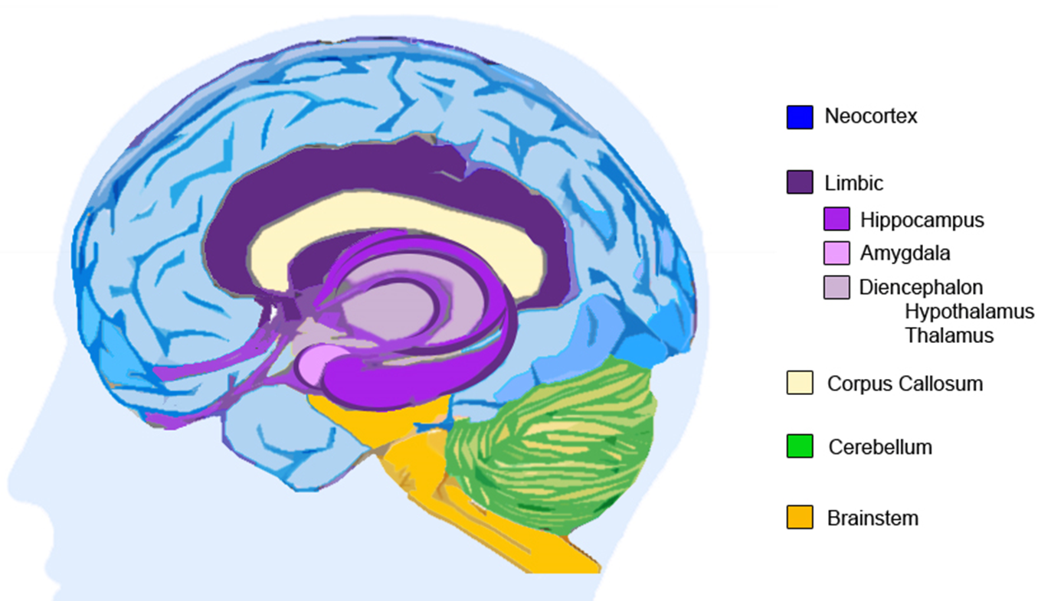
Our knowledge of the brain and how it develops helps us understand
Notes:
Please note: Trainers may choose to show one or both of these 2 slides of the brain – depending on the image you prefer. This selection was based on feedback from the Train the trainer group. The information in this notes page is the same for each slide and the handout is applicable regardless of which image you choose.
Handout: Neurosequential development – this outlines the different parts of the brain and how and when they develop. It is likely you will spend some time on this slide as you go through the sequential development of the brain as outlined in this handout.
Background information
An additional resource has been provided for this slide which is a trainer version of the handout provided for participants regarding neurosequential development. This additional resource provides further information about the parts of the brain and the impacts of trauma. This is for your information only and is not to be used as a handout for participants.
In addition to the extensive overview of the different parts of the brain provided in the trainer handout accompanying this slide, it is also important that the following key terms are discussed while delivering this session. We also encourage you to do your own additional reading to expand your understanding of the brain, its parts, development and function.
Key points
Neurons: Nerve cells in the brain (in particular) that connect to enable us to undertake the extraordinary range of tasks the brain enables us to do. We are born with billions of neurons and they make trillions of connections in the complex web of our brain and its activity.
Neuronal connections: Once the neurons are connected we call them, unsurprisingly ☺, neuronal connections but these can also be called templates, synaptic connections or neuronal pathways. It is critical to understand that neuronal connections develop through repetition – and the more a connection is activated, the stronger it becomes. As trainers, we know you will have multiple ways of describing this process but it needs to be reinforced during this section and throughout the training because it helps us understand that the brain of a child who has experienced trauma is very good at surviving trauma because those neuronal patterns have been repeated so many times and that we are seeking to develop new neuronal connections not linked to trauma in our work with children and young people and this requires LOTS of repetitions.
Cortical: it is important to differentiate between these 2 terms when talking about the brain. Cortical refers to the parts of the brain in the cortex or neocortex, including the prefrontal cortex. We talk about cortical functioning and this means functioning that is conscious and invariably based in cognition.
Subcortical: Subcortical functioning is probably more relevant to trauma informed and responsive practices as it helps us to understand many of the presenting behaviours of children and young people who have experienced trauma. Subcortical refers to the parts of the brain underneath (sub) the cortex so this includes the limbic lobe/system, diencephalon, cerebellum, brainstem and the body. Subcortical functioning is most often subconscious and does not require specific cognition to activate. It is reactive rather than responsive. It is not a conscious choice.
Hemispheres: the time of this session means we cannot go into detail about everything so we just want to clarify with people that there is also hemispheric development occurring during infancy, childhood and adolescence and there may be reference to the right and left hemisphere at different points in the session.

Slide 23
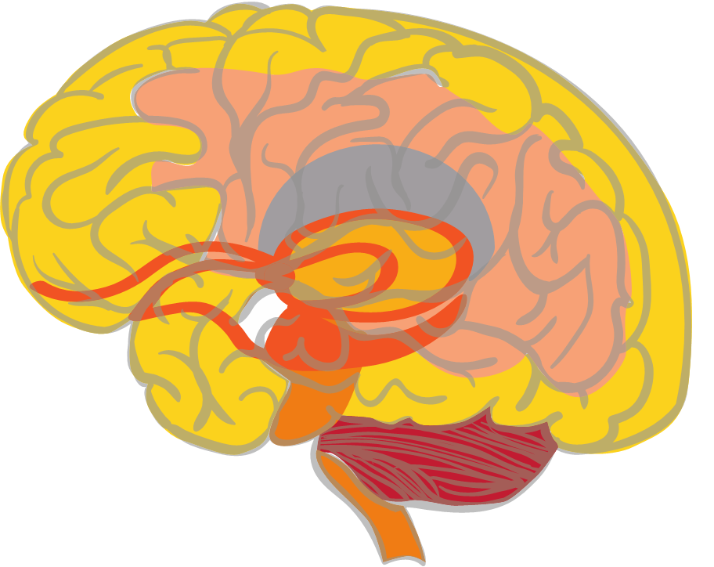
Our knowledge of the brain and how it develops helps us understand
Hypothalamus
Links the nervous system to the endocrine system via the pituitary gland. It synthesizes and secretes hormones to control body temperature, hunger, thirst, fatigue, sleep, and circadian cycles.
Corpus Callosum
Bridge between the 2 hemispheres. Chronic stress can damage and thin down this bundle of neurons
Prefrontal cortex
Responsible for executive functions, such as judgement, reasoning, and self awareness. Final part of the brain to mature in one’s mid 20s.
Thalamus
Sensory receptor within the diencephalon. Receives and passes on sensory data to be further processed by other areas of the brain
Amygdala
Survival response centre within the limbic lobe that becomes enlarged and more sensitive the more it is activated through responding to threats
Hippocampus
Consolidates memory by providing the context/ sequential data for episodic memories. Goes offline if trauma overwhelms and disrupts cortex.
Cerebellum
Balance and coordination, motor skills may be impacted by trauma
Image source: ©2018 ACF
Notes:
Please note: Trainers may choose to show one or both of these 2 slides of the brain – depending on the image you prefer. This selection was based on feedback from the Train the trainer group. The information in this notes page is the same for each slide and the handout is applicable regardless of which image you choose.
Handout: Neurosequential development – this outlines the different parts of the brain and how and when they develop. It is likely you will spend some time on this slide as you go through the sequential development of the brain as outlined in this handout.
Background information
An additional resource has been provided for this slide which is a trainer version of the handout provided for participants regarding neurosequential development. This additional resource provides further information about the parts of the brain and the impacts of trauma. This is for your information only and is not to be used as a handout for participants.
In addition to the extensive overview of the different parts of the brain provided in the trainer handout accompanying this slide, it is also important that the following key terms are discussed while delivering this session. We also encourage you to do your own additional reading to expand your understanding of the brain, its parts, development and function.
Key points
Neurons: Nerve cells in the brain (in particular) that connect to enable us to undertake the extraordinary range of tasks the brain enables us to do. We are born with billions of neurons and they make trillions of connections in the complex web of our brain and its activity.
Neuronal connections: Once the neurons are connected we call them, unsurprisingly ☺, neuronal connections but these can also be called templates, synaptic connections or neuronal pathways. It is critical to understand that neuronal connections develop through repetition – and the more a connection is activated, the stronger it becomes. As trainers, we know you will have multiple ways of describing this process but it needs to be reinforced during this section and throughout the training because it helps us understand that the brain of a child who has experienced trauma is very good at surviving trauma because those neuronal patterns have been repeated so many times and that we are seeking to develop new neuronal connections not linked to trauma in our work with children and young people and this requires LOTS of repetitions.
Cortical: it is important to differentiate between these 2 terms when talking about the brain. Cortical refers to the parts of the brain in the cortex or neocortex, including the prefrontal cortex. We talk about cortical functioning and this means functioning that is conscious and invariably based in cognition.
Subcortical: Subcortical functioning is probably more relevant to trauma informed and responsive practices as it helps us to understand many of the presenting behaviours of children and young people who have experienced trauma. Subcortical refers to the parts of the brain underneath (sub) the cortex so this includes the limbic lobe/system, diencephalon, cerebellum, brainstem and the body. Subcortical functioning is most often subconscious and does not require specific cognition to activate. It is reactive rather than responsive. It is not a conscious choice.
Hemispheres: the time of this session means we cannot go into detail about everything so we just want to clarify with people that there is also hemispheric development occurring during infancy, childhood and adolescence and there may be reference to the right and left hemisphere at different points in the session.

Slide 24
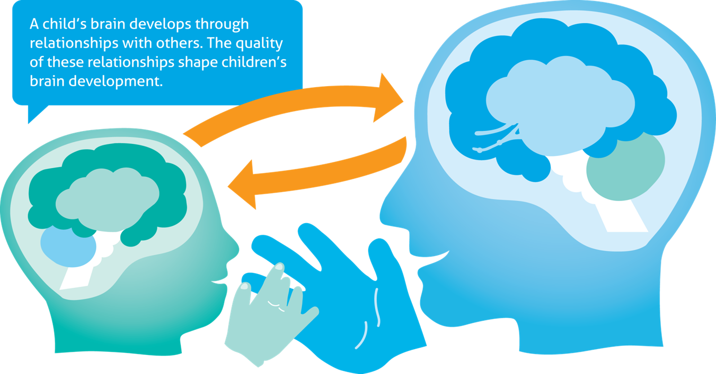
Relationships are fundamental to our wellbeing
Support survival
Self-regulation through co-regulation
Build through repetition
Experience of positivity in connection
Relationship is a therapeutic tool
Notes:
Background information
This image shows how important relationship is to both of the people engaging in the connection. Relational interactions engage the same parts of the brain in both the adult and the child. These interactions are connected to our heart, or feelings, as the expectation is that they will produce pleasure in that connection.
Abuse and trauma take away the pleasure of connection and this is particularly damaging because relationships are fundamental to our wellbeing.
Key points
Support survival: as human infants, we need to connect with other humans to survive and so we innately seek relationships to enable us to grow and thrive. This happens long before cognitive (or cortical) development. This is a biological drive for connection. This means that anything that threatens our relationships is experienced as something that threatens our survival. This tells us about the intensity of the impact of relationally based trauma.
Self-regulation through co-regulation: The only way we can learn to regulate our own emotional states is through the interactions we have with others that help us to understand the regulatory process. We don’t expect babies to always regulate their own emotional states. We pick them up and speak lovingly and soothingly to them, we rock them and we hold them tightly so they can learn ways to soothe themselves over a long period of time. We all tend to need more co-regulation through attuned responses when we are put under stress, duress or trauma.
Build through repetition: Like all experiences, the more often we experience something the stronger the neuronal connections in our brains become and the more we come to expect the same thing to happen. Positive relationships develop through multiple experiences of positive relationships. What happens if I experience multiple negative relationships? (I come to expect relationships to be negative). It takes a lot of repetitions of positive relational experiences to change our brain’s way of viewing this sort of thing.
Experience of positivity in connection: That is actually underselling relationships because we actually experience pleasure in the connection (through the release of hormones such as dopamine and oxytocin – but don’t feel you need to understand or explain this in your session!!) The purpose of this pleasurable experience is to make us seek out more connections because that facilitates our survival so it is a helpful biological set up. We want the children and young people we work with to experience pleasure or at least positivity in the connections they have with educators and this needs to be repeated to enable change.
Relationship is a therapeutic tool: This is the message of hope. Every relational exchange we have with a child or young person is an opportunity for repair or healing from their experiences of trauma. We as educators need to view this as a positive because generally relationships are something that we all as a profession do well. We just need to acknowledge the power of those connections.

Slide 25
Safety is essential – Understanding Dysregulated Arousal
Fight or Flight Hyper-vigilant, action-orientated, impulsive, emotionally flooded, reactive, defensive, self-destructive
Freeze Physically frozen, tense musculature
Mobilisation
Hyper-arousal
Social
Engagement
Window
of Tolerance
AROUSAL
Submit Collapsed, weak, defeated, flat affect, numb, empty, helpless, hopeless
Immobilisation
Hypo-arousal
Notes:
25
Background information
This content links concepts of safety as stems from an understanding of Polyvagal Theory with information about arousal levels and the window of tolerance.
You may like to start with the regulated arousal slide to discuss the key concepts or talk about the impacts of trauma on the window of tolerance.
Activity
Think about the kids you’ve worked with. What activities do you do to increase their window of tolerance?
-Submit – raise physiological arousal to keep them engaged
-Freeze – stretching, massaging, hand wringing to stimulate blood flow and movement through body
-Fight or Flight – Calming activities to help bring the hyper response down and restore manageability.
The goal is to produce a manageable level of arousal in order to process trauma.
We want regulated arousal (NEXT SLIDE)
Key points
What does this look like for the children we work with?
The lack of predictability makes transitions threatening – if I don’t know what is coming next and my amygdala is always switched on I’m going to appear either angry and aggressive or flat and withdrawn
Until I can learn to calm and quiet my mind I may over react in situations that would normally give me pleasure and I enjoy
Many abused children do not understand what they feel or why they act as they do. “ when asked why did you do that?” – it’s like asking yourself why you locked your keys in your house and pulled the front door shut, you just know you are preoccupied and thinking of something else. Traumatized children often do things that do not make any logical sense – they do not live in a world of logic or reason, their bodies are often on autopilot.
Background information
Chronic exposure to trauma increases cortisol
Cortisol increases the amygdala’s potential to be activated
As such, the amygdala becomes highly sensitized to any signal of potential threat
The amygdala keeps the adrenalin system turned on leaving the child in a constant state of readiness for threat
- The hippocampus is unable to provide context so the amygdala is unable to restrict threatening stimuli to specific examples
The amygdala then associates any change with threat
Please note: This content is covered in more detail in the ‘Exploring Polyvagal Theory and neurobiology’ session.

Slide 26
Safety is essential – Understanding Regulated Arousal
Fight or Flight hyper-vigilant, action-orientated, impulsive, emotionally flooded, reactive, defensive, self-destructive
Freeze Physically frozen, tense musculature
Mobilisation
Hyper-arousal
Social
Engagement
Window
of Tolerance
AROUSAL
Submit Collapsed, weak, defeated, flat affect, numb, empty, helpless, hopeless
Immobilisation
Hypo-arousal
Image source – ©ACF 2018
Notes:
26

Slide 27
Why is it important?

Slide 28





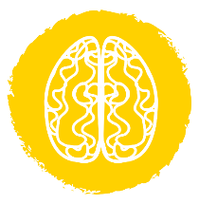

Trauma leaves a lasting residue
Trauma can impact all elements of children and young people’s development: brain, body, memory, learning, behaviour, emotions, relationships.
Image source: ©2018 ACF
Notes:
Key points
Abuse-related trauma can lead to significant difficulties
in affect regulation
on brain development
with relationships
Traumatised babies and children are dealing with the impact of their experiences in all elements of their lives
Understanding the impact of traumatisation on children and young people is a crucial step in facilitating change
WHAT DO YOU SEE IN THE SCHOOL SETTING?
In any class you may have:
Students in out of home care
Students involved with CAMHS/HEADSPACE
Students displaying learning difficulties while being quite bright
Students showing a significant inability to trust
Students who overreact to usual situations
Students displaying a significant inability to deal with change
eg. A student who seems to grasp a concept one day but by the next cannot recall or apply that concept
Despite your extra efforts in relationship building with a student they still seem to avoid you wherever possible
another student yells and this student yells too, starts crying or behaves in another way we might call overreacting
A student who acts out during an excursion despite being excited about it for the past week
Schools can provide a sense of security that is lacking elsewhere for this child
Planning, consistency and repetition across the whole school are crucial response strategies
Abuse related trauma is the result of damaging relationships and patterns for relating to others in the child’s life. It then is critical to understand that recovery is based on building appropriate and safe relationships.
For traumatised children/yp, school can provide safety and security as well as predictability in their otherwise chaotic lives. However, we often see that school becomes a place where children ‘act out’ more because they feel safe enough to express some of the inner turmoil they are experiencing

Slide 29
The trauma behaviour cycle
The lack of explicit, logical memory, means the child does not know what started the trigger behaviour
Most likely the defence state they used at the time of the initial trauma
Child/YP is startled by event or trigger
Child’s/YP’s subcortical areas enact responses
Behaviour provokes a reaction in others
This reaction is perceived as an additional threat
Child/YP is in state of heightened defense– either hyper or hypo arousal
Developing brain imprints the emotions felt at the core of the trauma, as well as the defence used against it
Child/YP is still in their right hemisphere and so is not using their cortex to read or interpret your response…and is primed to perceive ongoing threat
The behaviour pushes another’s “buttons”
Image source: ©2018 ACF
Notes:
Please note: This slide can be printed as an Optional handout
Key points
This slide is to emphasise the cycle of trauma behaviours that hijack our classrooms. It is important to reflect on the teachers’ and peers’ role in the cycle with regards to responses to these children and how it can perpetuate and sometimes escalate these behaviours.
Teachers have amygdalas too – and they can activate when stressed by challenging behaviours.
Discuss what this means for teachers and their process in the classroom and what they need to do to manage their arousal when working with complex trauma.
To cope with trauma, children use initial ADAPTIVE RESPONSES to survive, which if they continue, can become MALADAPTIVE PATTERNS OF BEHAVIOUR
These responses will be different for an individual child at different developmental stages
Often a combination of appropriate developmental behaviours and dysfunctional patterns of behaviours emerge
They tend to play out patterns of responses aiming to minimise perceived threats.
This work can be challenging and how traumatised children behave can “trigger” behaviour in us as those who support these children. The importance of support and care for those working with traumatised children cannot be over-stated – for the benefit of the student and the teacher.
What makes this challenging work less overwhelming is the understanding this knowledge gives us that their behaviour is not a direct personal attack on the individual teacher but a response to what that person represents or triggers for that child.
This does not mean that we don’t respond to the behaviour, but we do think about how best we respond – to manage the outcome as positively as possible

Slide 30
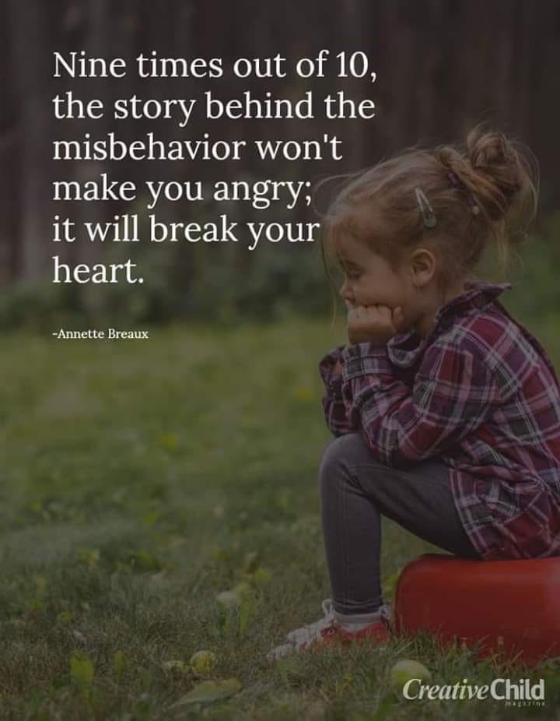
Understanding the meaning behind the behaviour
Notes:
Background information
Please read through the key points below and consider the example provided, using each of the response starters. You might like to develop your own example or scenario based on your understanding of the school and its students or feel free to use the one provided as your example.
Key points
This slide reminds us that what our understanding does is to help us look beyond the child’s behaviour – which is often confusing, challenging and unhelpful to the child. We want to look beyond the behaviour to see if we understand the meaning that it holds and the need that directs it. This enables us as professionals to then respond to that underlying meaning and need rather than the behaviour itself.
1. Example: A child yelling and telling us ‘f*&% off’.
2. Response to behaviour is likely to be: some form of punitive response such as sending the child from the room or removing them from an activity
3. Possible meaning behind the behaviour could be: ‘I am feeling overwhelmed and worthless and want to hurt you before you hurt me’. It is important to note that the child is unlikely to be aware of this possible meaning behind the behaviour but we will know if the response actually elicits a calming down of the situation
4. Unmet need directing the behaviour is likely to be: the need for co-regulation when feeling overwhelmed by a situation
5. Response that meets the unmet need would be: Speak gently and quietly, walk away from other children with the child and just ask them to sit and sit down with them. There is no need to speak with them about anything but just be quietly present. You may need to direct the other children or young people to undertake a particular task that is also quiet and self-activated.
Optional activity
Ask the participants to work in groups using the 5 sentence starters as outlined above and complete the process using an example of their own.
You may ask the groups to share their examples with the whole group.

Slide 31
How do we use our knowledge?

Slide 32

Reflect on what we already do
This Photo by Unknown Author is licensed under CC BY
Notes:
Activity
In small groups – Based on what we have talked about thus far, what are some examples of what you already do that would effectively support children and young people who have experienced trauma?
Share these responses with everyone.
You may like to ask a supplementary question about what you could do based on what has been covered in the session already.

Slide 33
Implement SMART PRACTICE
Predictable
Responsive
Attuned
Connecting
Translating
Involving
Engaging
Calming
Notes:
Background information
This is an opportunity to provide a brief overview of each of the elements of SMART PRACTICE along with an example of a strategy or response that is connected with each of the elements.
If the SMART strategies booklet is being provided as a handout, this can be introduced at this point and provided as additional materials for participants to read and thus reflect on the session and its content.
Please note: this content is explored in more detail in the ‘SMART PRACTICE – strategies in action’ session
Optional handout: SMART strategies booklet

Slide 34
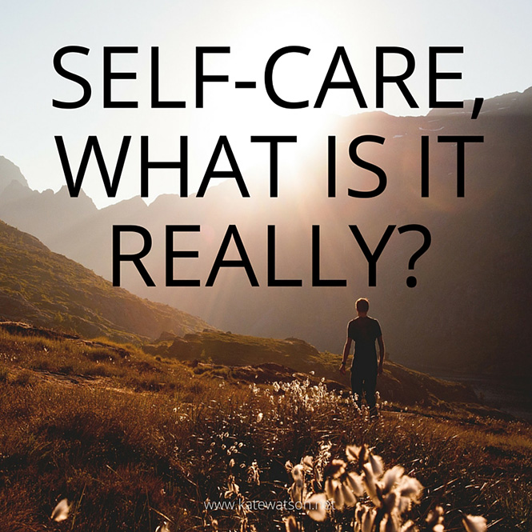
We look after ourselves
This Photo by Unknown Author is licensed under CC BY-NC
Notes:
Key points
Working relationally with children and young people who have experienced trauma is challenging and we need to take care of ourselves through the process. This is not just about it being ‘good’ but self-care enables us to stay in our own window of tolerance and thus best meet the learning needs of children and young people. Thus, we need to take self-care seriously. We also need to understand, neurobiologically, that self-care often involves activities that engage the lower parts of the brain and body (are sub-cortical) because that needs to be supported and healthy to enable the higher parts of the brain to function effectively.
Please note: This content is explored in more detail in the ‘Neurobiology of self-care and staff wellbeing session’.

Slide 35

We look after our children, young people, families and communities
This Photo by Unknown Author is licensed under CC BY-NC-ND
Notes:
Key points
Neurobiology of trauma helps us to understand the people in the communities that surround education settings and can be helpful in terms of how we might best work with families and the broader community, as we are often dealing with multiple experiences of trauma which could have occurred over generations. We can apply the principles of SMART PRACTICE to our work with families and communities as well.
Optional activity
This provides an opportunity to link SMART PRACTICE to working with families and communities. What are some ideas the group might have? This could be a large group discussion just to get the ball rolling.

Slide 36
We can consider further training and implementation
SMART PRACTICE – strategies in action
Establishing and maintaining safe, supportive learning environments
SMART audit tool – supporting trauma responsive school practices
Neurobiology of self-care and staff wellbeing
Exploring Polyvagal Theory and neurobiology
Education:Trauma Informed Practice DECD.TraumaInformedPractice@sa.gov.au
Notes:
Key points
Ensure that you mention the SMART Training calendar as well as a brief overview of the Trauma Aware Schools initiative (if not already mentioned)
Again, these are the additional 1 hour sessions that can be offered, as well as connecting people with the DfE resources associated with trauma responsive practice.

Slide 37

Holding hope
This Photo by Unknown Author is licensed under CC BY-NC
Notes:
Key points
We are hope holders for many of the children and young people in our schools and early learning centres. Through the support, predictability, relationships and safety that we can provide we enable children and young people to see a future of possibilities that give them opportunities for change and healing.

