Slide 1
Yumbin Healing Understanding and responding to trauma and its impacts in school communities
Notes:
Yumbin Healing Handouts
Understanding our Community History (Slide 10)
Understanding trauma (Slide 12)
Neurosequential brain development (Slide 13)
Principles of culturally strong trauma responsive practice (Slides 19-20)
Audit tool- Principles of culturally strong trauma responsive practice (Slide 21)
Words matter (Slides 22-23)
Strategy ideas- Principles of culturally strong trauma responsive practice (Slide 24)
Self-care A – Z (Slide 28)
Self Care A-Z Blank (Slide 28)

Slide 2
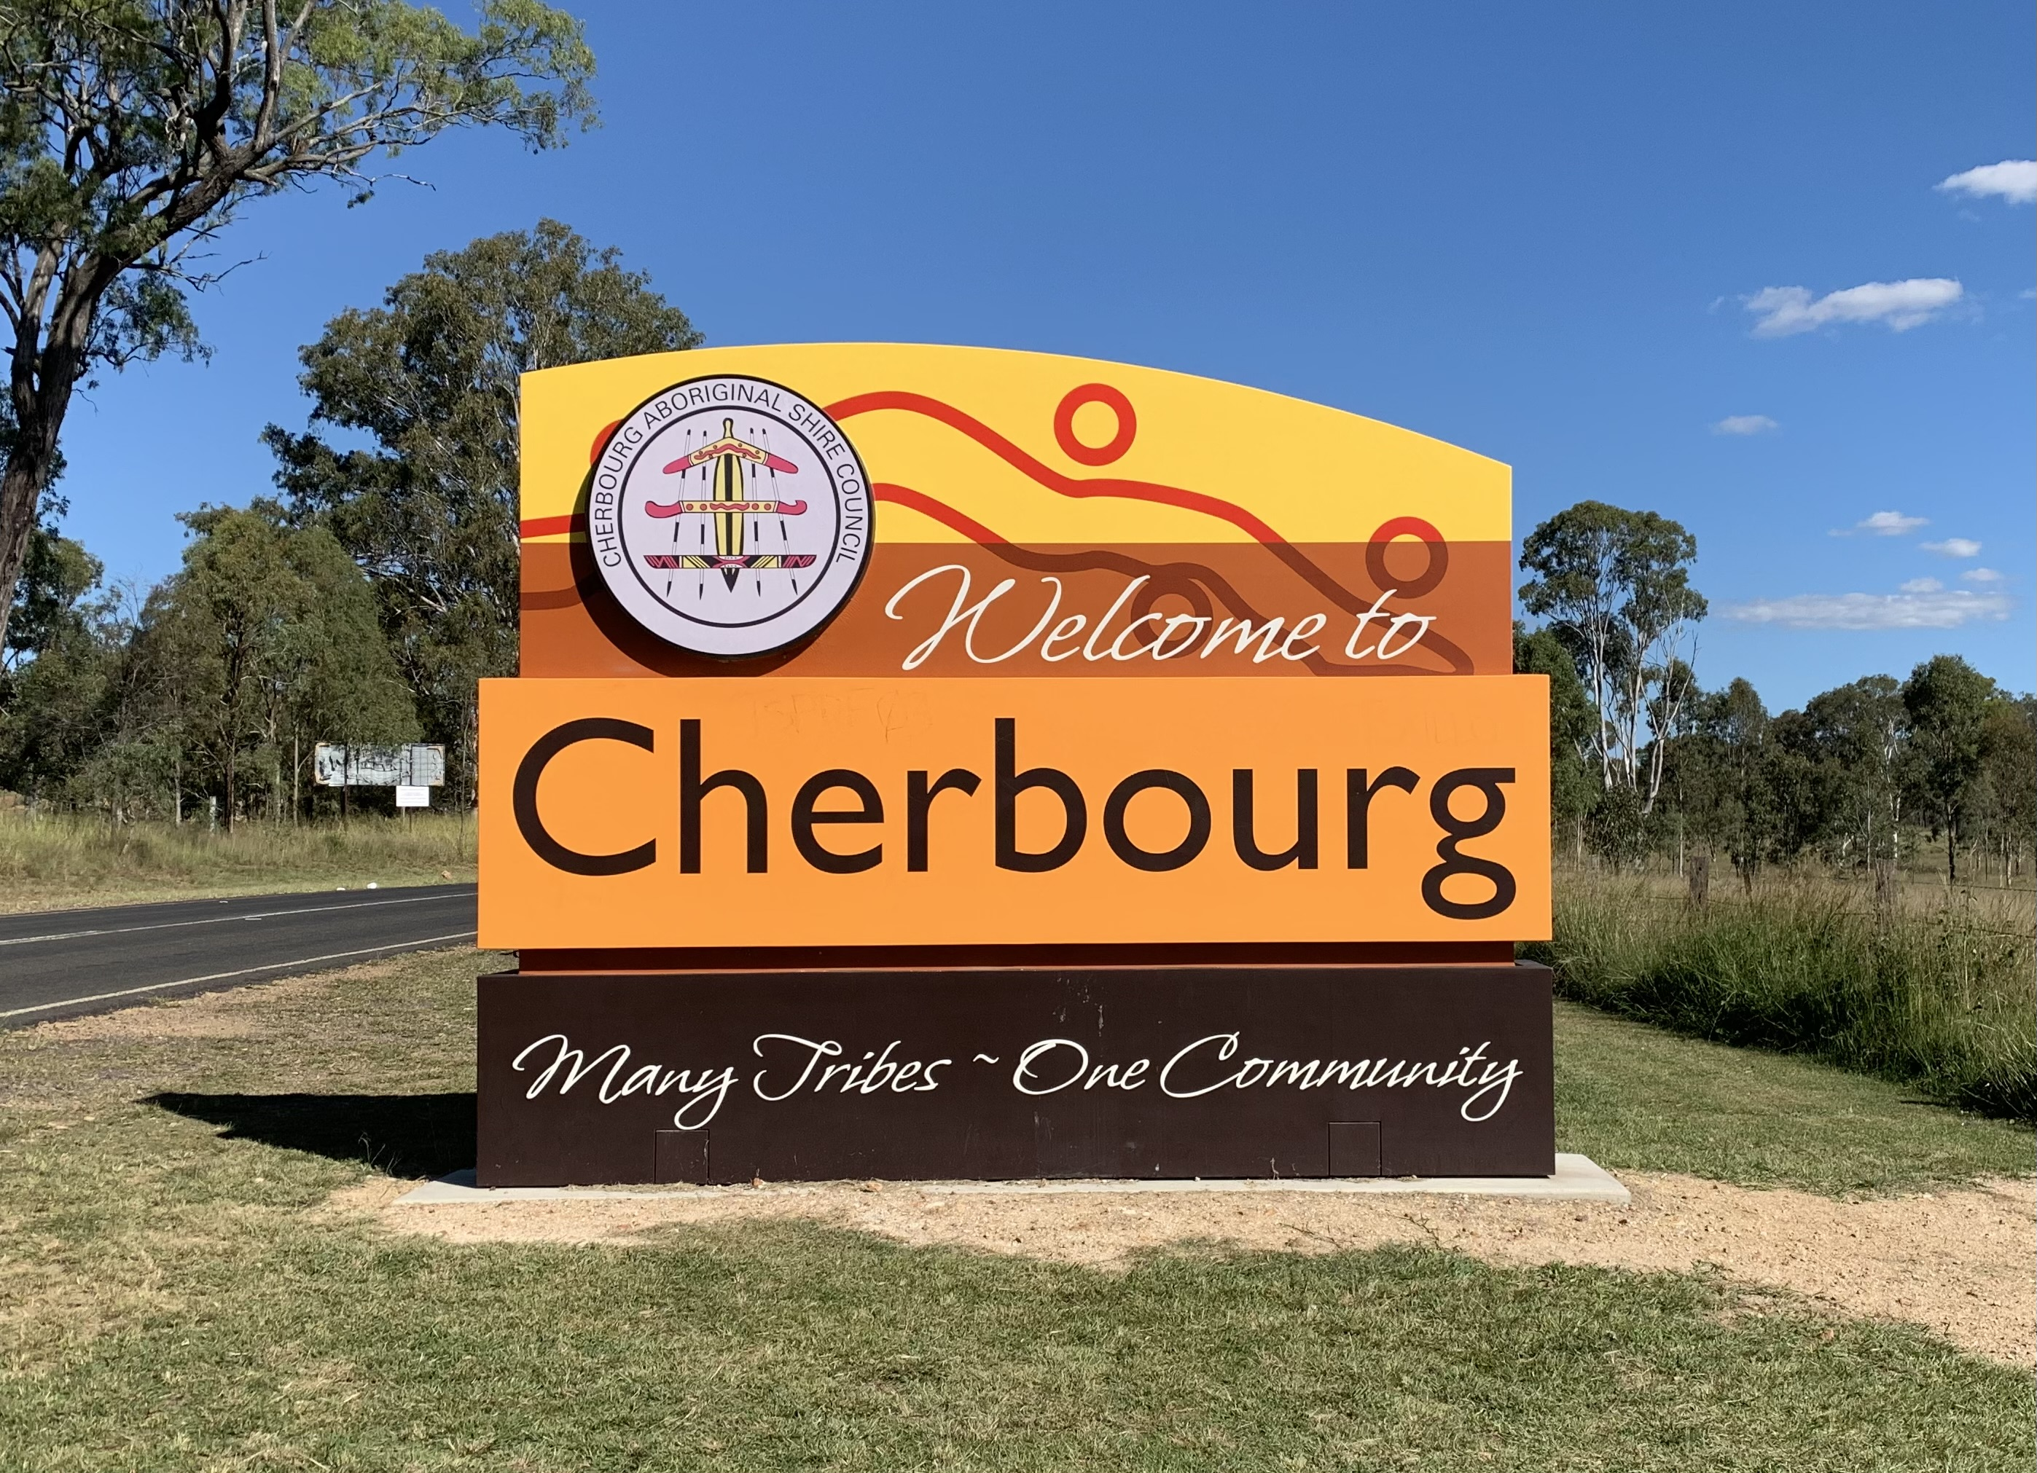
Ngara yumbin
Notes:
Key message
Welcome and/or acknowledgement of country
Facilitators to use language if they feel comfortable doing so
Trainers to introduce themselves

Slide 3
Yumbin Healing Project
This trauma informed practice project is a partnership between the Australian Childhood Foundation (ACF) and the Department of Education
It has been developed by a working group of key staff members from across the schools of Cherbourg, Moffatdale and Murgon
The project includes training about trauma and its impacts
A series of resources have been developed to support culturally strong trauma informed practice implementation in our schools
Notes:
Key message
This project is based on understanding the past, present and ongoing impacts of colonisation on our children, young people, families and communities
Everyone has a story and while we ask you to reflect on the stories for our children, young people, families and communities we understand that we all come from stories of trauma, grief and loss
We hope as a result of this project we can all connect and walk together for our children and young people

Slide 4
Yumbin healing project
Content to be added regarding the authorizing environment that underpins trauma informed practice within schools

Slide 5
This session
Part 1
Understanding trauma in the context of our communities
Understanding how the brain develops and responds to trauma
Part 2
Exploring principles of culturally strong trauma responsive practice
Identifying and building on what we are already doing
Part 3
Self care and its importance

Slide 6
Please take care of yourselves as your wellbeing is very important
Notes:
Key message
We are talking about trauma and hard times in this presentation.
All of us come to this presentation with different experiences and so its important we look after ourselves, during the presentation but also in the important work we are doing with children and young people .
We don’t always know the ways in which things can touch us so if you need a break please feel free to go and get yourself a cuppa, take a breath, go outside
Please feel free to check in with us at the end of the presentation
Remember, for ongoing support there is EAP and other services such as Beyond Blue, Lifeline

Slide 7
Part 1 Understanding trauma in the context of our communities Understanding how the brain develops and responds to trauma

Slide 8
What is trauma?
Notes:
Key message
Trauma is complex and has multiple elements to it. How we respond to it is also complex and has multiple elements to it and that is what this presentation will cover
Activity
Choose one activity from the two below:
1. Brainstorm
Ask the group what their ideas are about what trauma is
Record on whiteboard, butchers paper or take notes so you can keep referring back to their ideas during the rest of the presentation.
Or
2. Firing Line (Sociometric Line)
Ask the group to put themselves into a line based on how well they think they understand what trauma is and how to respond
If they feel less confident they should position themselves somewhere left of the centre of the line and if they feel more confident they should position themselves more to the right of the centre of the line
Invite people along the line to share why they positioned themselves where they did
Let the group know that by the end of the training the hope is that everyone will have moved further to the right on the line i.e. they will have a deeper understanding of trauma and why this is relevant to the work they are doing with children and young people they are working with

Slide 9
Understanding intergenerational trauma
Notes:
Key message
We ask that you walk side by side with us to support each other and our children and young people, our families and community, including our school community
Activity- Whole group
Invite the group to share their thoughts/reflections on the video

Slide 10
Understanding our community history
Pre-Contact
Contact
Post Contact
Contemporary
Notes:
Key message
Important for facilitators to manage time here
Facilitators to include information they think is most relevant to this slide including:
Handout- Understanding our Community History
The handout provides some examples of the changes and trauma Aboriginal and Torres Strait Islander people have survived since contact
Facilitators to use their knowledge and wisdom to share some examples from the handout which will help workshop participants understand community history and its current impacts
Additional resource
Department of Education Cross Cultural resources file:///C:/Users/showlett/AppData/Local/Microsoft/Windows/INetCache/Content.Outlook/N7KQRFF1/Cross%20Cultural%20Posters%20(003).pdf

Slide 11
What do you see in your classroom, in your school?
Notes:
Key message
As a part of this presentation we hope that you will walk away with a greater understanding of our community and our children and young people and how we can all work together to best support them, their learning and their wellbeing
Activity- Whole Group Discussion
Invite the group to think about 1-2 things that they see in their classroom or in their school that could be related to what we have spoken about so far; trauma, intergenerational trauma, community history

Slide 12
Understanding trauma
Traumatic experiences, particularly those experienced by children and young people, have the following elements. They:
overwhelm our capacity to cope
are responses to perceived threats and bring about a threat response
are experiences that are outside of our control
bring about physical, psychological, emotional and spiritual responses
are often multiple events over a period of time
are based in relationships and thus feel like they threaten our survival
Notes:
Key message
We need to understand what we mean by trauma because it helps us understand what the impact of these experiences might be as well as telling us what those who have experienced trauma will need from us.
While we are focusing on our children and young people, this is equally relevant to other community members who have experienced trauma, as well as ourselves if we have our own trauma history.
Handout-Understanding Trauma
The handout outlines these elements of trauma, what the impacts are likely to be and then tells us what children and young people need from us if they have experienced trauma.

Slide 13
Understanding neurobiology
Notes:
Key message
Neurobiology is the science of the brain
This short video (4.5 minutes) explains some of the key concepts of how brains develop, the importance of safety and relationships and what happens when children and young people experience trauma in their lives
It asks us to use this knowledge and understanding to think about ways we can respond and support children and young people
There is a handout that provides more details on brain development
There is also a resource you can use with children and young people to help them understand the ways all our brains develop
It uses the metaphor of a house to help them understand what happens when we all feel strong emotions and how we can support ourselves and each other
Handout- Neurosequential brain development
The handout gives more detail of the different areas of the brain, the way they develop in sequence and some of the possible impacts of trauma

Slide 14
Linking trauma, loss and grief
Loss: the severing or breaking of our attachment to someone or something that results in a changed relationship.
Grief: the normal response to loss and includes a range of physical emotional, psychological, behavioural and social reactions
Cumulative grief: when an individual experiences multiple losses either all at once or before processing an earlier loss.
Experiences of trauma always include loss and grief and are likely to be cumulative
Collective grief is the shared grief held by families and community for the losses across time and the losses that are still continuing
Notes:
Key message
A reminder to the group that as we talk about trauma, grief and loss to look after themselves
Our people, families and communities have experienced multiple losses since the time of contact. These losses across and within generations have led to cumulative and collective grief and chronic sorrow that continues today
These losses include our land, culture, language, our families, communities and connections, our children who were taken, our people who died through the impact of colonization, our young people who we continue to lose
Note for facilitators:
Loss, grief and cumulative grief definitions are from McBride, M. (1996) Working with grief and loss. NSW: Open Training and Education Network

Slide 15
Why do we need to know this and what does it tell us?
Notes:
Activity- Whole Group Discussion
So far we’ve looked at:
how trauma is defined and its links to loss and grief
intergenerational trauma
the history of our communities
how the brain develops and some of the impacts of trauma on brain development
Question for group
Why is it important for us to know about these things? What does it tell us about the children and young people we work with?

Slide 16
Where to from here?
Past
Share & Acknowledge
Present
Learn & Apply
Future
Build & Change
Notes:
Key message
While it is important for us all to acknowledge the way that the echoes of the past impact on our present, our focus is on the future, especially for our children and young people
Past
Sharing the past is about telling the stories of what has happened to build a common understanding.
Acknowledging the past is about making sure that we all understand that what has happened still impacts on us all today.
Present
Learning in the present is about learning from the past to make sure the mistakes and trauma of the past are not repeated.
Applying that learning is what we need to do every day to make sure that the trauma of the past is not repeated.
Future
Building the future is about using our understanding and our skills to achieve positive outcomes for children and young people
Changing the future tells us that we want to support our children and young people (and ourselves and the broader community) to learn, grow and develop in a way that incorporates the past and the present.

Slide 17
Part 2 Exploring principles of culturally strong trauma responsive practice Identifying and building on what we are already doing
Notes:
Key message
This next section is about exploring principles of culturally strong trauma responsive practice
We are often doing things that help support children and young people, who have experienced trauma but we don’t recognise it or call it trauma responsive practice
This next section will give us opportunities to identify what we are already doing and think about ways we can strengthen our approaches and strategies to help meet the needs of our children and young people

Slide 18
9 times out of 10, the story behind the misbehaviour won’t make you angry, it will break your heart Annette Breaux
Notes:
Key message
It is important for us to look for what is behind the behaviour of our children and young people and try to understand how we can support them
It is important to understand that our children and young people come to school with a bag of baggage. This could include difficult times at home including family violence, possible upheaval in community, grief and loss from recent and past losses
Children and young people show us the baggage they carry through their behaviours
Activity- Whole group
1. Ask the group to bring to mind the behaviour of a child or young person they are currently teaching or working with
Invite group to share their thoughts on the questions below:
Thinking about what we have talked about so far what does this tell you about the behaviour of the child or young person?
How might we understand what that behaviour is trying to tell us and how we need to respond
2. Facilitators could share some examples of how they have responded to children and young people’s behavior after the group has had their discussion.
Note for facilitators:
Annette Breaux is a former classroom teacher, curriculum coordinator, and teacher induction coordinator from the US so this quote comes from an educator and reminds people to think about the meaning behind the behaviour and what the children and young people are bringing into the room.

Slide 19
Principles of culturally strong trauma responsive practice
Relationships are everything
Safety is critical – we all need to feel safe and be safe
Cultural safety and strengths are fundamental
Trauma responsive practices are often things we are already doing
Behaviour is a story and we need to find the meaning underneath
Notes:
Key message
The next two slides describe 10 principles of culturally strong trauma responsive practice
These principles help guide the work we do with children and young people and help us make sense of how we can support them
We will use these principles later in the workshop to help us think about strategies that can help our children and young people
The handout describes each principle in more detail
Handout- Principles of culturally strong trauma responsive education practice
The handout provides a summary of the 10 principles described on the next 2 slides

Slide 20
Principles of culturally strong trauma responsive practice
We need to use actions as well as words
Repetition brings about change
We cannot do this work alone
We have to look after ourselves
Culturally strong trauma responsive practice is everyone’s business- We walk together in responding to children and young people

Slide 21
Sharing stories. What are we already doing?
Notes:
Key message
We are already working in ways that can help our children and young people who have experienced trauma
The purpose of this training is to gain a greater understanding of how we can all work together to better meet the needs of our children and young people
Culturally strong trauma responsive practice can help all children and young people thrive
Facilitators share some of the things that are already happening in the schools that are trauma responsive, and what you are seeing as a result in the children and young people, or with the staff.
Activity- Small Group Discussion
Give the group the Handout- Audit tool Principles of culturally strong trauma informed practice- What we are already doing
In small groups ask people to fill in 1-2 things they are already doing for each of the 10 principles we have just talked about
Ask the groups to come up with one thing they could do tomorrow now that they have done this training
Ask the groups to share with the wider group examples from one of the 10 principles
Use the handout in follow up staff meetings and continue the discussion on the ways in which the school is implementing these principles at a whole school, classroom, individual student and family and community level

Slide 22
Language as power
The way we describe our children and young people is very powerful
The way children and young people describe themselves is very powerful
Words matter so what words can we use?
We always have to make sure our words and actions match
Notes:
Key message
We know that behaviour is a story, a way that children and young people are telling us what they need, sometimes with words, often with what they do, with their actions
How we view our children and young people and the language we use to describe them and their actions is important
Negative language and unhelpful words can serve to blame children and young people for their past experiences of trauma
We should use more positive language that builds trust and safety, is responsive to their needs and helps them be more open and ready for learning.
The language we use with children and young people can help them make sense of some of the big emotions they are feeling, it can help them make sense of their world, see themselves more positively and feel more supported in their wellbeing and learning

Slide 23
Language as Power
Language is more than words, it includes body language
We need to be aware of our volume and tone of voice
Visual language helps our children learn
We need to speak to our children and young people not down to them
We need to speak with our children to support and gudie them and so their voices can be heard
Notes:
Activity- Brainstorm
Ask the group
What are some of the ways you hear children and young people being described when they are struggling at school e.g. they’re losing it, out of control, away with the fairies, manipulative, can’t keep still, rude, psycho?
Give out Handout- Words Matter
Go through some of the examples
Ask the group for any thoughts and reflections they have about what this might means for the children and young people who are struggling

Slide 24
Cultural healing
Kinship relationships and family
Sharing and caring
Elders
Respect
Cultural protocols
Being and going on country
Storytelling and yarning
Learning lore
Confidentiality and privacy protocols
Artwork
Craft work activities
Humour
Notes:
Handout- Strategies for Culturally strong trauma responsive education practice
Give out handout which includes ideas for strategies and activities that are linked to the principles of culturally strong trauma responsive practice as discussed earlier in the session
Use the handout in follow up staff meetings and continue the discussion on the ways in which the school is implementing these principles at a whole school, classroom, individual student and family and community level

Slide 25
What this means for my work
What are you going to do differently tomorrow?
Notes:
Key message
There is no magic fix for some of the challenges our children and young people experience but by working together and supporting each other we can better meet their needs while also looking after ourselves
All of us can take a step and do something differently which will help support our children and young people’s wellbeing and learning
This project includes a series of additional resources that will be made available to all school staff which may help answer some of the questions you may still have
Activity- Whole group
Ask the group to take a moment to think about something they will do differently tomorrow in the classroom/in the school as a result of what they have learned in this training.
Ask the group to write this down
Ask the group if anyone would like to share what they will do differently
We can also provide a list of the additional resources being developed – or give them some of those resources in the training?

Slide 26
Part 3 Looking after ourselves
Notes:
Key message
This next section looks at the importance of looking after ourselves and each other in our work with all children but in particular with children and young people who have experienced trauma
It is important and powerful work but it can also be confusing, challenging, tiring, as well as triggering big emotions in ourselves or even our trauma histories
In this section we’ll be exploring ways we look after ourselves and each other

Slide 27
Looking after ourselves
Children and Young People
Working group
Leadership team
Staff team
Regional and Central team
The Circle of Care
Notes:
Key messages
We all need to look after ourselves and each other in working with and supporting children and young people who have experienced trauma
We can achieve the best outcomes for our children and young people when we work together and support each other
Activity- Whole group
Ask the group to take a moment to think about 3 things they currently do to look after themselves (it could be at work, at home, outside of work and home)
Ask the group to write these down
Encourage people to think about other strategies that might work for them as we go through this part of the presentation

Slide 28
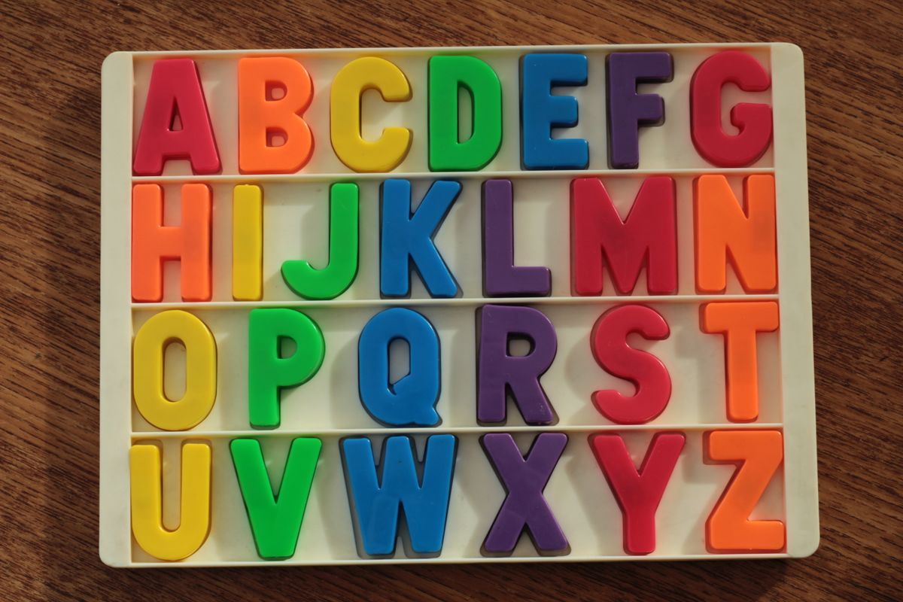
Looking after ourselves
Self-care is so important because it helps us to stay calm and able to think, plan and support children and young people
Everyone has different ways of looking after their own wellbeing
We need to have lots of options to make sure we can look after ourselves
This Photo by Unknown Author is licensed under CC BY-SA
Notes:
Key messages
Self care is important because it helps us to stay calm and able to support children and young people when they need our help
Self care is important so that we can work well and also be well for all the other important people and activities and challenges in our own lives
We need lots of self-care strategies because we can’t always do the things we want when we want them eg: H for holidays
One person’s self-care may be another person’s stress so we can’t know what will work for everybody eg: M for massage
A lot of self-care activities target the lower parts of the brain and body because that is what we experience as nurturing and that makes us feel better
A lot of self-care activities we do for ourselves can also be useful strategies to use in the classroom or the playground with the children and young people because it can help them to experience calm and help them to be able to think more clearly
Looking after ourselves also means knowing what supports are available to us within our schools and the Department of Education e.g. EAP (Employee Assistance Program)
Activity
Choose one activity from the two below:
1. Self Care Alphabet Handout
Give out Self Care Alphabet Handout
Ask people to put a tick beside any strategies they already use
Ask people to put a circle around 3 strategies or add 3 strategies to the list that they would like to start using
Ask if anyone would like to share with the whole group some of the strategies they would like to start using
Or
2. Blank Self Care Alphabet handout
Give out blank self care alphabet handouts
Small groups try and come up with a strategy for each letter of the alphabet and record on the handout
The whole group shares some examples for each letter

Slide 29
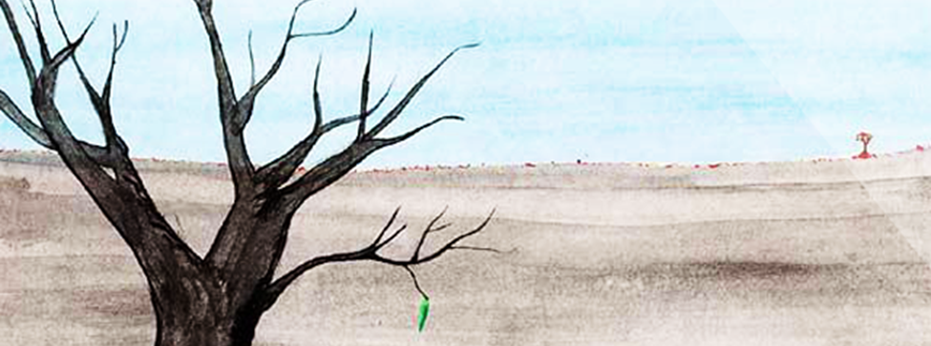
What are your hopes for the children and young people? How will your vision change?
Notes:
Key message
Read or tell this story to the group
This image is called ‘Hope with a Leaf’ and it was created by a young person. They used this picture to show how they were feeling. They said they were the tree and felt like they, and everything around them, was dead and lifeless. Anything with colour and life felt like a long way away – away on the horizon.
However, through their experiences at school they felt like there was some hope and that the one green leaf on the dead tree is that hope. They said that their relationships at school made them feel like there was hope, ‘that it wasn’t always going to be like this’.
This tells us that there is always hope for change but that it can be a small step that is made. It is important for us to recognise this and the ways in which we can support and influence the children and young people we work with.
Activity
Choose one activity from the two below:
1. Discussion
Ask the group what are the leaves of hope they have for the children and young people they work with?
Or
2. Hopes on Sticky notes
Draw a tree with branches on the whiteboard
Ask the group to write a hope or hopes they have for the children and young people they work with on sticky notes and put on the whiteboard tree at the end of the session
Invite a few people to share their hopes with the group

Slide 30
Thank you for your time and your commitment to our children and young people Golang Goo
Notes:
Key message
Thank the group for their participation in the workshop, their commitment to our children and young people
Remind them to look after themselves and use their self care strategies in this important but challenging work
Tell them how you are looking forward to walking together on this journey of supporting our children and young people with greater understanding
Activity (optional)
Ask group that if they were to put themselves on a line again (firing line/sociometric line) based on their understanding of trauma and how they can support children and young people, do they think they have moved along the line?

