Slide 1
This session will be starting at 10 am. While you are waiting please use the chat function to introduce yourself (and any colleagues with you) and where you are located.

Slide 2
Informed, aware and responsive:
Making SPACE for Learning in Tasmanian Schools

Slide 4
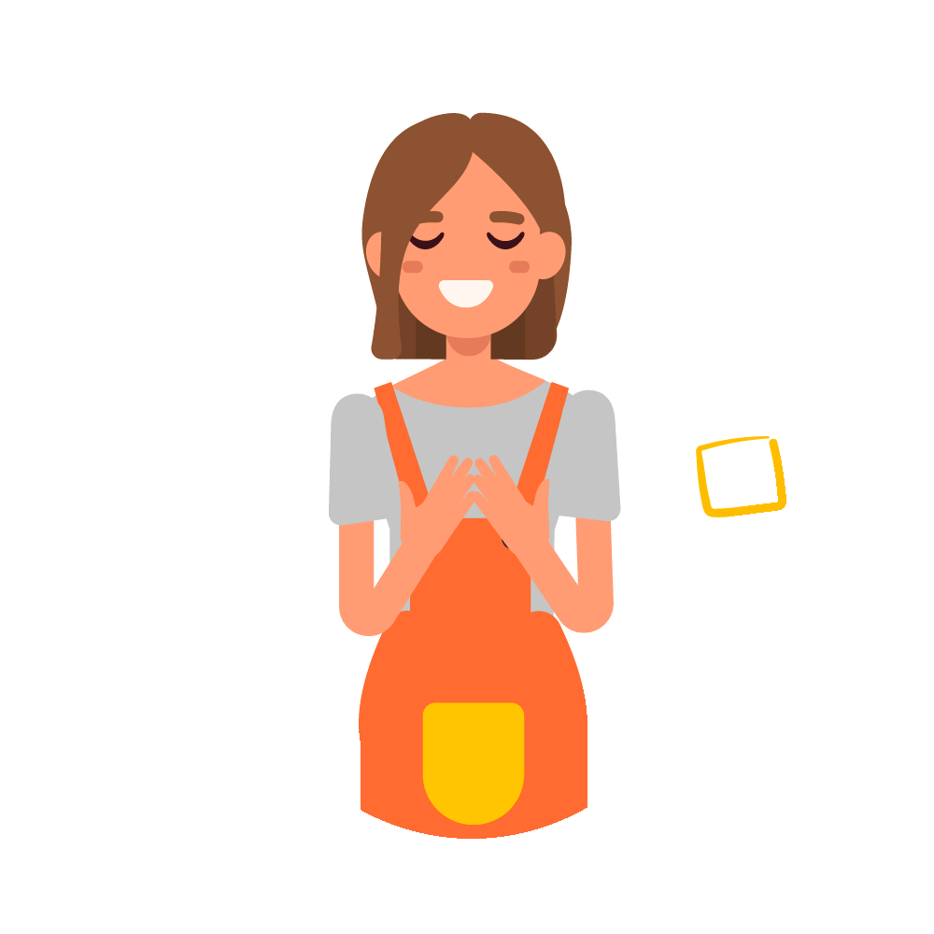

Slide 5
Learning together
We all have knowledge, lived experience and practice wisdom we can share
Learn with curiosity and openness
Notes:
How the session will be facilitated
Examples of what you might include:
Participation encouraged – use of chat function, introductions in the Chat
Mute yourself when not talking
Hands up or use the chat button if you have questions
Please use headphones if children are in your training space
Confidentiality
Include any housekeeping (eg breaks etc)

Slide 6
Develop an increased understanding of the impact of trauma on children and how it may present in the classroom. Develop confidence in building strong and healing relationships with all students Develop a toolkit of strategies for working with students impacted by trauma that are accessible and applicable.

Slide 7
Overview
Notes:
Evolving Practice: Acknowledge the learning both formal and informal they have done individually and possibly as a team to support their students.
(Jen - these are the words Angela added to the resource guide re our evidence base) The program is based on knowledge and theories including neurobiology and trauma, and wisdom from practice, culture, and those with lived experience of trauma. It acknowledges that children and young people need to feel safe before they can learn, they need relationships with adults they can trust, they need to be able to make meaning of their world and they need connection to their culture (this last part of from the ACF Model of Practice).

Slide 8
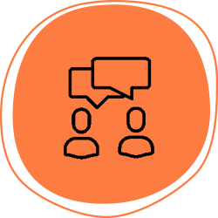
Reflective question
All educators want children and young people to thrive in the spaces we create with them at school. What makes the best kinds of learning spaces for children and young people?

Slide 9
Today's session flow
Notes:
Define Practical Strategies and Activities

Slide 10
Defining trauma
Intergenerational
Transgenerational
Any single, ongoing or cumulative experience which:
is a response to a perceived threat, usually to survival
overwhelms our capacity to cope
feels/is outside our control
often evokes a physiological and psychological set of responses based on fear or avoidance
Simple
Complex
Developmental
Notes:
Van der Kolk makes a similar point about the complicated nature of trauma when he says, “Traumatization occurs when both internal and external resources are inadequate to cope with external threat” (1989: 393)
Trauma across the lifespan:
Van der Kolk (2007) argued that childhood trauma was probably “todays single most important public health challenge” and that it can be linked to:
•Ongoing physical health problems
•Intra- and inter-generational transference of negative attitudes
•Troubled behaviour
•Transference of historical trauma across family and communal systems
•More likely to stay in the criminal justice system
Complex developmental trauma is the focus of this session – and how our understanding of complex trauma and its impact on neurobiology and neurophysiology can inform our practice with children and young people and their families.
Discuss here briefly also intergenerational trauma.
Australian context impact of colonization. NT Youth Justice context – almost 100% of YP in youth detention are Aboriginal and Torres Strait Islander young people in NT.
We will discuss intergenerational/transgenerational trauma a little later in the session

Slide 11
Trauma and needs
The residue of trauma becomes an experience of unmet needs for children. Children are left with needs that in the moment of hurt, pain and fear are unfulfilled. These needs stay activated ready for available relationships to respond to them, see them and gradually help them to be met. These needs are physiological, developmental, and interpersonal, requiring relational investment and presence in order to be resolved “ It is like they are on a loop hoping that their needs for safety, attention and validation that were not fulfilled will eventually find at least one relationship in the present that meets these needs consistently over time “ Joe Tucci
Notes:
How needs arise…

Slide 12
Trauma and needs
Connected relationships can restore safety by understanding and addressing the needs that were not met.
For example:
An experience of being alone, can be met with accompaniment
An experience of fear met with protection, and
An experience of shame met with acceptance. Needs can be identified within the domains of trauma and can be responded to by reparative experiences described in the Making SPACE for learning framework.

Slide 13
Impacts of trauma
Notes:
Review of Trauma impacts:
When thinking about previous PL or the online course what do you remember about Trauma Impacts?

Slide 14
Impacts of Trauma
Trauma creates changes in the way our brain functions – trauma increases a child’s base arousal level – leaving them in state of vigilance.
Trauma and exposure to chronic stress experienced during childhood and adolescence shake the foundations of healthy brain and body development.
Exposure to complex trauma affects how well key brain structures are able to integrate the different dimensions of memory. The emotional and physiological resonances of traumatic experiences come to be stored as memory fragments in the limbic system, cerebellum and brain stem without reference points, They don't connect to the detailed explicit memories (ie the facts of these events in which reactions occurred). This means that children may struggle to remember life events, particularly in sequence. Their working memory may also be impacted and, as such, they may struggle to remember instructions. ​
Notes:
Brain, Body, Memory

Slide 15
Impacts of Trauma
Trauma can affect the foundations for learning children who have experienced trauma may find it difficult to pay attention, to engage in class activities, to reason, goal set or think critically. They may also find transitions at school difficult.
Because of the trauma in their lives, children may have developed ways of keeping themselves safe. This can include behaviours such as hitting, withdrawing, running away or other ways of avoiding getting hurt. Their survival behaviours may have once had a purpose but may not be ok at school – children will not know this.​
​
Notes:
Behaviour, Learning

Slide 16
Impacts of Trauma
Trauma can disrupt the way that a childs’s brain manages, remembers and processes the emotional dimensions of experience. Children and young people who have experienced trauma can stop practising integrating their feeling states (a function of their right hemisphere) with words and constructs (a function of their left hemisphere) they can use to know and communicate about their internal sensations. They can have limited emotional literacy. They can find it hard to attribute language to them and describe them meaningfully for others to understand.
Children who have experienced trauma have not had good connective experiences and therefore their working models of connection can be built on fear and mistrust.
Notes:
Emotions, Relationships

Slide 17
Today's session flow
Notes:
Highlight where we are in the flow
This framework is coming to attend to needs and safety through domains

Slide 18
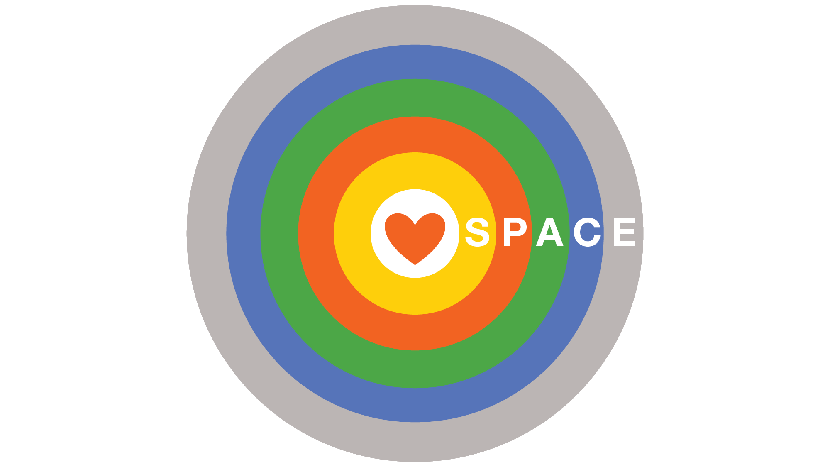
Making Space for Learning
SPACE is the central acronym of the program. It includes 5 domains to help educators better understand the needs of children who have experienced trauma and ways to support them in the educational setting.
Notes:
The acronym SPACE represents five key dimensions that if incorporated into strategies offer the most potential to establish effective opportunities for schools to respond to the needs of children and young people who have experienced trauma.

Slide 19
Domains | Domain Explanation | Translated into needs statements
Staged | The brain develops sequentially. Sophisticated functions only emerge after basic functions are consolidated. We should resource children in line with what their developing brain’s need. | Children’s brains need support to grow and learn My brain grows upwards step by step
Predictable | Uncertainty and unpredictability can disrupt emotional wellbeing and threaten social competence. Strategies which promote stability and familiarity enhance social and emotional wellbeing. | Children need to know what they can count on I feel better when I know what is coming next.
Adaptive | Familiar behavioural routines are more likely to be enacted in response to life challenges than new ones. Familiar routines may not always be constructive. Strategies which promote adaptability in children’s behavioural routines are ones that meet children creatively with multiple options for intervention. | Children need support to grow up healthy and strong There are things I need to grow up healthy and strong.
Connected | Children’s internal maps for forming, maintaining and being in relationships are affected by their experiences of relationships throughout their lives. Negotiating relationships at school can be a source of stress when children have found them hard or unsafe in the past. Relationship with safe and consistent adults and peers form the foundation for change. | Children need to feel like they are connected. I need to feel like I am connected.
 |  | Children need to feel safe and know about what makes a safe connection. I need to feel safe. I need safe connections in my life.
Enabled | All children can benefit from engaging in the process of understanding themselves more deeply. The capacity to identify feelings and learn how they relate to the body, thoughts, and behaviours is a worthwhile life skill. Learning to communicate feelings with each other enriches social cohesion. Making sense of our stories helps us to build coherent identities over time. | Children need to know more about what makes them who they are. I grow stronger as I learn more about what makes me, me.
Notes:
Emphasis the needs framework

Slide 20
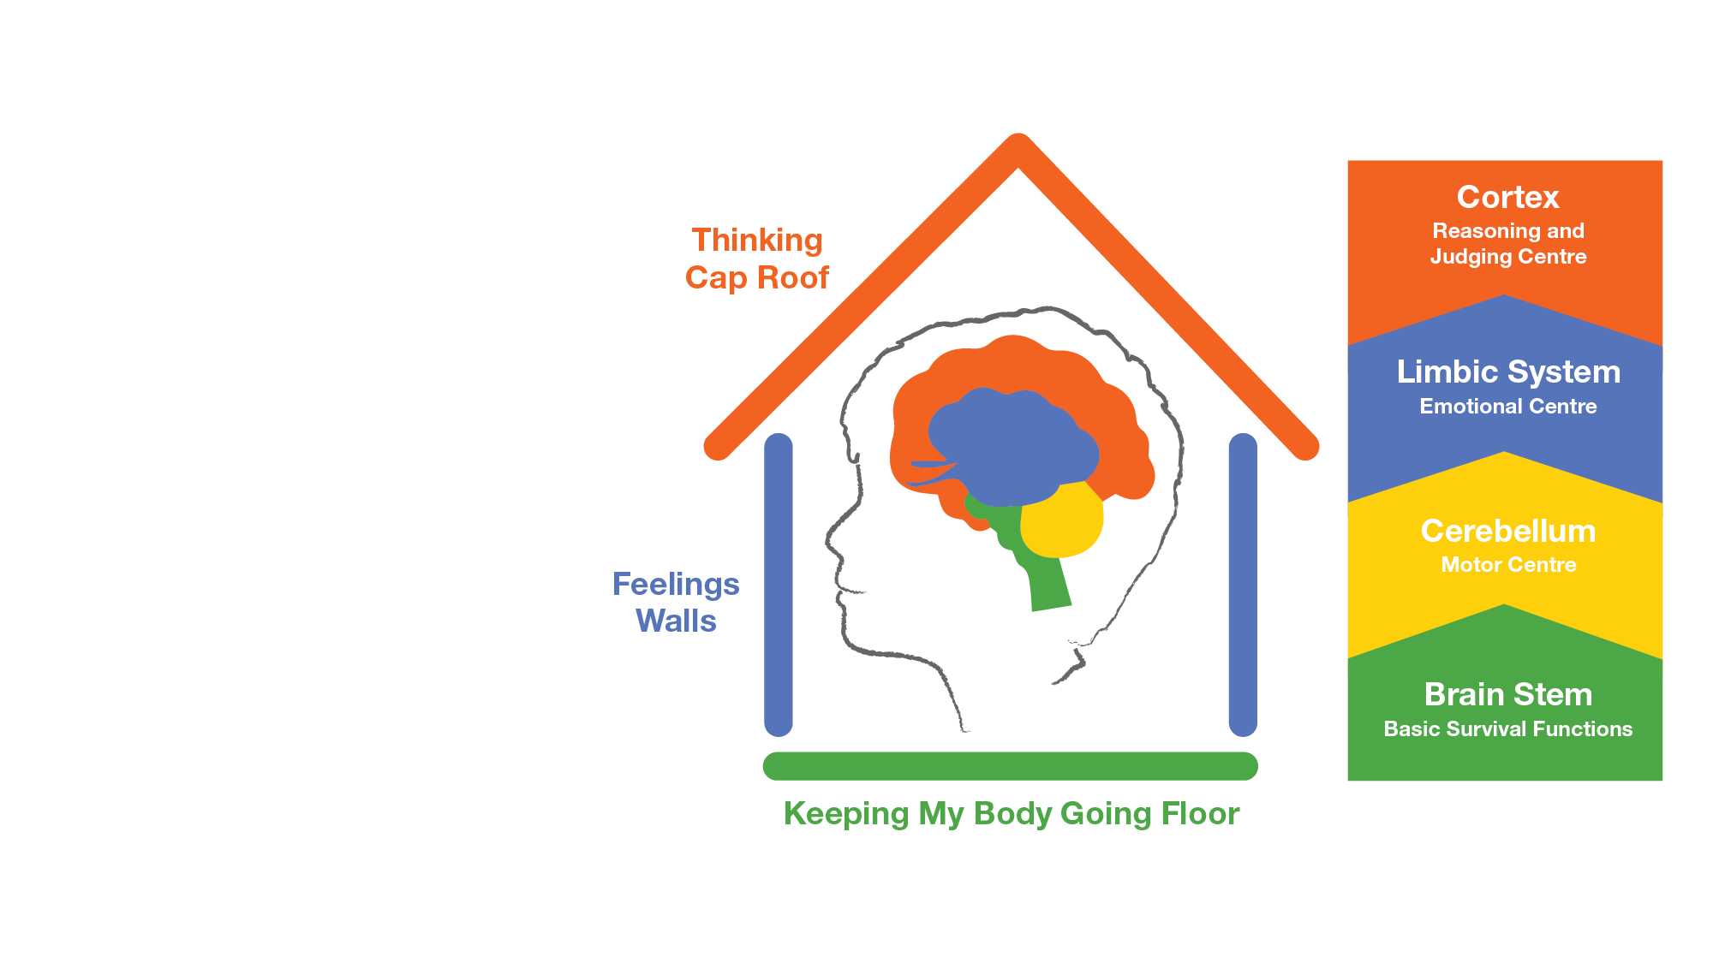
Staged
Brain development is sequential
One of the ways our brain develops is vertically, from the bottom to the top
Some neurodevelopmental delays such as those effected by trauma can cause brain changes. However, with the right support the brain can be repaired through neuroplasticity.
My brain grows upwards, step by step.
Notes:
Based neurosequential model of therapeutics Bruce Perry...

Slide 21
Predictable
Changes to routines and uncertainty can be a source of stress to student
Predictability in students' relationships and activities modulates their stress systems
This then promotes flexibility and adaptability
I feel better when I know what is coming next.

Slide 22
Predictable
Predictable you
“I’ve come to a frightening conclusion that I am the decisive element in the classroom. It’s my personal approach that creates the climate. It’s my daily mood that makes the weather. As a teacher, I possess a tremendous power to make a child’s life miserable or joyous. I can be a tool of torture or an instrument of inspiration. I can humiliate or heal. In all situations, it is my response that decides whether a crisis will be escalated or de-escalated and a child humanised or dehumanised.”
Hiam Ginott
Notes:
Kimberley space concept of the Hand- What can I count on
Traumatised Student and young people experience change in their relational and physical environment as a source of stress.
Their brain-body system maintains itself in a state of arousal readiness in preparation for the re-occurrence of threat.
Strategies which promote stability and familiarity reduce the need for the stress system to be as actively engaged. They then have the space to experience themselves as more flexible & more able tolerate small degrees of change in their environment.

Slide 23
Predictable
What might predictability look like in practice?
routines
relationships
physical
activities
instructions
learning tasks
behavioural expectations
For students
For families
For staff
Systemically
Notes:
What we already do.. How we can extend
REFLECTION
This is a starting point for reflection.
ACTIVITY
(if time permits) could get each table to look at one area and jot down points to consider for each area.
Share with the group
IDEAS to:
Increase predictability.
•Relationships – safe people, greet!
•Physical – safe places, calming spaces (swings), careful if rearranging furniture – invite student to help
•Routines – entering class, if late, for calming, consistent schoolwide, classroom routines, MBHS independent bell work 5 mins on entering each class.
•Instructional - pre-teach signal for attention (biggest challenge for beginning teachers) – school wide JRLF; what’s happening next?? VISUAL SCHEDULE for ALL .
•Learning tasks – What if need help? Steps? Finished early?
•Behavioural expectations – posted? shared language, shared expectations, role play relocation, re-entry, acknowledgements
Refer to TATS document in FRONTER room lots of ideas for predictability.
http://childhoodtrauma.org.au/2015/january/how-to-help-young-people-navigate-the-new-school-year Alexa’s blog

Slide 24
Adaptive
Most of us have a set of behavioural routines that we draw from to respond to challenges when they emerge. These routines are likely based in what has helped us get by in the past and the experiences of relationships through which these routines were interpreted and responded to.
To broaden children’s behavioural repertoires and promote increased adaptability we need to maintain multiple meanings for the behaviour and remain open to multiple options for interventions.

Slide 25
Adaptive
Behaviour is communication
If we can understand what drives a behaviour, we can work out how to respond to it.
If we can meet the need that is driving a behaviour, the behaviour can start to reduce.
Behaviours are functional and almost always makes sense given their specific experiences of trauma.
Openness and curiosity about behaviour is an important response.
Notes:
The image on this slide represents an anthill or termite mound and is a reflection that what we see above ground (the behaviour) is only the presenting tip of a more complex construction (like the termite mound where only about one sixth is visible above ground). The behaviour is a reflection of the underlying needs of a child, a young person or a caregiver and we want to open up genuine interest in understanding that underlying need rather than just responding to the visible behaviour.
Examples of common behaviours that teachers report as challenging:
Defiance – refusing to complete tasks when instructed
Clingy – wanting to be on or near them at all times
Brainstorm in groups: what are some different ways we could understand these behaviours? How might you wonder with a parent about the function underlying these behaviours? What would be some supportive responses to each of these behaviours, depending on how we have understood them?
Parents and caregivers need assistance to make sense of their life experience through a supportive, empathic emotional relationship which encourages authenticity, nurturing and direct communication

Slide 26
What does safety look like at school?
“Before we can engage in social behaviour and learning we must first feel safe”
Dr Steven Porges

Slide 27
Safe & Unsafe States of Being

Slide 28
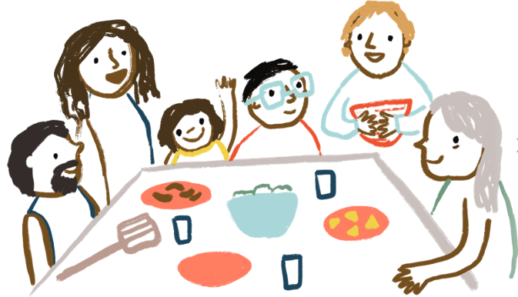
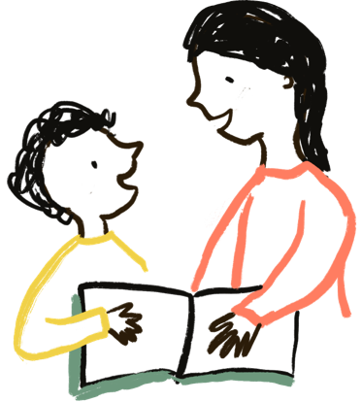
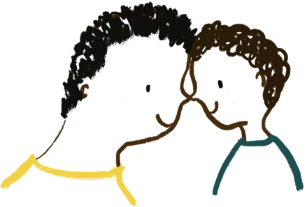
Tell Tale Signs
We feel safe in this state.
Our bodies are calm and relaxed.
We engage in mirroring and reciprocation with each other.
We are orientated towards one another with engaged, open faces.
Social Engagement

Slide 29
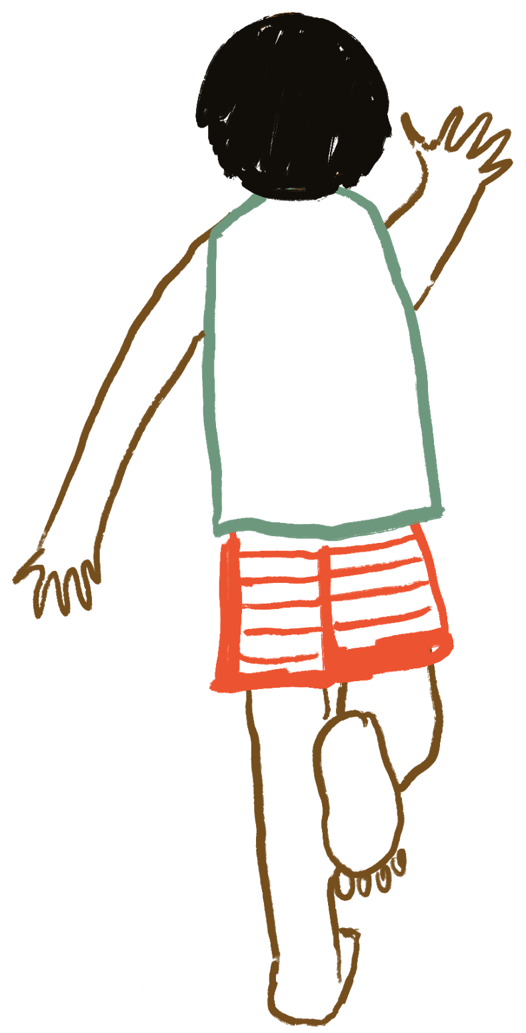
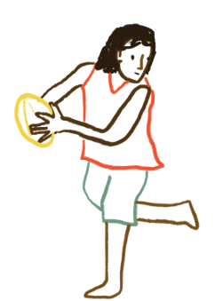
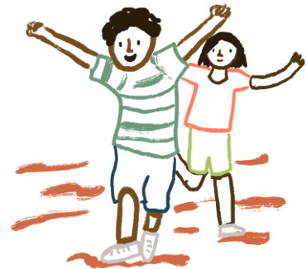
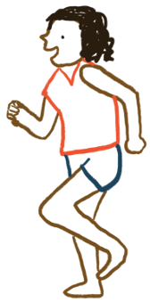
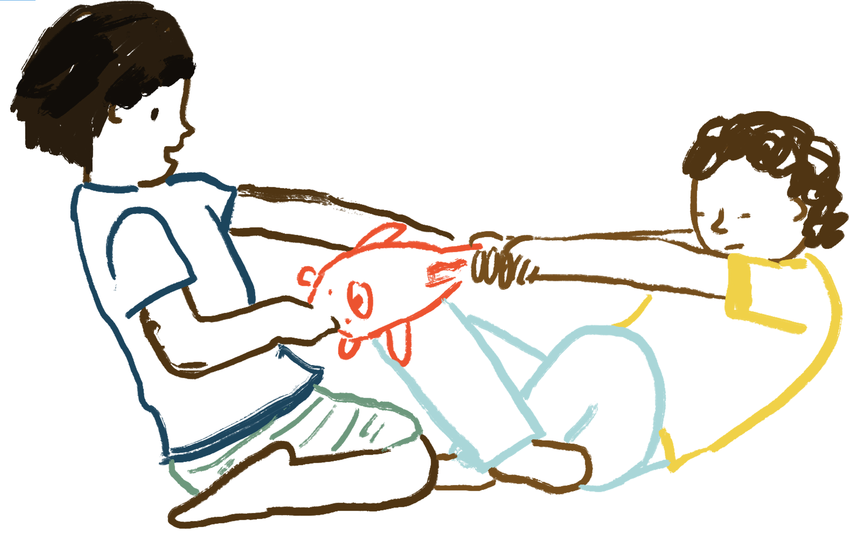
Tell Tale Signs * Our bodies are filled with energy, and we need to move.
Mobilisation
Play & Exploration
Fight or Flight or Active Freeze
We experience a blend of mobilisation and social engagement in a safely mobilised state.
We are mobilised without a sense of safety in this state.
Notes:
...Trauma undermines the child’s body, physiological health…. They have been in living out of their social engagement system which can impact eating, sleeping, play…

Slide 30
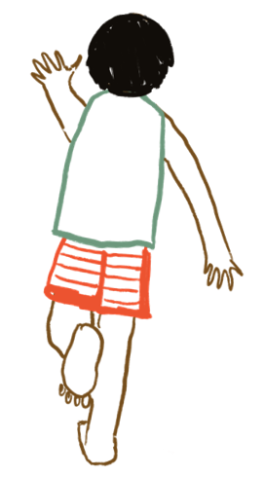
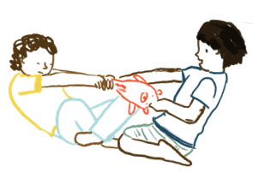
Tell Tale Signs in the Classroom * Our bodies are filled with energy, and we need to move.
Hypervigilant
Edgy/jumpy
Irritable – easily annoyed
Poor recovery from distraction
‘silly’, loud, over-excitement
Unsettled, sleep difficulties
Outbursts, aggression
Defensive, taking things personally
Increased expectations of self and others
Inflexible, ‘controlling’
Sensitive to sensory input
Mobilisation without feeling safe
Notes:
These are indicators- We acknowledge that in a classroom Trauma is one possibility. Today’s session is looking through the lens of trauma but there are other learning difficulties that can present in a classroom.

Slide 31
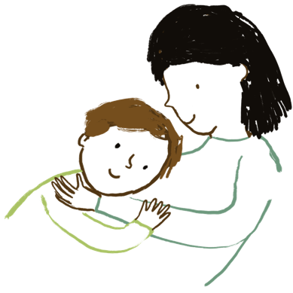
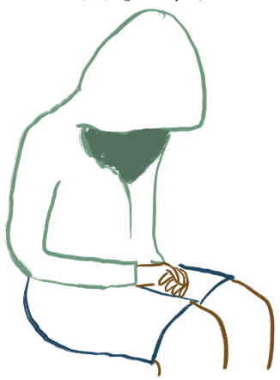
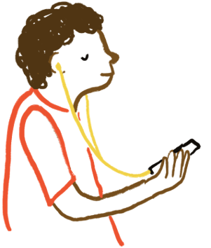
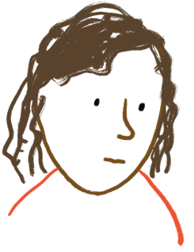
Tell Tale Signs * Our bodies are slowed right down
Immobilisation
Being still with others for pro-social reasons, like sharing a hug. We find pleasure in stillness. This is an intimate state.
Withdrawn, submissive, collapsed, numb
We experience a blend of immobilisation and social engagement in a safely immobilised state.
We experience immobilisation without a sense of safety in this state.

Slide 32
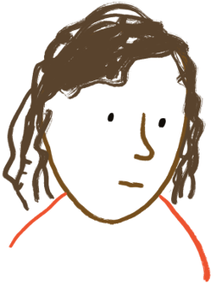
Tell Tale Signs in the Classroom * Our bodies are slowed right down
Flat, numb affect
Disengaged, disinterested
Withdrawn
“boredom”
Lethargic, unmotivated
Disconnected from peers
Developmental regression – e.g. with abilities to self-soothe, self-care/hygiene, toileting
Changes to appetite
Immobilisation without feeling safe

Slide 33
The Social Engagement System
Notes:
Dr Stephen Porges – Polyvagal Theory/Social Engagement System

Slide 34
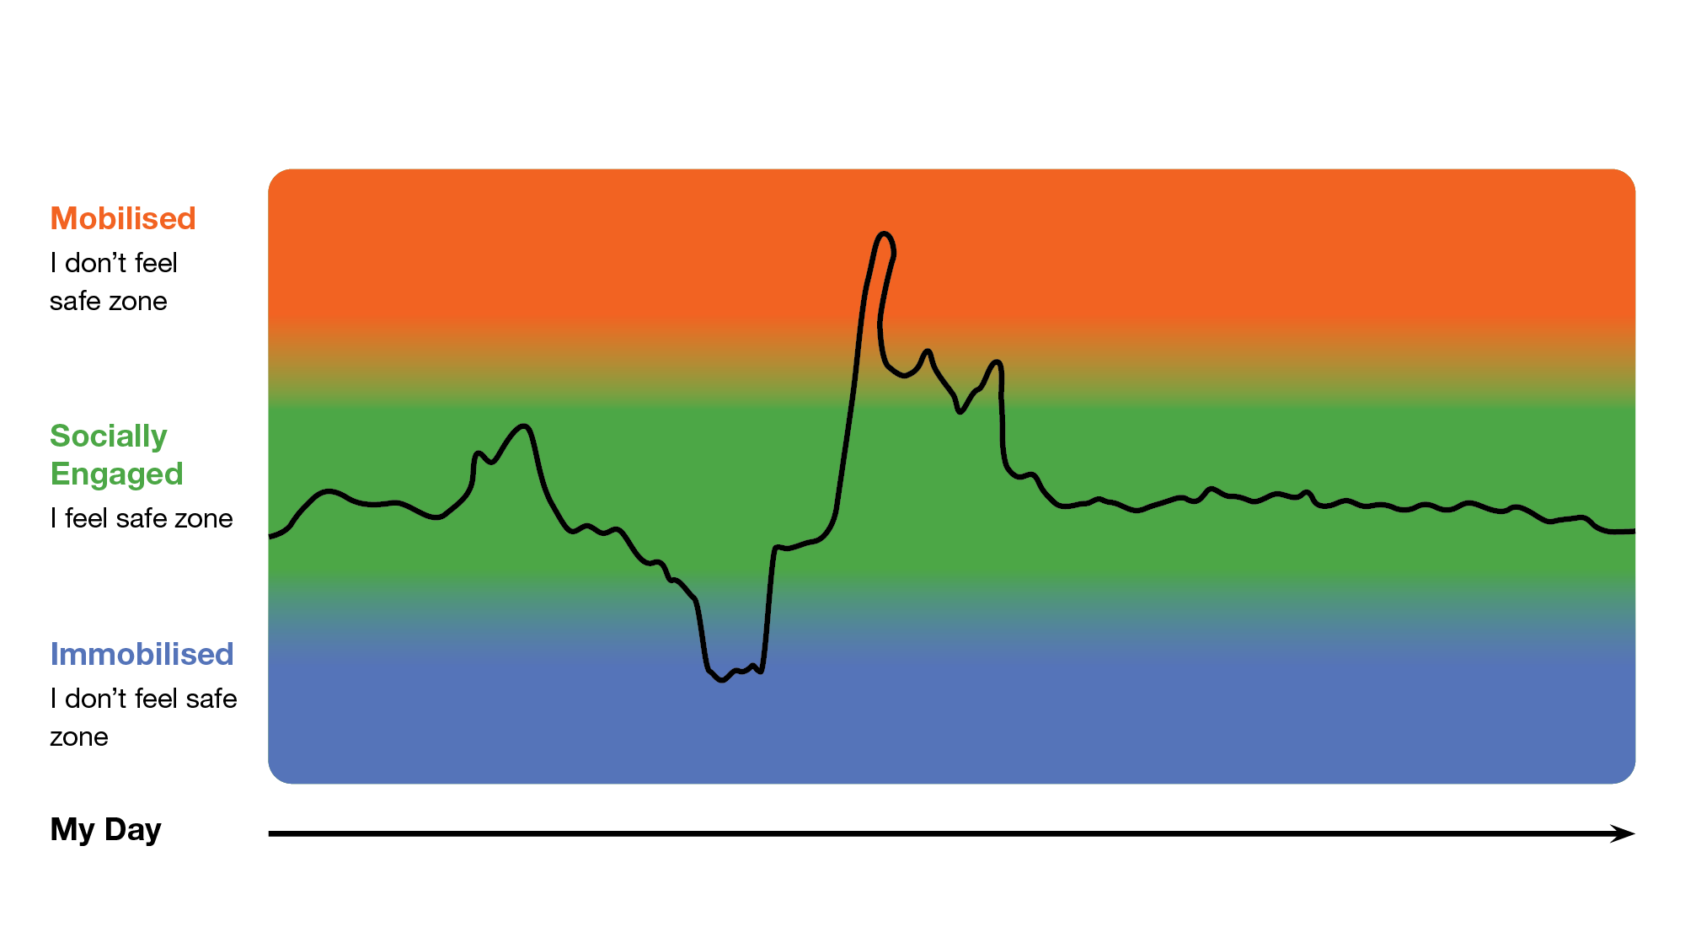
Line of my day activity
Notes:
Activity: Line of my day
Mobilised- too much energy in my body – too hot
Socially Engaged- ‘the goldilocks zone’- just right
Immobilised- too little energy moving through my body- too cold

Slide 35
Connected
Children’s relational templates for forming and being in relationships take shape as they grow. They learn what to expect and how to navigate relationships through their experiences of connection with those around them.
We tend to expect things from relationships based on what we have known from past connections.
Strategies to support children as their relational templates continue to develop emphasise relationships with safe and consistent adults and peers as the foundation for healthy, strong social and emotional functioning.
I need to feel like I am connected.
I need to feel safe. I need safe connections in my life.
Notes:
Sian Phillips et al 2021
Bruce Perry 2019
Brain research shows that when we are recognised and awarded the same recognition as others, the reward systems of our brain light up. Conversely, when we expect to be heard and then feel excluded or not heard, there is a significant drop in dopamine levels and we experience something close to physical pain.
When we are left out of an activity, we might perceive it as a threat to our status and relatedness. Research has shown that this response can stimulate the same region of the brain as physical pain. In other words, our brain is sending out the signal that we're in danger: we experience social pain in the same region of the brain as physical pain.
Humans are social animals and our brains are geared to connect. As we relate more easily with people we perceive as similar, great teachers are those who make a conscious effort to create positive connections in every interaction. They avoid making assumptions about students and stay curious and open with each student.
They also focus on building trust, creating safety and enhancing the neurobioly development
If connected The student feels safe and connected co-regulation occurs

Slide 36
Connected
Relational Safety
Safety occurs in relationships that support physiological growth and renewal
It is integrated into stories of meaning that offer predictability, security and stability
It is connected with memories of family and home and experiences of strength love and nurture.
It ritualises care and empathy
“ Safety and healing gives us back to ourselves. Not to hide or fight any more. But to sit still calm our minds, listen to the universe and allow our spirits to dance on the wind. It lets us enjoy the sunshine and be bathed by the golden glow of the moon as we drift into our dreamtime… Safety in relationships gives us back to our country. To stand once again in our rightful place, eternal and generational. It keeps us strong and gentle at the same time.”
Helen Milroy (2018)
Notes:
Invitation to talk about how kids can grow I the classroom
Intersubjective meaning making/connection
Meeting the needs
Sian Phillips et al 2021
Bruce Perry 2019
•Traumatised Student and y/people develop insecure and unstable templates for forming and being in relationships.
•
•They have distorted or confusing internal maps to help them navigate intimacy.
•
•They avoid engaging fully in relationships for fear of being hurt or rejected again.
•
•Strategies to support traumatised Student and young people emphasise relationships with safe and consistent adults and peers as the foundation for change.
Attuned listening activity A and B groups or a mirroring activity
Brain research shows that when we are recognised and awarded the same recognition as others, the reward systems of our brain light up. Conversely, when we expect to be heard and then feel excluded or not heard, there is a significant drop in dopamine levels and we experience something close to physical pain.
When we are left out of an activity, we might perceive it as a threat to our status and relatedness. Research has shown that this response can stimulate the same region of the brain as physical pain. In other words, our brain is sending out the signal that we're in danger: we experience social pain in the same region of the brain as physical pain.
Humans are social animals and our brains are geared to connect. As we relate more easily with people we perceive as similar, great teachers are those who make a conscious effort to create positive connections in every interaction. They avoid making assumptions about students and stay curious and open with each student.
They also focus on building trust, creating safety and enhancing the neurobioly development
Mirror neurons -Mirror neurons can be defined as a group of neurons that activate when we perform an action or when we see an action being performed. Mirror neurons are essential for imitation which is key in the learning process. “I see you.” “I am here”
If connected The student feels safe and connected
Co-regulation occurs
A feeling of connectedness is what you get when you feel like you belong in a group, when you are with others of your
Mirror neurons –eye contact
Attuned listening.

Slide 37
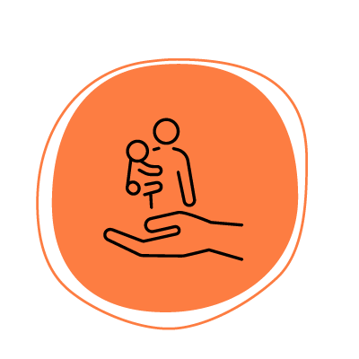
Connected
Safety is a central whilst complex concept in this training. It holds a range of meanings for us and for the children, families and communities that we work with What does a safe space feel like for you? How do you inhabit it? What do you bring to it to make it feel safe? What/ who else is inside the space that contributes to the safe nature of it?

Slide 38
Connected
What is Relational Safety in the classroom?
Accompaniment is an experience for a child that offers emotional reciprocity, validation, care and comfort. In this experience they feel heard, met, felt and understood.
“ Children internalise the people who understand and comfort them, so that they often have the felt sense of accompaniment when they are alone.”
Bonnie Badenoch
Notes:
WHAT IS RELATIONAL SAFETY IN CLASSROOM
It doesn’t just have to be the teacher…
Share meaning making experiences
Understanding that the challenging behaviors result from their specific vulnerabilities and needs
Focusing on and amplifying the child's strengths and talents
Using consistent and positive reinforcement

Slide 39
Enabled
Engaging students in the process of understanding themselves can build social and emotional learning.
When students know about their qualities, their attributes and their talents they can feel good about themselves.
Knowing about their own special story helps students to build a coherent self-narrative.
I grow stronger as I learn more about what makes me, me.
Notes:
•Traumatised young people find the process of understanding themselves difficult.
•
•They are challenged in their capacity to identify their feelings, understand them and communicate them to others.
•
•They struggle to piece together a coherent narrative about their qualities, their attributes and their talents.
•
•Strategies for responding to traumatised Student and y/ people in the school context will enable them to make meaning
Learning to observe the young persons non-verbal cues
Contact: verbally contacting what one tracks
Mindfulness: a state of conscious attending to the present moment as it unfolds
Curiosity: an attitude of open mind
Collaboration: getting the child’s collaboration in the process
Understanding truncated orienting and defensive responses
Skills for sequencing arousal in the body as a result of trauma

Slide 40
Today’s Session flow

Slide 41
Circle of Strategies
Notes:
*Separate meaning of Activities and Strategies
Some may be new, some may be an extension of what you already do, some might be old faithfuls
We trust that as a teachers/people working in schools you already have some tools in your tools box. These circles should be encouraging and assist you to understand why they work

Slide 42
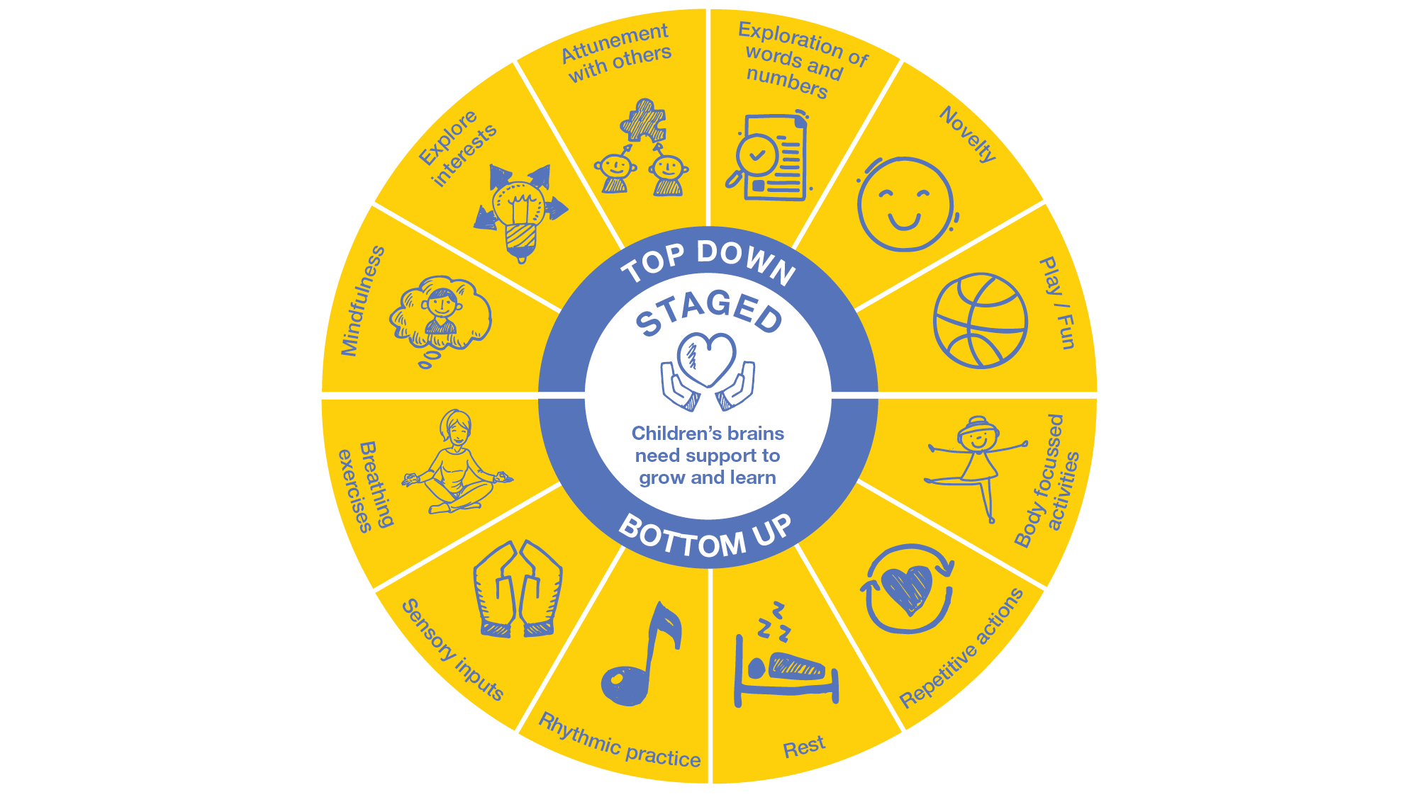
Circle of Strategies: Staged
Notes:
Staged:
Mindfulness:
Sensory check: Something I can hear, touch, taste, smell, see, internal check
Body scan:
Listen to a piece of music for 3-5 mintes in a comfortable position
Explore interests:
Curiously Curiouser – if you could…build anything from lego what would it be?
Share with se an image or story of your interest
Attunment with others:
Hand to Hand activity
Exploration of words and numbers
Acrostic Name poems
My life in numbers
Novelty
Principal or AP for read aloud story- ‘Special Guest’
Class birthday party with cake and streamers
Play/Fun
Knock Knock joke compition
Learning a magic trick together
Breathing Excises
Hot/Cold breathe- shallow and soft vs long and slow
Hand/Snake/Mountain breathing
Sensory Inputs
Variety of seating
Push the wall down/plank competition “personal best time”
Rythmic Practice
Desk drumming
Melodic Mantra for settling into the day, lining up, finishing a task
Rest
20 min reading after lunch
If someone falls asleep let them sleep (?)
Repetitive actions
Body Focused Activities
Brain Breaks
What I’m feeling ‘sensations’

Slide 43
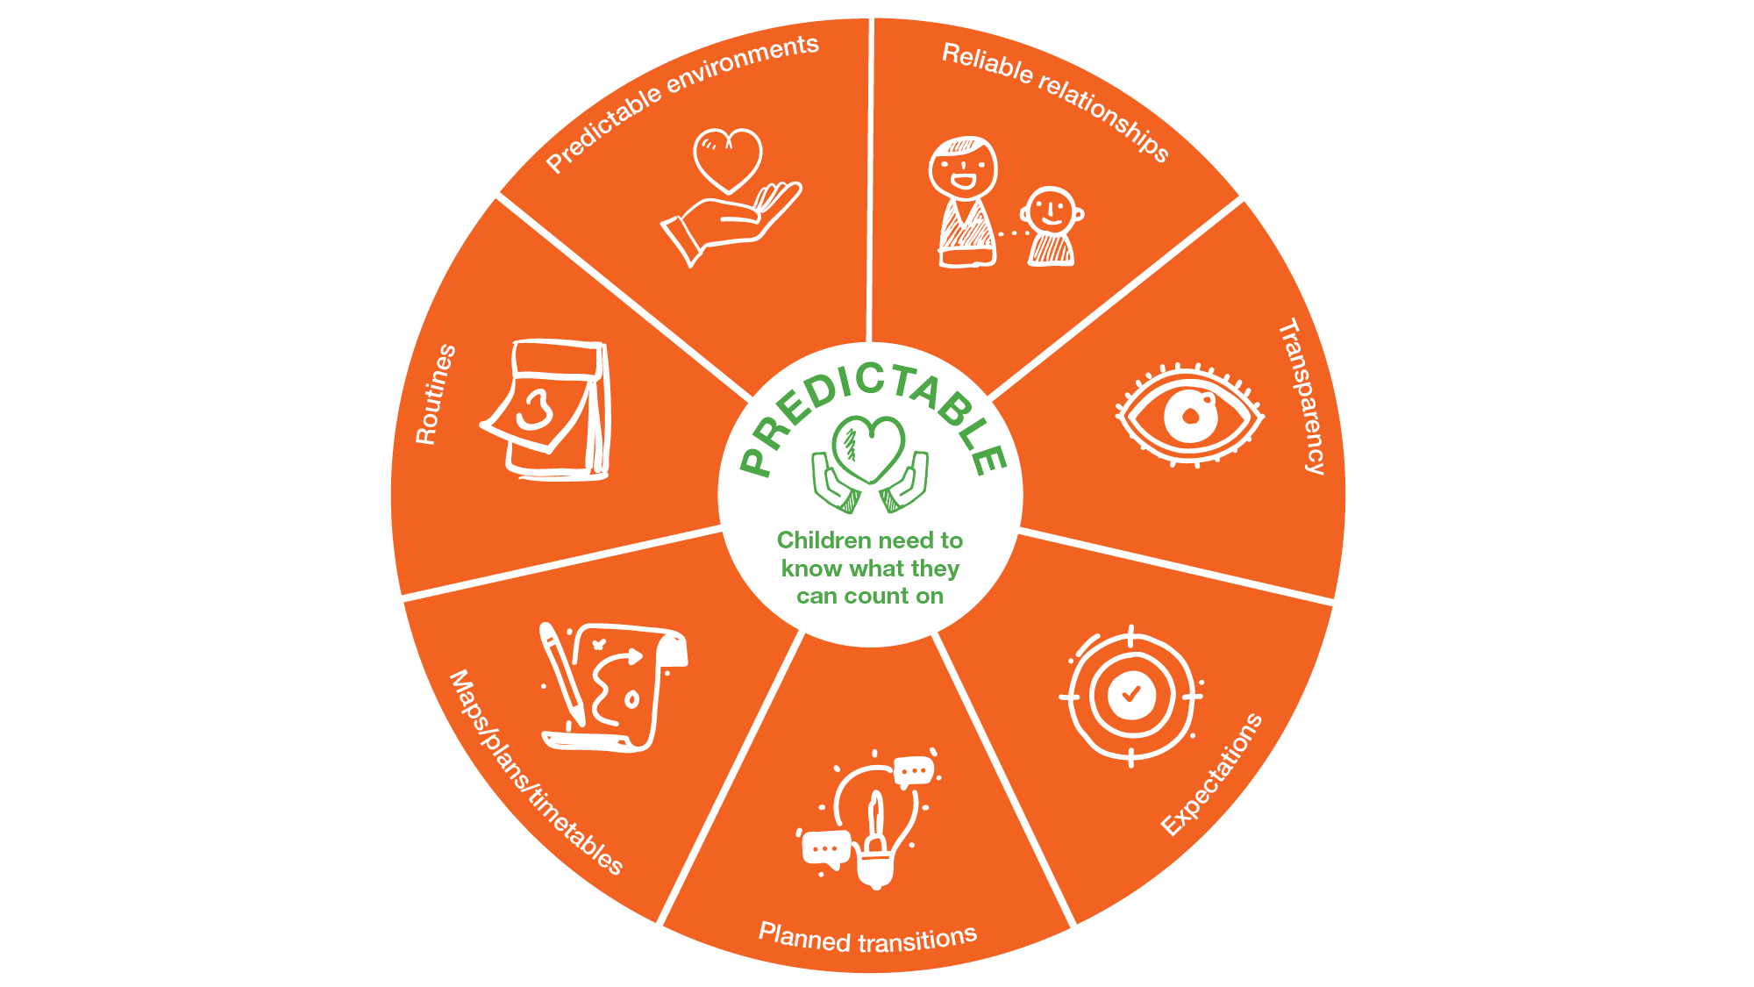
Circle of Strategies: Predictable
Notes:
Predictable:
Routines
Visual schedule
Opening statement- Happy Monday!
Predictable Environments
Reliable Relationships
5 people I can count on
Visuals of who is who and what they do
Transparency
Clear communication
Expectations
Clear and consistent communication
Planned transitions
Maps/plans/timetables

Slide 44
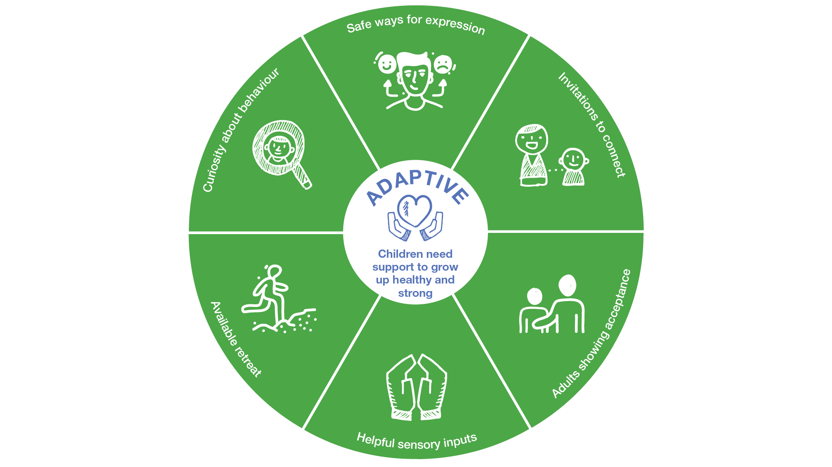
Circle of Strategies: Adaptive
Notes:
Adaptive:
Safe ways for expression
SEL communication
Invitations to connect
Adults showing acceptance
Helpful sensory inputs
Toy or Tool
Available retreat
Where I feel safe in the school
When a student leaves when to they go/run?
Curiosity about behaviour
Anthill/ice berg

Slide 45
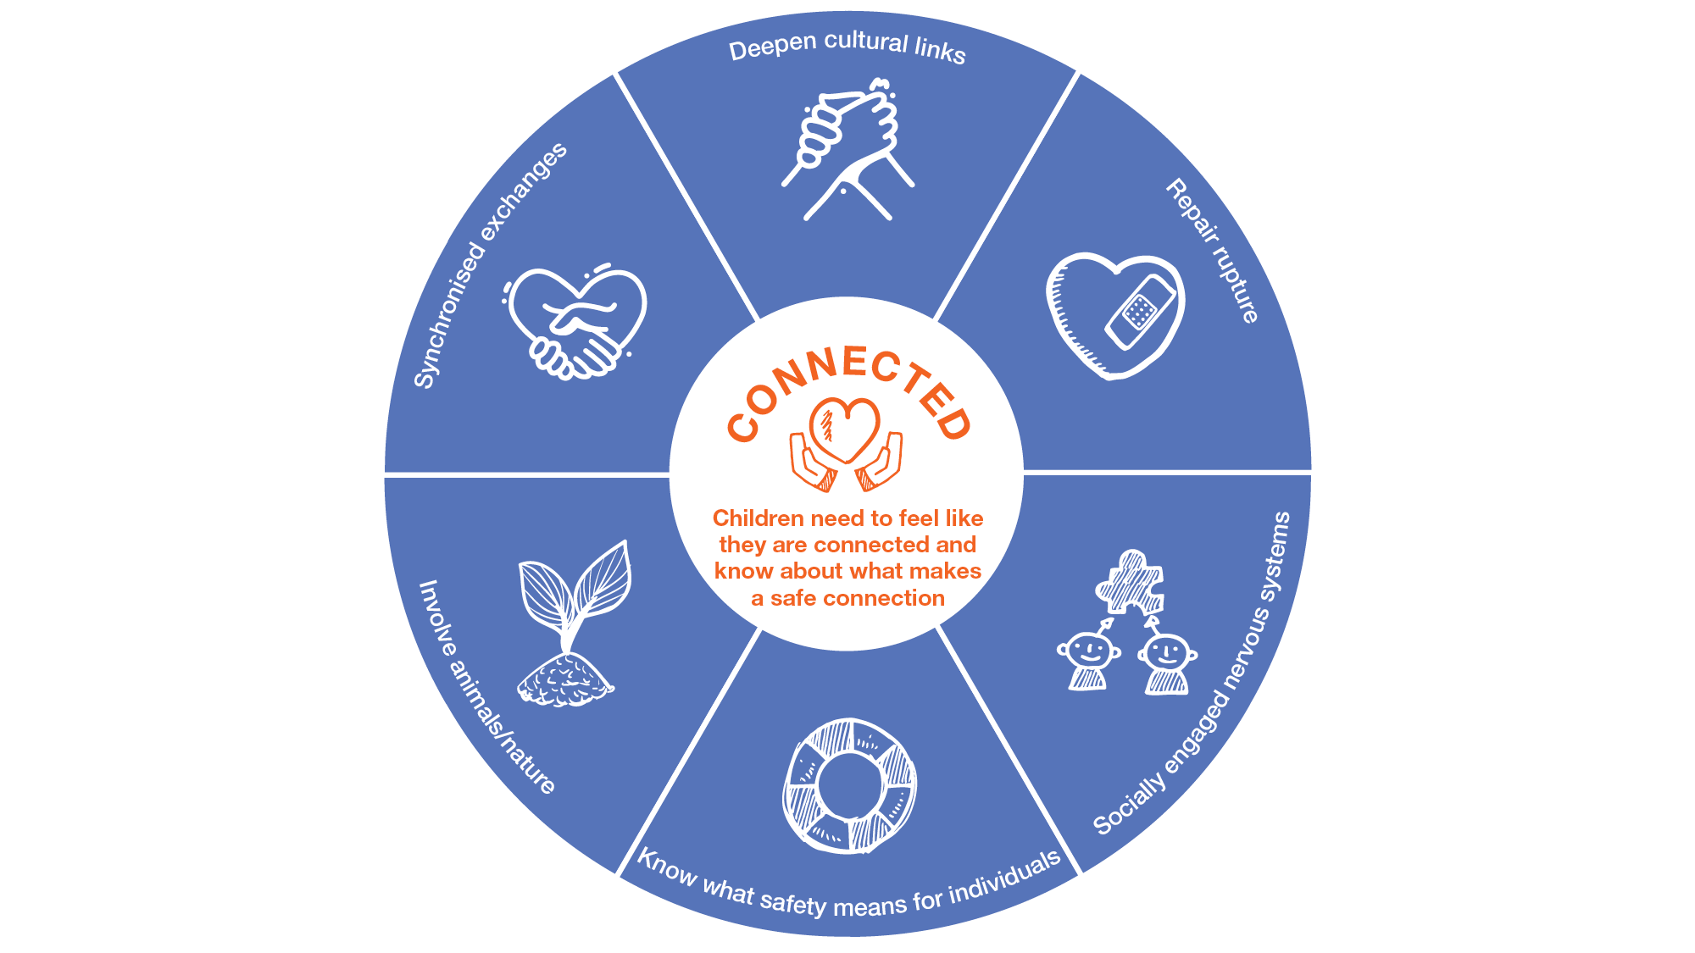
Circle of Strategies: Connected

Slide 46
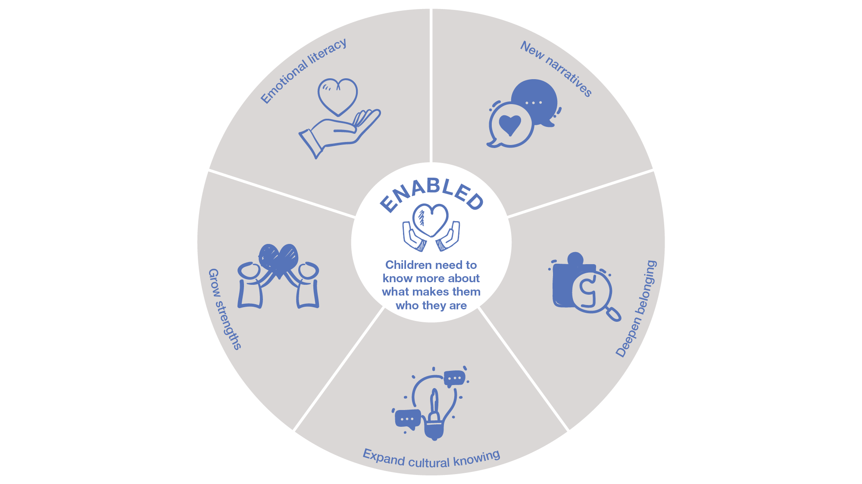
Circle of Strategies: Enabled
Notes:
Reminder at the end – Pages 30-33 of the Trauma informed Practice in Action workbook has a section on teaching practices and strategies. This includes strategies for the classroom and strategies for leadership and student wellbeing teams.

Slide 47
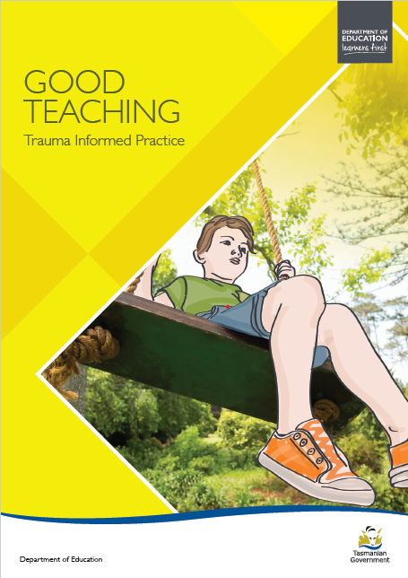
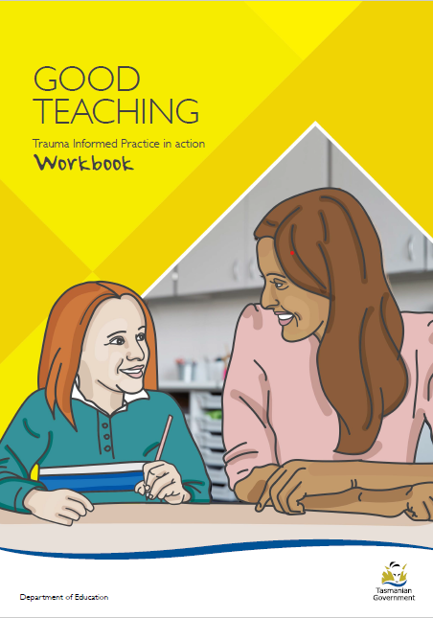
Resources
Notes:
Reminder at the end –
The Trauma informed practice good teaching guide Trauma informed Practice in Action workbook are both excellent resources to support you to use a trauma informed approach in your work. These are available online the link is in the further information slide and will be dropped into the chat. and Pages 30-33 of the Workbook has a section on teaching practices and strategies. This includes strategies for the classroom and strategies for leadership and student wellbeing teams.
The Guide and workbook are available as hard copies available from the Wellbeing unit.

Slide 48
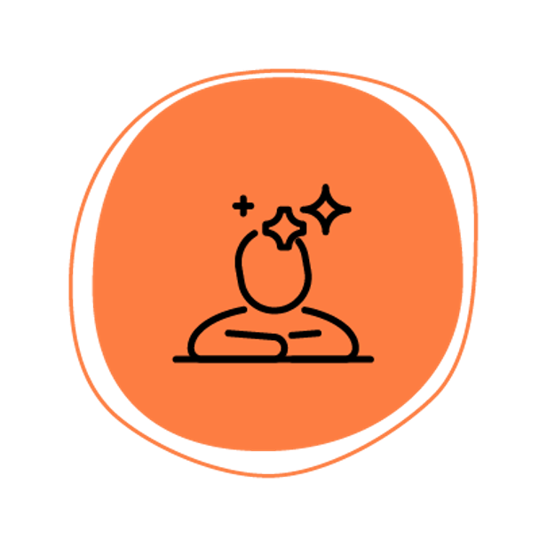
Check out
What are you taking back to your school/site tomorrow?
New perspective?
Strategy?
Activity?

Slide 49
For more information
If you have any further questions about the professional learning program, please contact the Wellbeing Unit at wellbeing.unit@decyp.tas.gov.au
The Employee Assistance Program can also be accessed by calling 1800 650 204 or by emailing admin@newportwildman.com.au
Further information and resources to support trauma informed practice can be found
https://professionals.childhood.org.au/resources/
Or sign up to ACF and you will be able to access even more resources! Training and resources https://professionals.childhood.org.au/professional-community-network/
Key DECYP resources Good Teaching: Trauma Informed Practice Guide and Good Teaching: Trauma Informed Practice in Action Workbook

Slide 50
Evaluation
Please complete the program evaluation using the QR code below.
Notes:
Also drop URL in CHAT
This program is being evaluation by UTAS and the information that is gathered will support the Department in it’s future planning related to this program and how best to support trauma informed practice in schools.

Slide 51
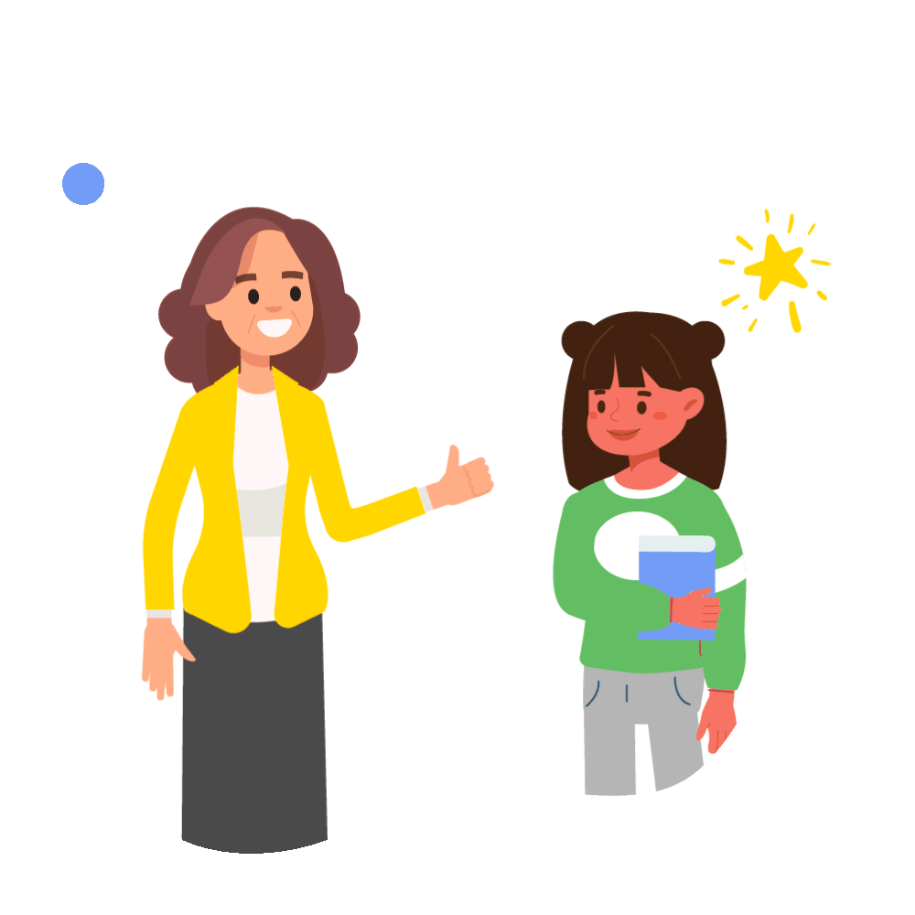
Thank you for your participation today

