Slide 1
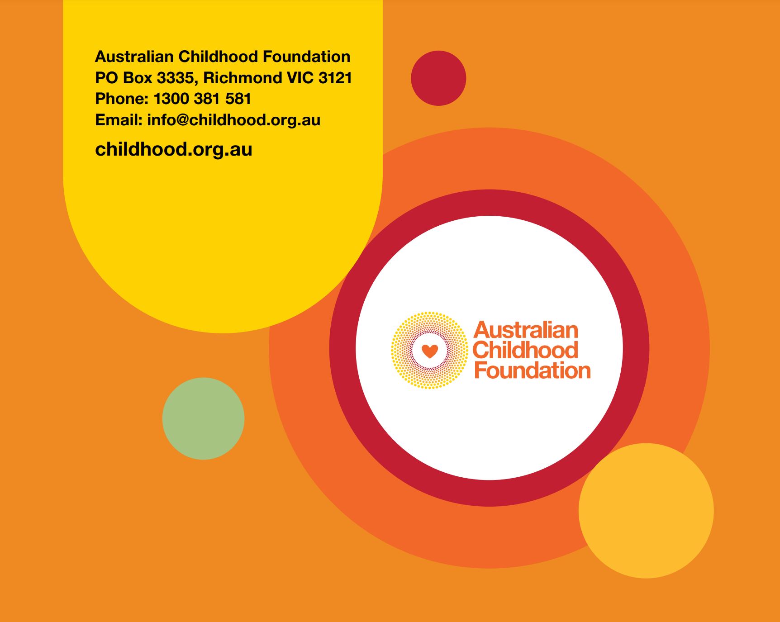
Making SPACE For Learning:
An Introduction to trauma responsive practice in:
Tutor Learning Initiative -Department of Education Victoria .
August 15. 2023
Donna Richards

Slide 2
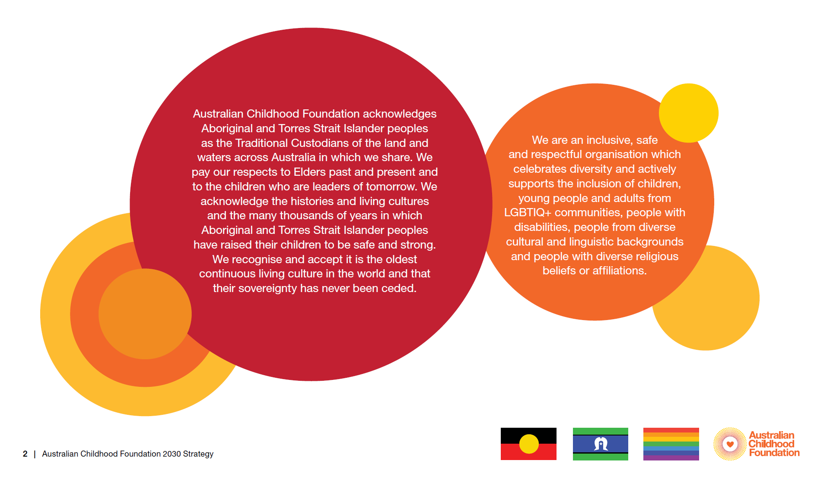
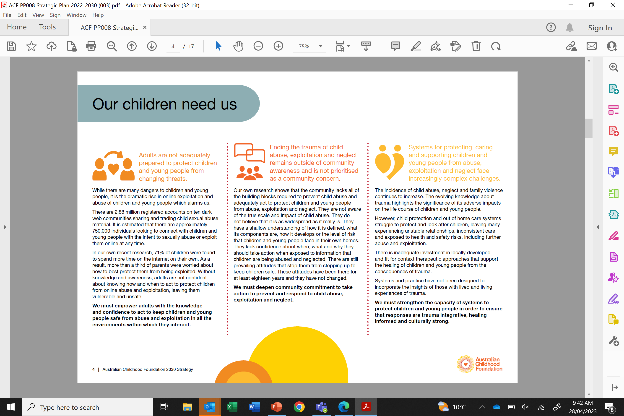

Slide 3
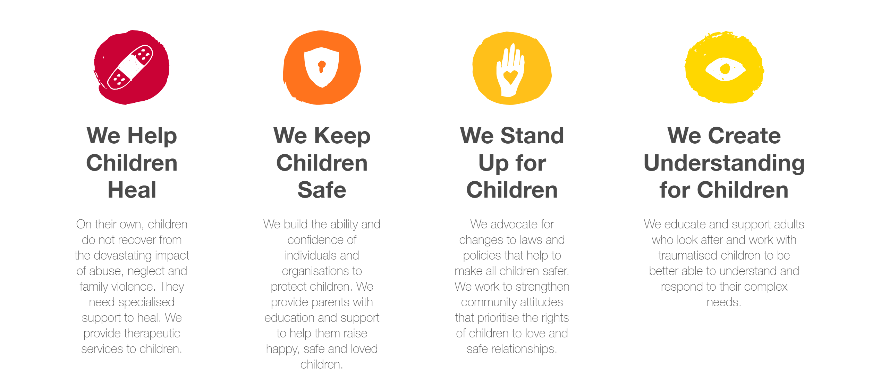
The Australian Childhood Foundation

Slide 4

We acknowledge you….and what you bring….
Knowledge
Practice skills
Experience
Passion
Compassion
A desire to bring about change
Notes:
We acknowledge you! ☺

Slide 5

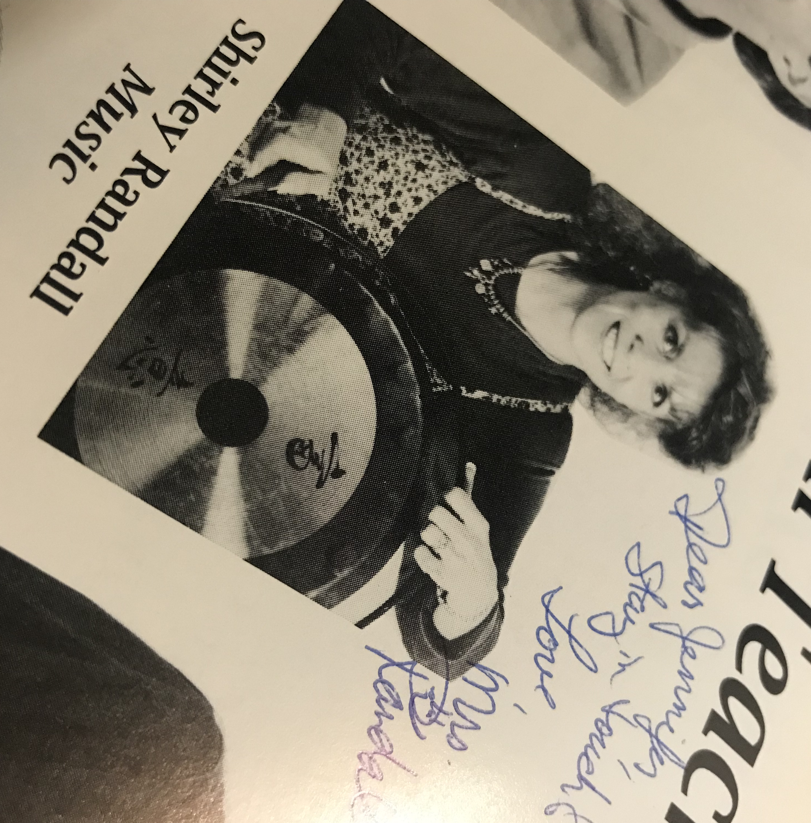

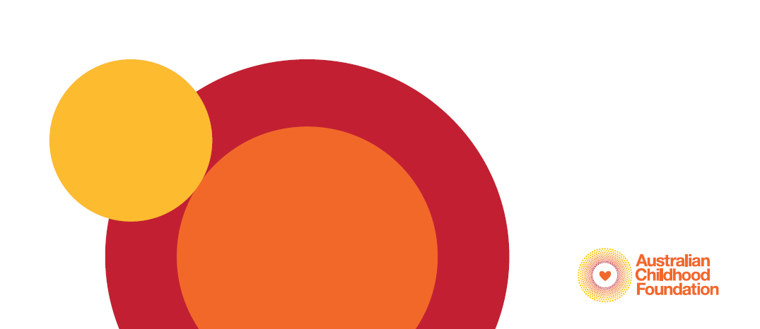
Consider a teacher who taught you, and had a positive influence on you...
What do you remember about them?
How did they make you feel?

Slide 6
SPACE is the central acronym of the program. It includes 5 domains to help educators better understand the needs of children who have experienced trauma and ways to support them in the educational setting.
Notes:
Linger here and define each area

Slide 7
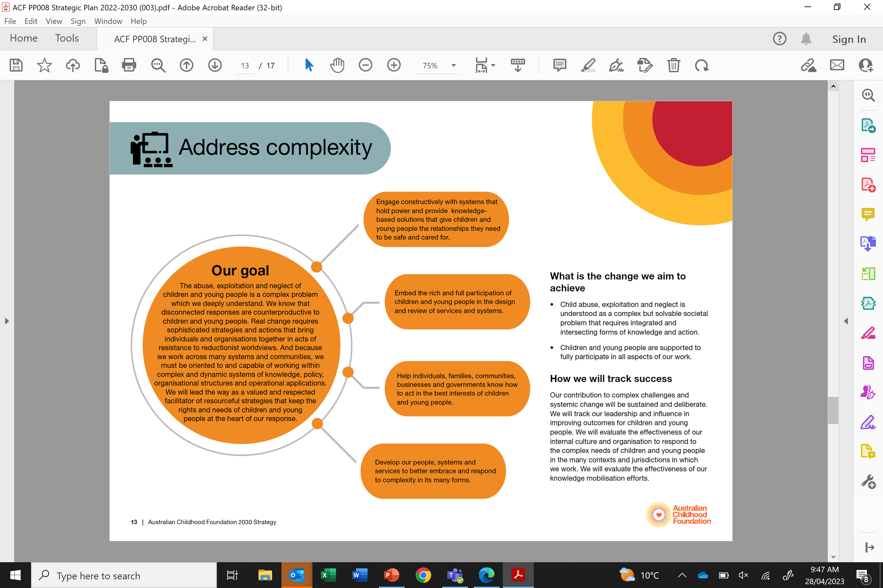
What is Trauma?
Trauma is the emotional, psychological and physiological
reactions caused by the prolonged and overwhelming stress that accompanies experiences of abuse, neglect and family violence.
The trauma that results from experiences of abuse, neglect or family violence is often called complex trauma or developmental trauma.
This type of trauma occurs in the context of relationships and is different to the trauma that may be caused by a one-off event such as a car accident or bush fire.
Children and young people are very vulnerable to the effects of trauma because of their brains’ developmental immaturity.
Notes:
https://www.cetc.org.au/wp-content/uploads/2022/07/behaviours-that-challenge-practice-guide.pdf

Slide 8


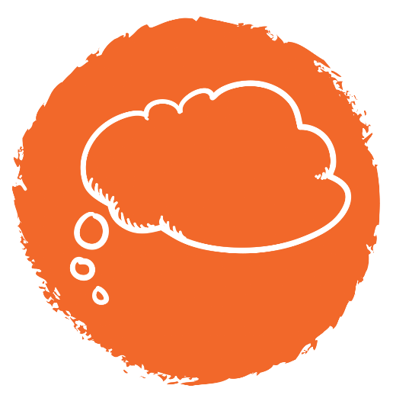
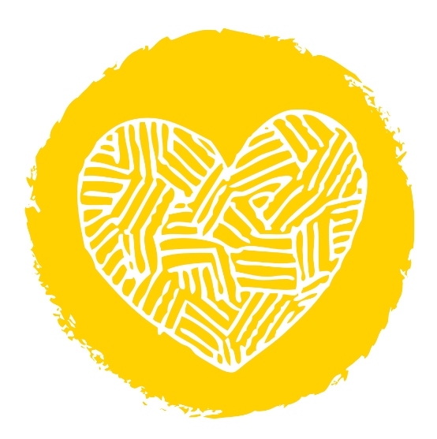
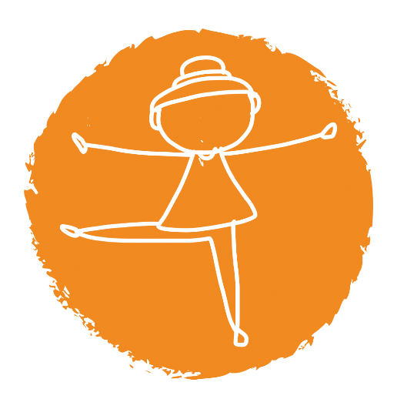
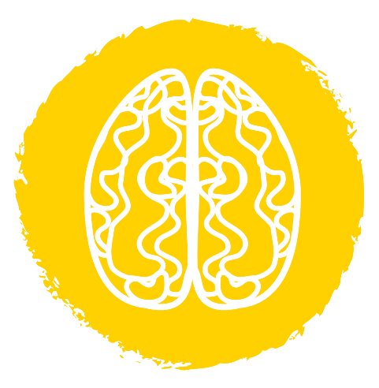
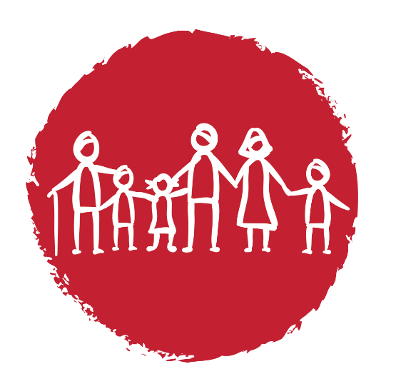
Trauma can impact all elements of Student’s development: brain, body, memory, learning, behaviour, emotions, relationships.
Notes:
Trauma is experienced in children and young people’s thoughts, feelings and bodies. It impacts their relationships with family and friends, their ability to feel good about themselves, their ability to concentrate at school, and their ability to make safe decisions for themselves. It significantly impacts their behaviour. Children and young people’s development can slow down or be impaired following trauma. Trauma can often lead to them developing in some areas and not in others. Even after the risks or danger is no longer present, children and young people cannot move on and forget what has happened to them.
Their brains and bodies continue to react as if the stress or trauma is still continuing. They can experience the consequences of this is in all aspects of their lives on a daily basis.

Slide 9
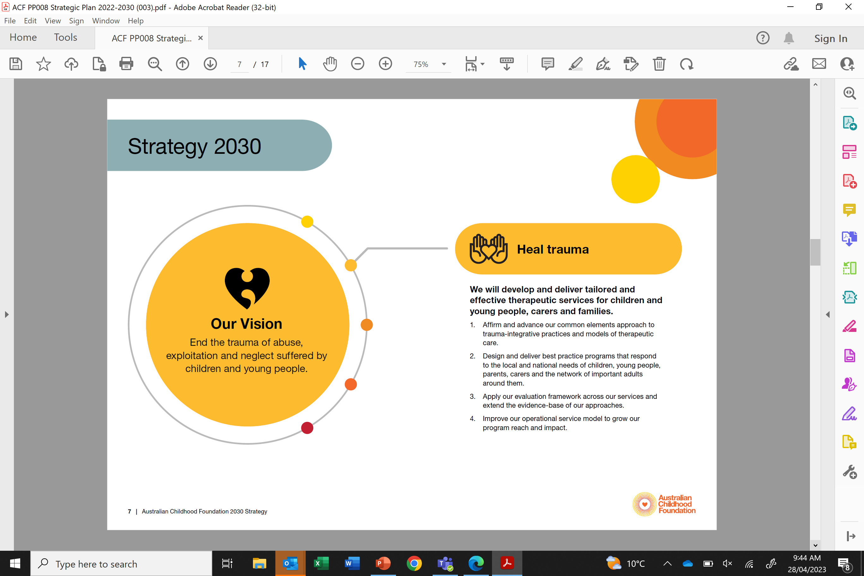
Trauma and needs
The residue of trauma becomes an experience of unmet needs for children.
Children are left with needs that in the moment of hurt, pain and fear are unfulfilled. These needs stay activated ready for available relationships to respond to them, see them and gradually help them to be met.
These needs are physiological, developmental, and interpersonal, requiring relational investment and presence in order to be resolved
“ It is like they are on a loop hoping that their needs for safety, attention and validation that were not fulfilled will eventually find at least one relationship in the present that meets these needs consistently over time “ Joe Tucci
Notes:
What is trauma?

Slide 10
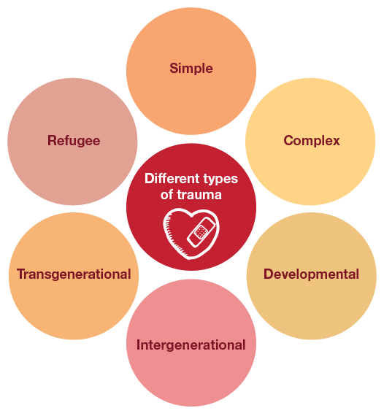
Experiences of trauma and impacts
Notes:
What is trauma?
Defining trauma
Trauma is:
any single, ongoing or cumulative experience which is a response to a perceived threat that overwhelms the individual’s capacity to cope. It induces a range of fear or avoidance-based physiological and psychological responses (Australian Childhood Foundation, 2020).
an experience of real or perceived threat to life, bodily integrity and/or sense of self. The impacts of trauma can be cumulative across the lifespan (Mental Health Coordinating Council (MHCC), 2013).
Types of trauma
Single event trauma: is related to a single, unexpected event e.g. physical or sexual assault, accident, natural disaster, or serious illness or injury (Orygen, 2018).
Developmental trauma: results from early, ongoing or repetitive trauma and loss, which happens within the child’s important relationships. There are seven areas impacted by Developmental trauma – sensory development, dissociation, attachment development, emotional regulation, cognition, and self-concept and identity development (Lyons et al., 2020).
Complex trauma: is related to prolonged or ongoing traumatic experiences such as family violence, bullying, neglect, emotional, physical or sexual abuse, or torture (Orygen, 2018).
Transgenerational trauma: is the transference of emotional, physical or social pain from one person to their descendants (epigenetics).
Intergenerational trauma: is the transmission of historical oppression and its’ negative consequences between generations. This is evident among Aboriginal and Torres Strait Islander families and communities (Queensland Government, 2019).
Orygen (2018). Trauma and mental health in young people: Let’s the facts straight. https://www.orygen.org.au/Training/Resources/Trauma/Mythbusters/Trauma-mh-yp/Trauma_and_MH_in_YP_Mythbuster?ext=.
Lyons, S., Whyte, K., Stephens, R., & Townsend, H. (2020). Developmental Trauma: Close up. https://beaconhouse.org.uk/wp-content/uploads/2020/02/Developmental-Trauma-Close-Up-Revised-Jan-2020.pdf
Mental Health Coordinating Council (MHCC) 2013, Trauma-Informed Care and Practice: Towards a cultural shift in policy reform across mental health and human services in Australia, A National Strategic Direction, Position Paper and Recommendations of the National Trauma-Informed Care and Practice Advisory Working Group, Authors: Bateman, J & Henderson, C (MHCC) Kezelman, C (Adults Surviving Child Abuse, ASCA). http://mhcc.org.au/wp-content/uploads/2018/05/ticp_awg_position_paper__v_44_final___07_11_13-1.pdf
Mental Health Coordinating Council (2018). A guide to recovery oriented language in mental health and human services. https://mhcc.org.au/wp-content/uploads/2022/07/Recovery-Oriented-Language-Guide-Mental-Health-Coordinating-Council-2022.pdf
Queensland Government (2019). Trauma-Informed Care and Practice: A Guide to working well with Aboriginal and Torres Strait Islander peoples. file:///C:/Users/e4103601/Downloads/49132-20-trauma-20-informed-20-guidelines-202pdf.pdf

Slide 11
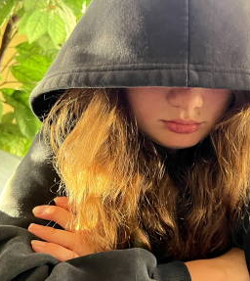
Embodied Trauma
It is important that we understand the deep connection between the body, the brain and trauma.
Our implicit memory can make us feel the sensations of trauma long after the trauma has occurred.
Students may struggle to remain in the present ‘here and now’
Ensure there is a de-escalation plan for students to help them recover from their distress within relationship.

Slide 12
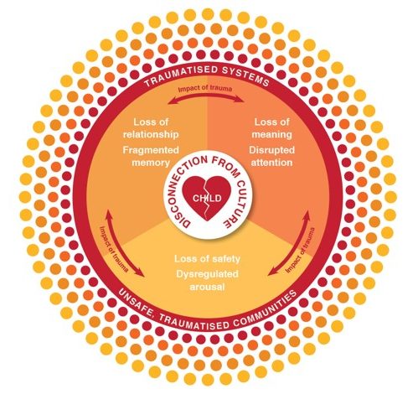
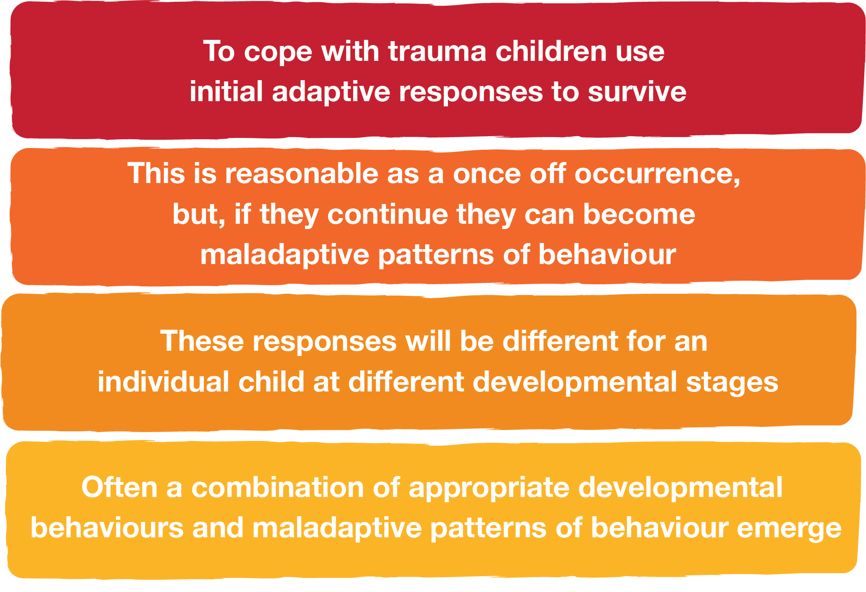
Effects of trauma on behaviour

Slide 13
Trauma-based behaviour, in general, serves
important adaptive functions. It often makes sense in
the context in which it first emerged. However, it can
become counterproductive if it continues after the
need for it has changed.
Comfort Seeking
Seeking connection
Self-Protection
What feelings are under the behaviour?
What needs are under the behaviour?
Notes:
Behaviour & Learning
When a student is feeling ‘unsafe’ and feeling a sense of powerlessness, we may see:
Aggression
Overactive stress responses
Withdrawal
Agitation
Tiredness due to lack of sleep
Loss of fine motor skills
Emily : class given 4 step process she remembers up to three then decides to chat with her class mates.
Behaviour Effects such as hyperactivity, poor impulse control, demanding, attention seeking, violence, oppositional behaviour, difficulty following rules, stealing, hoarding, self-harm, overly compliant, eating problems, sleep disturbances, maladaptive self-soothing, substance abuse
Cognitive Effects such as lack of curiosity, learning disabilities, language difficulties, problems with executive functioning, problem solving difficulties
-Attention and memory
-social skills
We will look at this more closely next session when we explore SPACE
the Department for Education Behaviour Support Policy (2020) is the main document referenced. It states, ‘complex and unsafe behaviours that are severe, of high frequency or extended duration, or are unsafe for a child or young person and those around them. Behaviours at this end of the continuum require intensive and individualised interventions in addition to targeted and universal strategies’. This is an indicator that the young person needs support, rather than seeing a suspension as punitive, the reconnection meeting provides an avenue to work in partnership with the student and family to provide support, and set goals moving forward. Reconnection meetings are a useful tool to involve families with whom we struggle to be in regular contact with. Other Department for Education protocols considered in this ethical dilemma were the Wellbeing for Learning and Life Framework which has safety as one of its six core principles and a strengths-based approach and the Protective Practice Guidelines, supporting leadership to work as a team and make the complex issues ‘public.
South Australian Department for Education. (2010) Sexual Behaviour in Children and Young People: Procedure and Guideline. Retrieved from Sexual behaviour in children and young people procedure and guideline (edi.sa.edu.au). (4th Edition, revised 2022)
South Australian Department for Education. (2017). Protective Practices for Staff in their Interactions with Children and Young People: Guidelines for Staff Working or Volunteering in Education and Care Settings. Retrieved from Protective practices for staff in their interactions with children and young people guidelines for staff working or volunteering in education or care settings (edi.sa.edu.au). (2nd Edition, revised 2019)
South Australian Department for Education. (2020). Behaviour Support Policy. Retrieved from Behaviour support policy (edi.sa.edu.au)

Slide 14
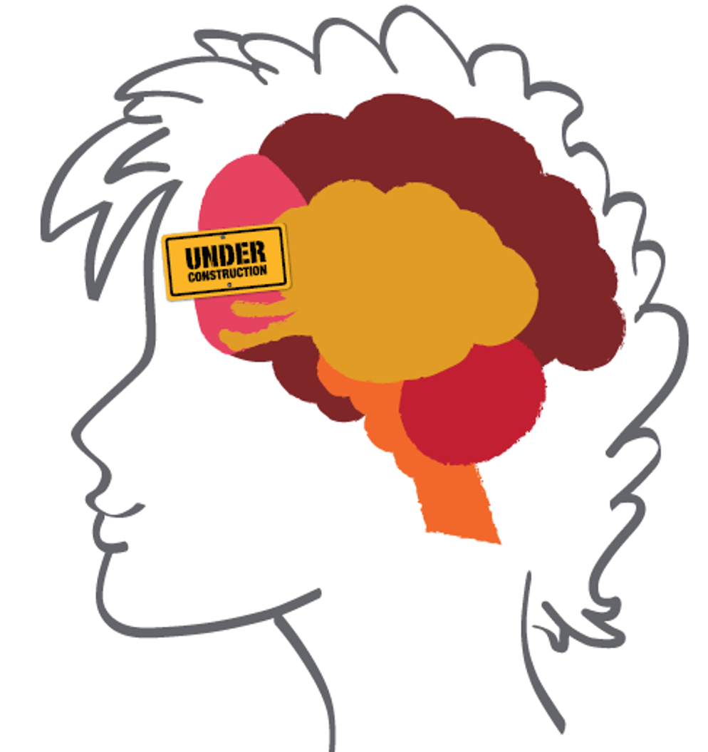
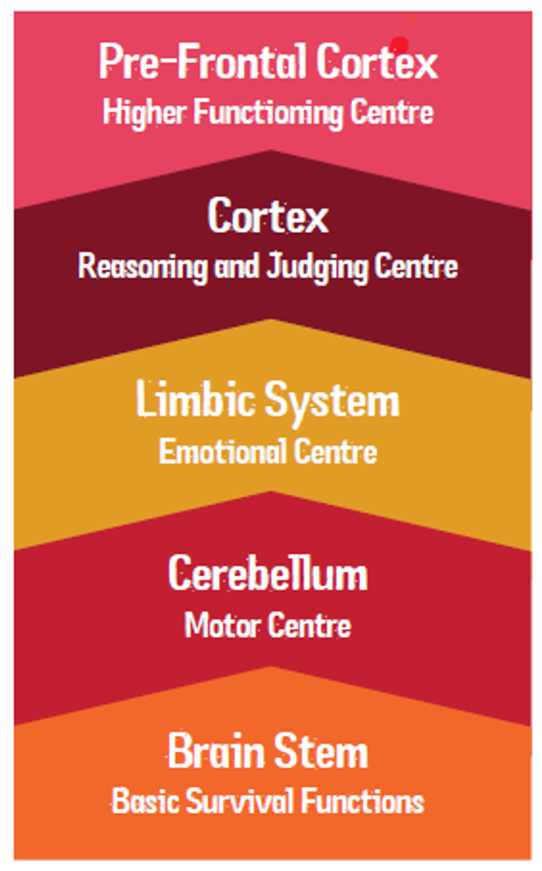
Brain development
Notes:
The adolescent brain is different from the brain of a younger child, and different from an adult brain. The last area of the brain to develop fully, is the front section of the cortex- the Pre-Frontal Cortex, situated just behind the forehead. This activity is the opportunity to explore how the pre-frontal cortex develops in adolescence (refer to the handout).
N cx
3 x videos provided in manual to support the conversation on this topic.

Slide 15
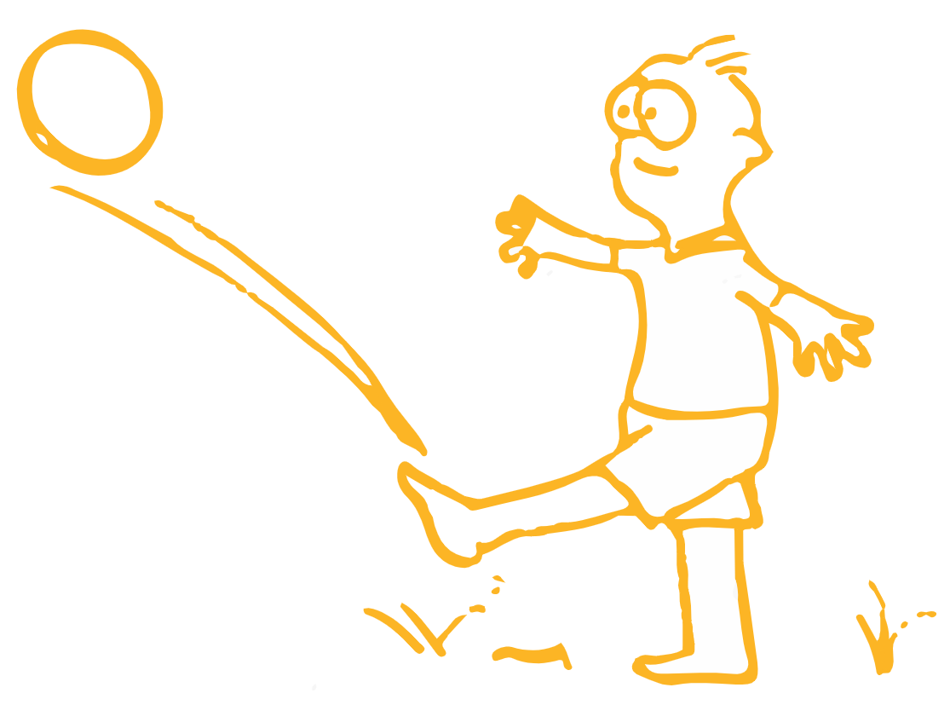
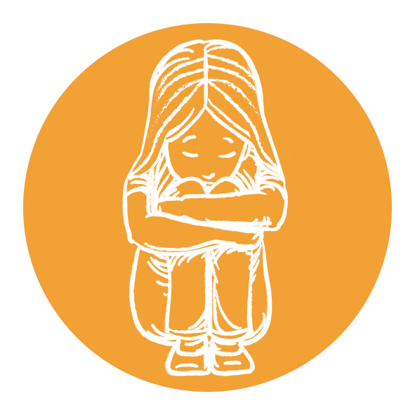
Survival
Our brain's 1st priority is to survive. Responding to a perceived threat initiates an immediate whole-body experience where we either:
Seek relationship (most advanced)
Fight, flight, actively freeze (Mobilise)
Flop (Immobilise)
During this time, the cortex and hippocampus are offline. We are not able to 'consciously think', we are in the moment and reactive.
During this time, we are terrified, uncontained and disconnected from our body.

Slide 16
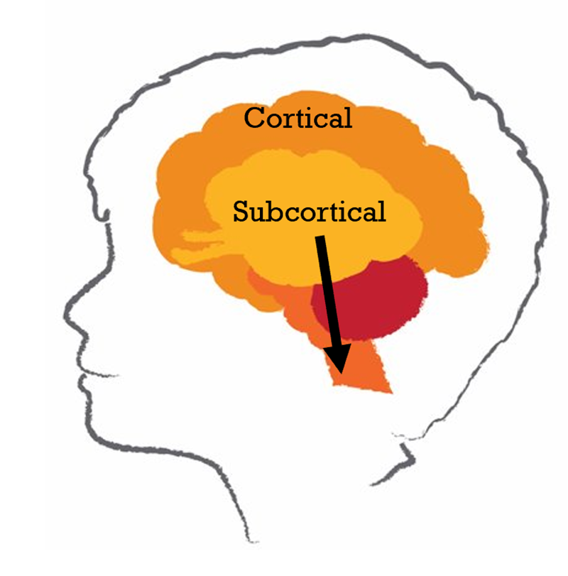
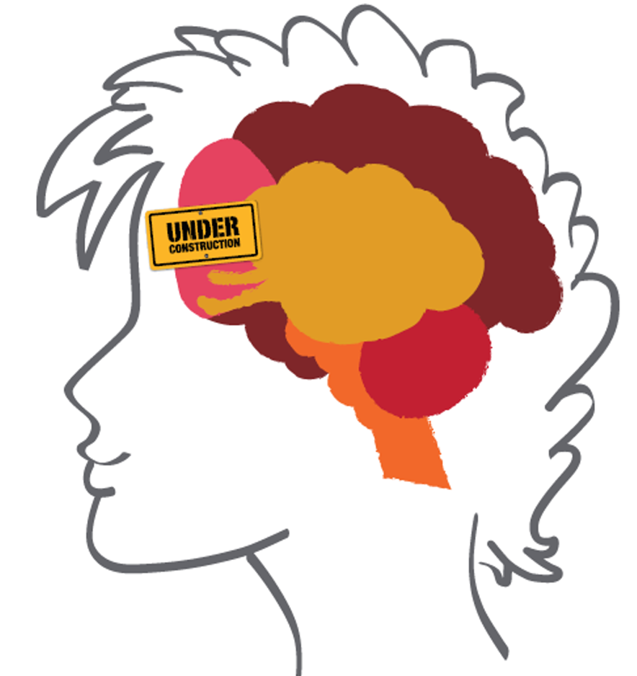

Cortical
Consciously activated for reflection
Responsive
CORTICAL
SUBCORTICAL
Subcortical
Unconsciously activated for constant survival
Reactive
Notes:
CORTICAL
Key to human advancement.
Unlike other species we have the ability to mitigate our basic evolutionary motivations through conscious reflection.
The cortex offers us the advancement of reflection to mitigate basic drives/ motivations
Mindfulness and the ability to be aware of our impact/ perception = compassion
Consciously activated for reflection

Slide 17
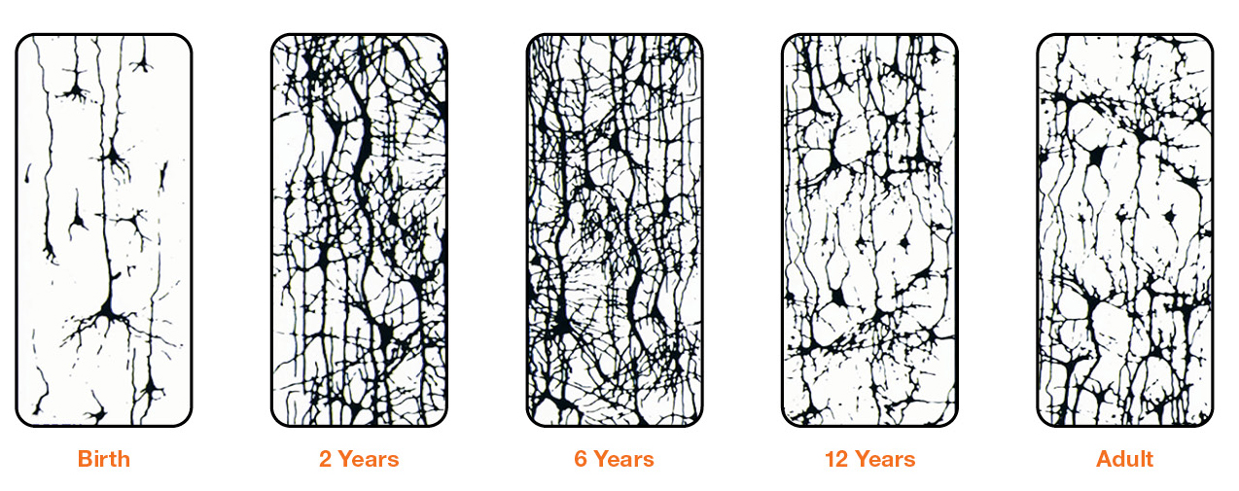
Life span development
Image source: ©2022 ACF
Notes:
Neurons – cells in our brain interact and communicate with other neurons
The neural system has the ability for one neuron to communicate with up to 10,000 other neurons
The newborn brain has approximately
100 billion neurons
What builds our neuronal connections?
Get participants to think about what might build our neuronal connections.
Consider the importance of repeated, supportive experiences.
Activities
Wool neuronal network activity – you will need a ball or balls of wool.
Squeeze activity
(see activity sheets in the folder)
Check with COVID restrictions – use sanitizer!
ACRONYMN Activity
Ask participants to come up with an acronym that explains what babies, children and young people need the most for optimal brain developments and physical, emotional, social and relational development?
The acronym should answer complete the statement: “Every child (baby etc.) needs…..”
Carolyn’s acronym is:
S.O.C.K.S
S- Safety
O- Opportunities
C- Connection
K- Kindness
S- Support
Provide paper and markers to do this activity
Additional information
The neuron is a single cell, composed of four primary parts: the nucleus, axon, dendrites and synapses
This neural system has the ability to communicate with up to 10,000 other individual neurons which in turn has the potential to communicate with another 10,000 other neurons
The newborn brain has approximately 100 billion neurons at birth
Neurons interact and communicate with each other to form 1,000 trillion synaptic connections by three years of age
One month after fertilization, the brain is generating 500,000 neurons every minute
Long before birth the developing young person has a full compliment of neurons at 24 weeks of gestation

Slide 18
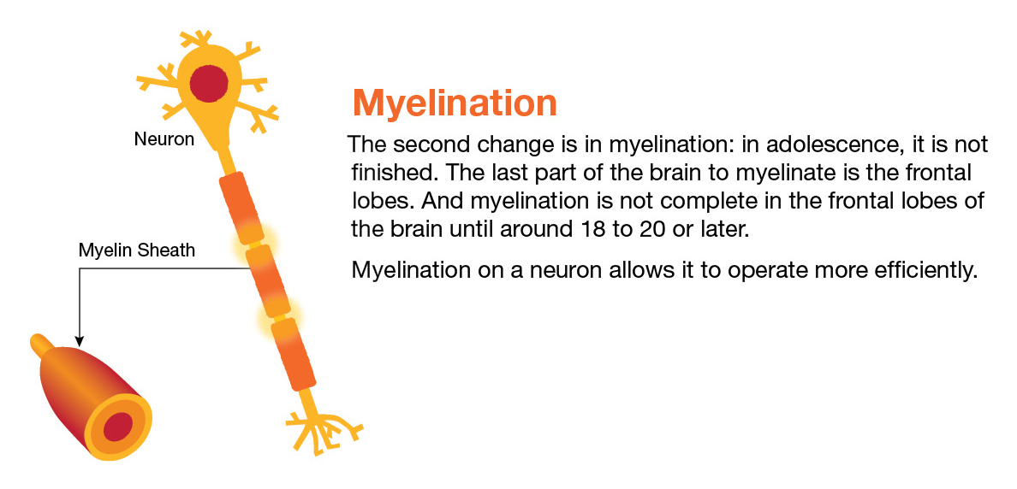
Pruning & myelination in the adolescent brain
Notes:
This is the link to Dan Siegel’s video on The Remodelling Brain: Pruning and Myelination in the Teenage Brain.
https://www.youtube.com/watch?v=jXnyM0ZuKNU
Get participants to watch and reflect on any key learnings.
A good question to ask….how many times more efficient is a myelinated circuit as opposed to an unmyelinated one? How does that translate into reality
Also flag Dan Siegel’s Book “Brainstorm – the Power and Purpose of the Teenage Brain – An Inside-Out Guide to the Emerging Adolescent Mind Ages 12 - 24
There seems to be a general rule that myelin goes where there is action in the brain
Throughout adolescence the part of the brain that young people are learning and practicing to work is the prefrontal cortex which is responsible for abilities like judgement, self regulation, and impulse control
Myelin helps to strengthen these processes by making the connections between the neurons more efficient and stronger
Genetically programmed process
Experientially moulded process
Stress exacerbated process
Compared to adults, young people use different brain structures to make decisions
We know a fully developed pre-frontal cortex curbs impulses coming from other parts of the brain. It is the structure that has final sign off on how we will react in situations. We also know that a teenager does not have full use of this region as it is under developed
Studies have shown that teenagers use local regions of the brain in responding to some tasks while adults whose brains are more integrated recruit regions from different areas of the brain and have them work together when responding to particular situations
Other information about Pruning….
Neuronal pathways can change
Influxes we lay down for life = templates
After this it is harder to learn things.
Process can take up to two years.
Trauma affects this.
Prior to puberty there is a period of synaptic excess in the brain. This spike in synapses is like an explosion of extra work power for the brain. The brain over-produces these connections- some 50% more than will be preserved in adulthood.
This increase occurs in different parts of the brain at different ages: in the frontal lobes, the growth continues until about age 11 in girls and 12 ½ in boys
During this critical period, a young person’s experience determines which of these synapses will be preserved, through pruning of the least useful connections and strengthening (myelination) of the useful ones
A teenager who studies the piano for e.g. will strengthen connections in the auditory and motor part of the brain Another who studies drawing will do the same in the visual cortex
This process is the brain’s way of setting itself up for the future. The brain works out what it thinks a person will want to do in the future by taking note of what they are doing now
In this way, each young person’s brain becomes tuned to meet the challenges of her or his particular environment
A great deal of pruning goes on – brain lets a number of systems go if they are not being use
Brain reaches 90% of its full size by 6 years
Brain undergoes massive reorganisation between 12th and 25th years
Discussion point: Renovation not Construction (e.g. house reno – keep what is still needed, pull out the rest, re-do to suit tailored needs. Some circuits might be affected during the process – e.g. need to use a site toilet temporarily, but not permanently!)
Drives efficiency, tailored to its environment
If goal of remodelling is INTEGRATION how can we help the brain be more integrated?
https://www.youtube.com/watch?v=jXnyM0ZuKNU
Play Dan Siegel’s video – Myelination and Pruning in the Adolescent brain.
Normative Development : Puberty =Hormonally based
Age and Experience = related to pre-frontal cortex development
These different changes are linked to different parts of the brain.
Comment on school situations – US and Germany whereby teenagers starting school later in the day and results in more effective learning and outcomes.
DVD = The Human Mind
Inextricable links.
Adolescence is a remodelling phase of development. Brain is pulling all individual parts into functioning whole.
Genetically programmed process
Experientially moulded process
Stress exacerbated process
Allows areas to be differentiated (fruit salad, not smoothie)
A great deal of pruning goes on – brain lets a number of systems go if they are not being use
Brain reaches 90% of its full size by 6 years
Brain undergoes massive reorganisation between 12th and 25th years
Discussion point: Renovation not Construction (e.g. house reno – keep what is still needed, pull out the rest, re-do to suit tailored needs. Some circuits might be affected during the process – e.g. need to use a site toilet temporarily, but not permanently!)
Drives efficiency, tailored to its environment
If goal of remodelling is INTEGRATION how can we help the brain be more integrated?

Slide 19

What does this mean for our students - the importance of rest and sleep…
Pruning and myelination occur during sleep
Sleep strengthens learning and memories
What impacts our adolescents’ sleep?
Later release of melatonin during adolescence
Lack of safety to sleep well, if at all
Poor sleep hygiene
Use of devices
Notes:
Aadolescents need more sleep than adults or Young people- optimal time being about nine and a half hours
Later starting times for schools show statistically significant impact on academic achievement
Think about

Slide 20
Adolescent brain development
Behaviours associated with an under -developed
pre-frontal cortex:
Short attention span
Impulsivity and increased risk taking
Procrastination (lack of motivation or internal reward systems)
Disorganisation (trouble working through long term goals)
Poor Judgement and problem solving
Reduction in ability to see things from other’s perspective

Slide 21
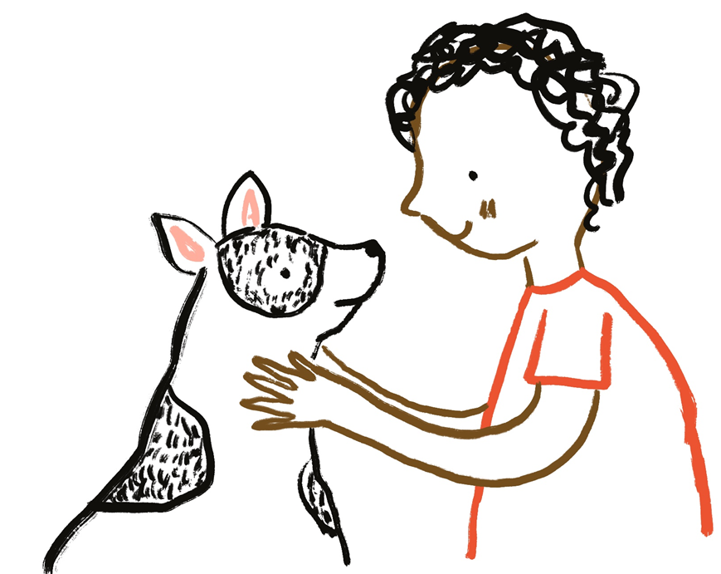
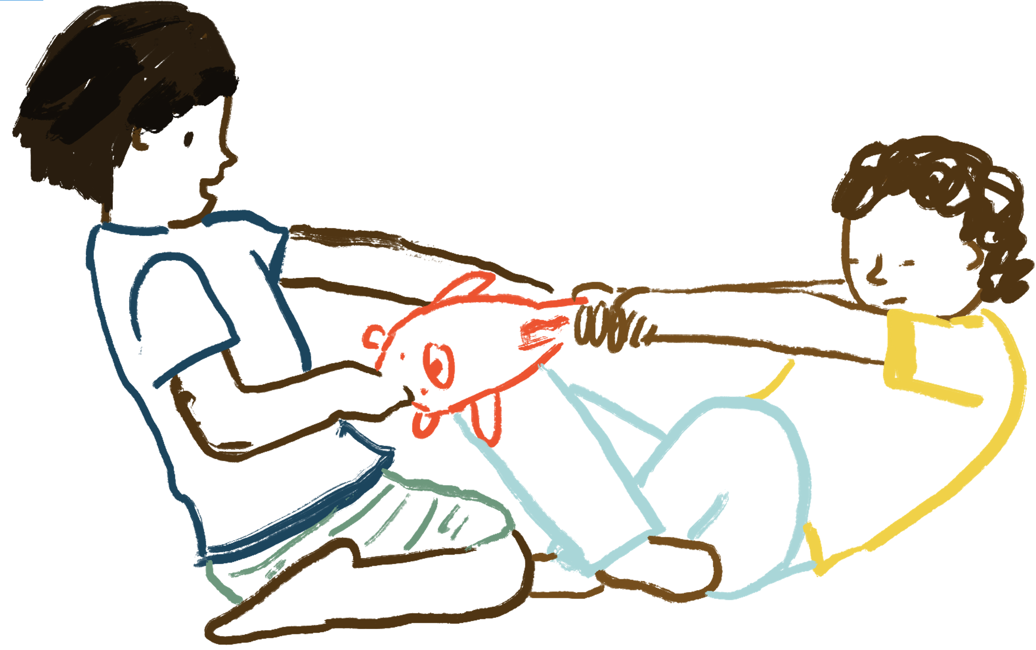
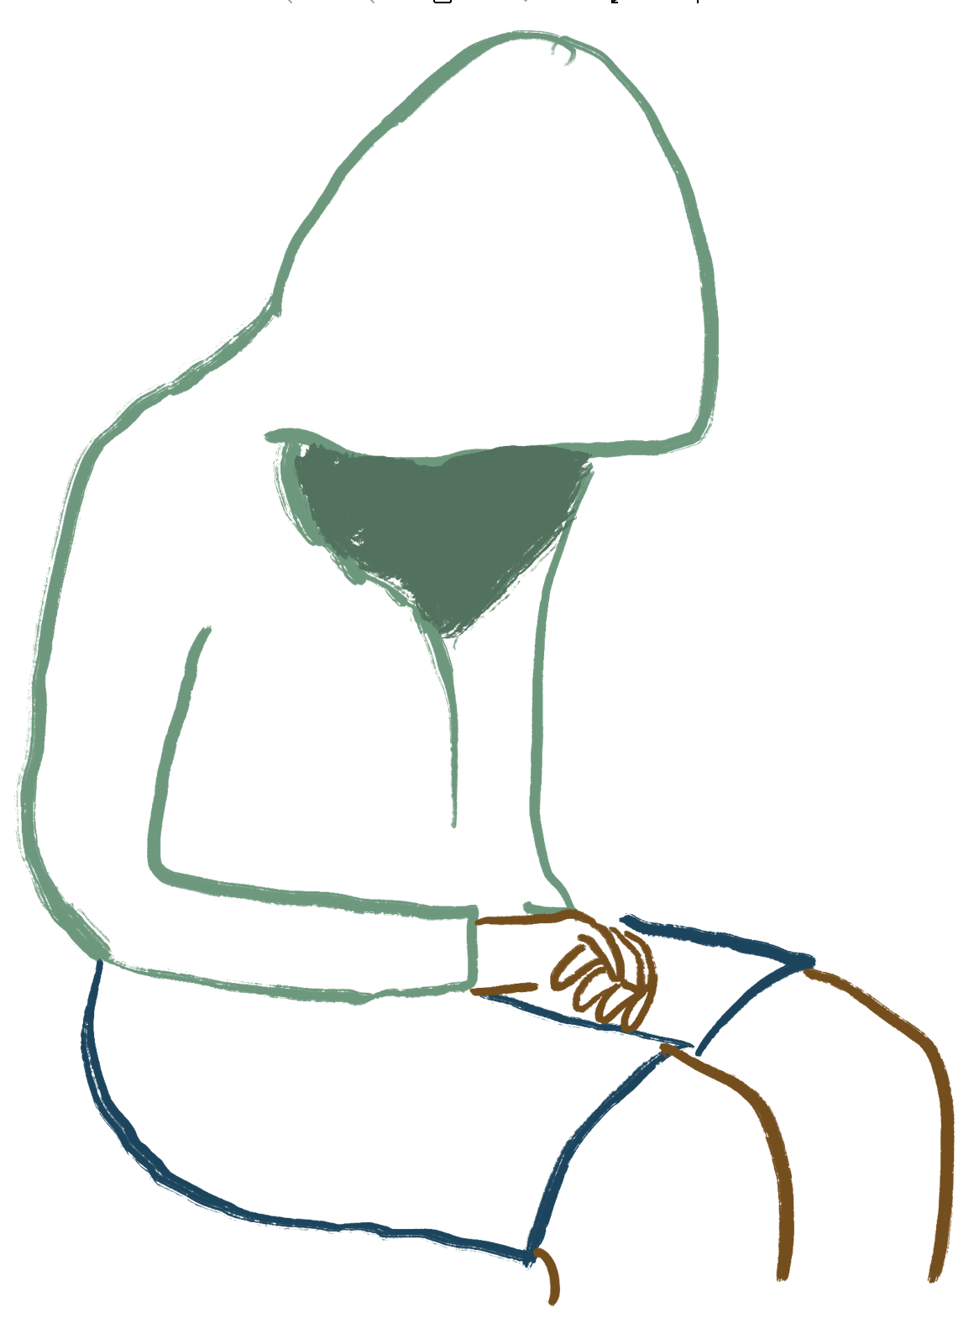
Polyvagal theory and Protective Responses
Notes:
In school context, prime message: optimal learning happens when you can socially engage. The other behaviours we see are adaptive behaviours. Keeping them safe.
Where there’s rupture we need to repair to get the child back to feeling safe. So often the repair happens with assistant principal but then child and teacher back in class together with no repair.
Safety – to sense of self – judgement and shame
The goal of this slide is to describe how Porges Polyvagal Theory helps us to understand the responses we see in Student.
Polyvagal Theory outlines three evolutionary stages that took place over millions of years in the development of our autonomic nervous system. It proposes that the three stages are hierarchical in their use, even today.
The first formed defence developed uses the older branch of the Vagus and conserved energy for the animal or human in the face of a threat too big to face and would effectively produce an Immobilization response.
The next stage was the evolution of the sympathetic-adrenal system which assisted us to mobilise against threats, allowing the heart rate to rise and the SNS to take over.
(At this point in time we had a ‘all or nothing’ ANS response to threat – either Mobilized (even in active freeze) or Immobilized)
The newest to form to develop was the Social engagement system, where through the use the newer vagus branch we could modulate calm bodily states and social engagement behaviors.
The hierarchy emphasizes that the newer “circuits” inhibit the older ones - we start with our most modern systems, and work our way backward.
(The use of this system means we can modulate our response and transition between ANS states, but our capacity to do so depends on modes of regulation set as a result of interactions early in life (Schore 1994).
We use the newest circuit to promote calm states, to self-soothe and to engage. – We are able to slow down or speed up as required.
When this doesn't work, we use the sympathetic-adrenal system to mobilize for fight and flight behaviors.
And when that doesn't work, we use a very old vagal system, the freeze or shutdown system. This can be dangerous due to the extremely high amounts of stress hormones and opioids in the body, people can faint/slip into unconsciousness- and the heart can stop beating.
What does this mean for Student?
The newer, social engagement system can only be expressed when the nervous system detects the environment as safe.
Trauma impacts the use of this branch because it ‘tunes’ Student to scan their environments for threat, thus they cannot apply the “Vagal Brake” and maintain elevated heart rates which in turn inhibit the use of the Social Engagement.
The linkage between the nerves the facial nerves and the nerves that regulate the heart and lungs mean that using the facial muscles can calm us down.
Student who present with no facial expression (the face has no muscle tone, the eyelids droop and gaze averts) will also highly likely have auditory hypersensitivities and difficulty regulating his or her bodily state… PVT suggests that the neural system that regulates both bodily state and the muscles of the face has gone off-line because their nervous system is not providing information to calm them down.
When Student are in the distressed state, their nervous system evaluates even neutral things as dangerous, rather than pleasant. But once they become calm and engaged, they see neutral as being neutral, and then they engage people and they start reacting back to them. (Cf the shark music slide or the pussy cat/lion slide).
To assist Student in regulation (moving them into the middle of the window of tolerance), PVT would suggest strategies to create a sense of safety, like retreating to a quiet environment, changing intonation, presenting familiar faces and familiar people, playing musical instruments, singing, talking softly, or even listening to music… When we do these we can actually recruit these neural circuits, trigger the social engagement system, and this will turn off our stress responses.
Therapeutic methods that promote the use of the associated body functions in the social engagement system will be soothing and calming, and will be more metabolically efficient. They will also produce a host of health benefits.
When we are in a mobilized anxious state (middle tier) and want to communicate or relate on a calmer personal level, we need to put the brake on our sympathetic-adrenal system and recruit the neural circuit that promotes social behaviors. We can do this by using our facial muscles, making eye contact, modulating our voice, and listening to others. The process of using the muscles in our face and head to modulate our social engagement will actively change our physiological state by increasing vagal influences on the heart and actively blunt the sympathetic-adrenal system. Then we can be more in contact with reality, more alert and engaged.
(How your nervous system sabotages your ability to relate. An interview with Stephen Porges about his polyvagal theory By Ravi Dykema, in Nexus)
Collapse- dissoc a defence in which an overwhelmed individual cannot escapte nor take meaningful action or successful flight, and so escapes instead by altering internal organization i.e.. By inward flight (Kluft)
The body gets crowded- either sped up or stopped. Healing = re in instilling the mastery of the body- to pick up on body cues

Slide 22
What trauma or stress response can look like
Cognitions & Behaviours:
Asking lots of questions
Bravado (speech or actions)
Attention, concentration and memory difficulties
Black & White thinking, negative thoughts
Generalised worries
Rigid thinking & behaviours
Compulsions/ repetitive behaviours
Ruminating – what if’s, should, cyclic thoughts
Mobilised Responses:
Hypervigilant
Edgy/jumpy
Irritable – easily annoyed
Poor recovery from distraction
‘silly’, loud, over-excitement
Unsettled, sleep difficulties
Outbursts, aggression
Defensive, taking things personally
Increased expectations of self and others
Inflexible, ‘controlling’
Sensitive to sensory input
Immobilised Responses:
Flat, numb affect
Disengaged, disinterested
Withdrawn
“boredom”
Lethargic, unmotivated
Disconnected from peers
Developmental regression – e.g. with abilities to self-soothe, self-care/hygiene, toileting
Changes to appetite
Notes:
Invite them to think about the Young people and young people/families they work with – what does the stress response look like? What do they see?
ACTIVITY: THINK ABOUT THE STUDENTS YOU HAVE ENGAGEDWITH THIS WEEK- WHAT HAVE YOU SEEN? WHAT HAVE YOU EXPERENCED?

Slide 23
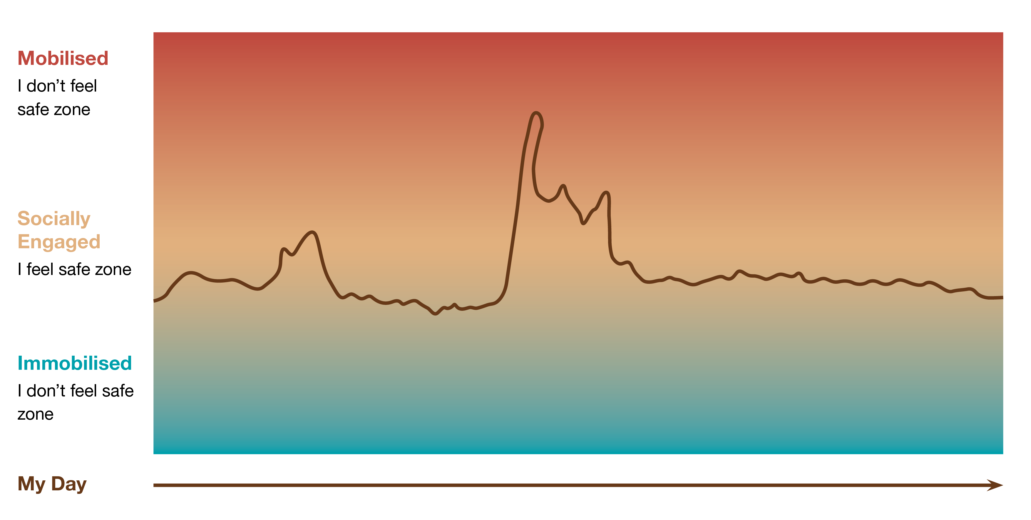
Notes:
Mobilised- too much energy in my body – too hot
Socially Engaged- ‘the goldilocks zone’- just right
Immobilised- too little energy moving through my body- too cold

Slide 24
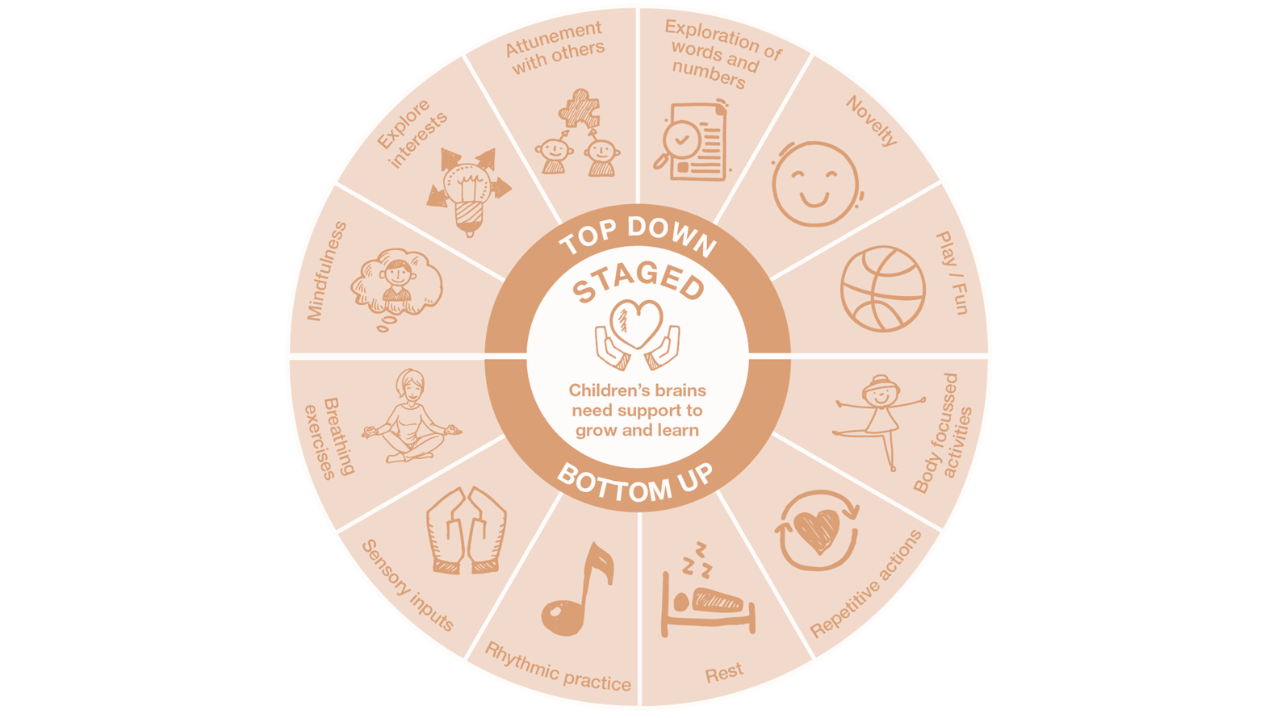
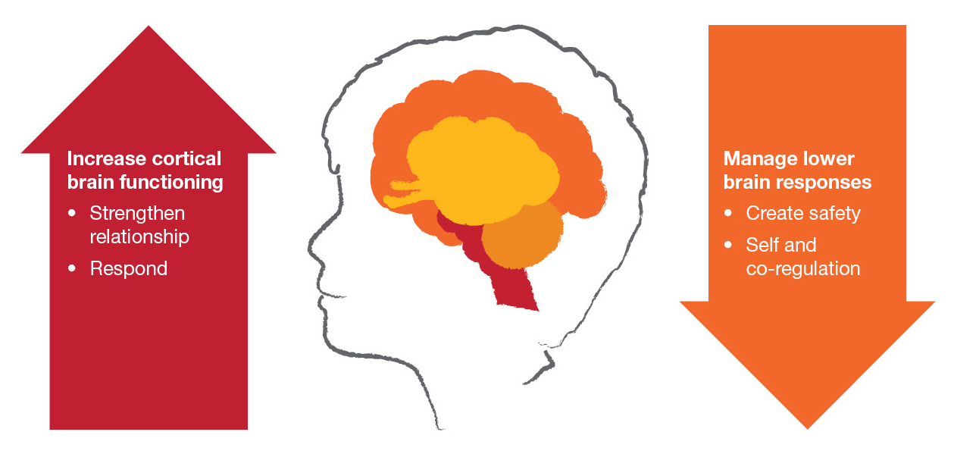
Bottom up and top down responding

Slide 25
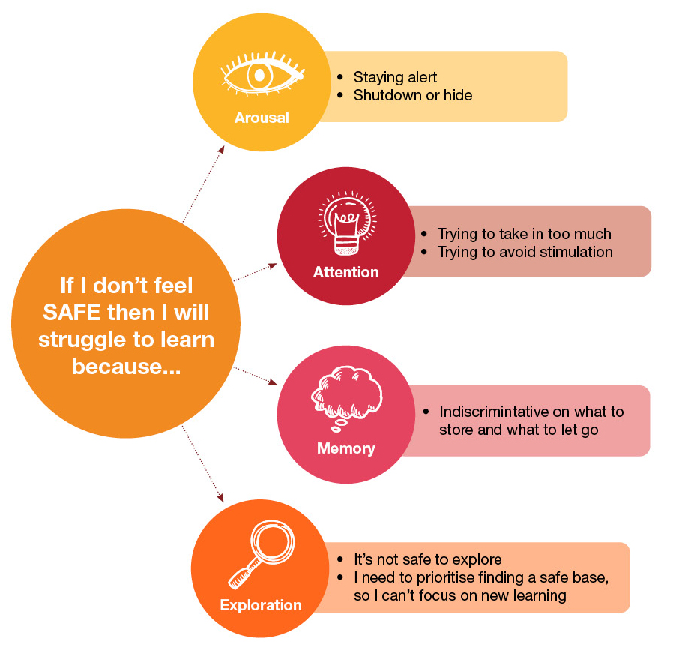
Safety
Notes:
What is trauma?

Slide 26
SPACE is the central acronym of the program. It includes 5 domains to help educators better understand the needs of children who have experienced trauma and ways to support them in the educational setting.
Notes:
Linger here and define each area

Slide 27
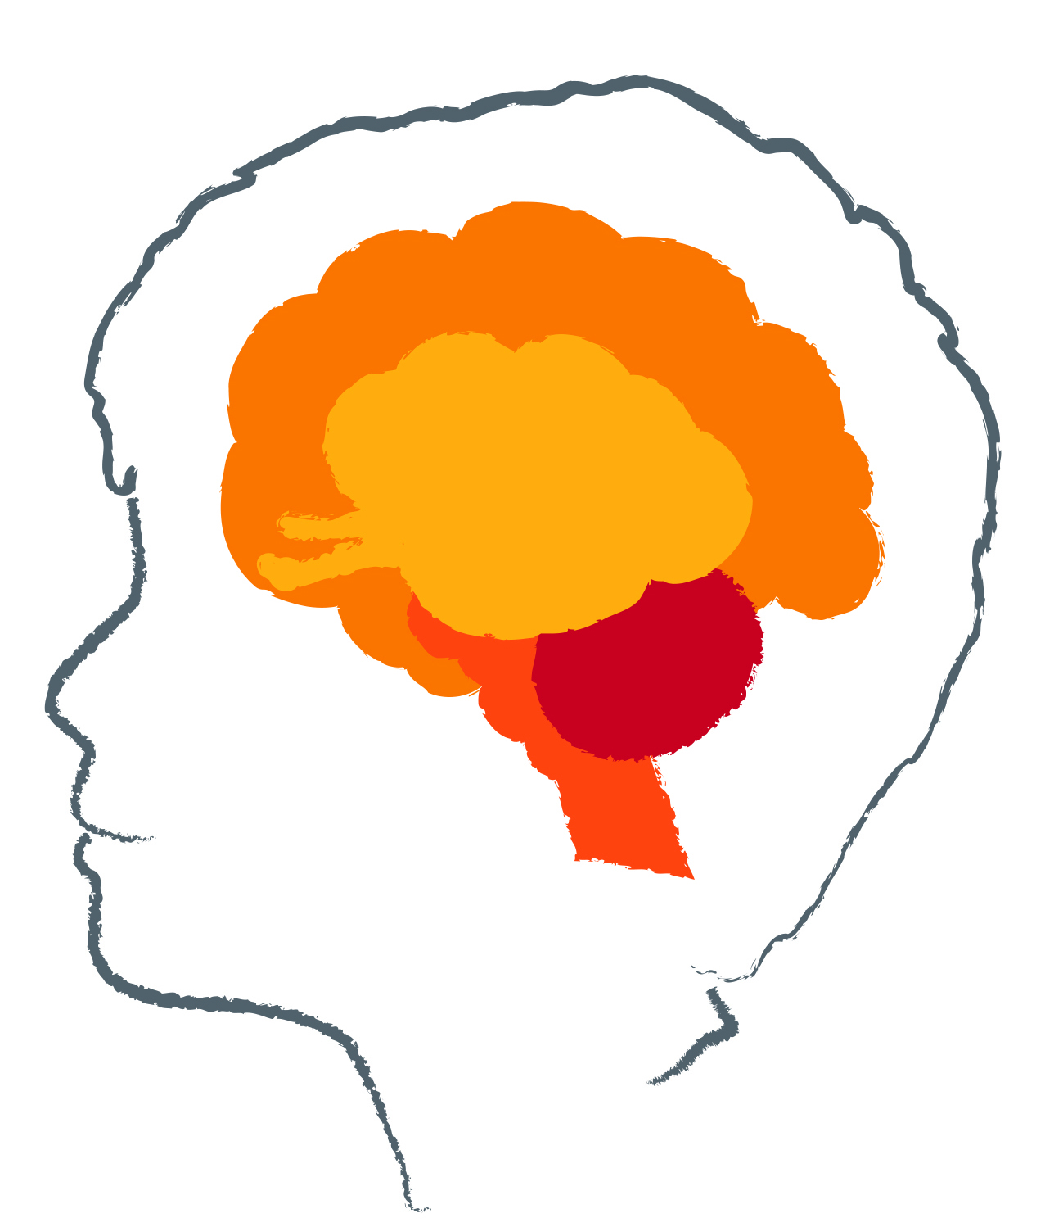
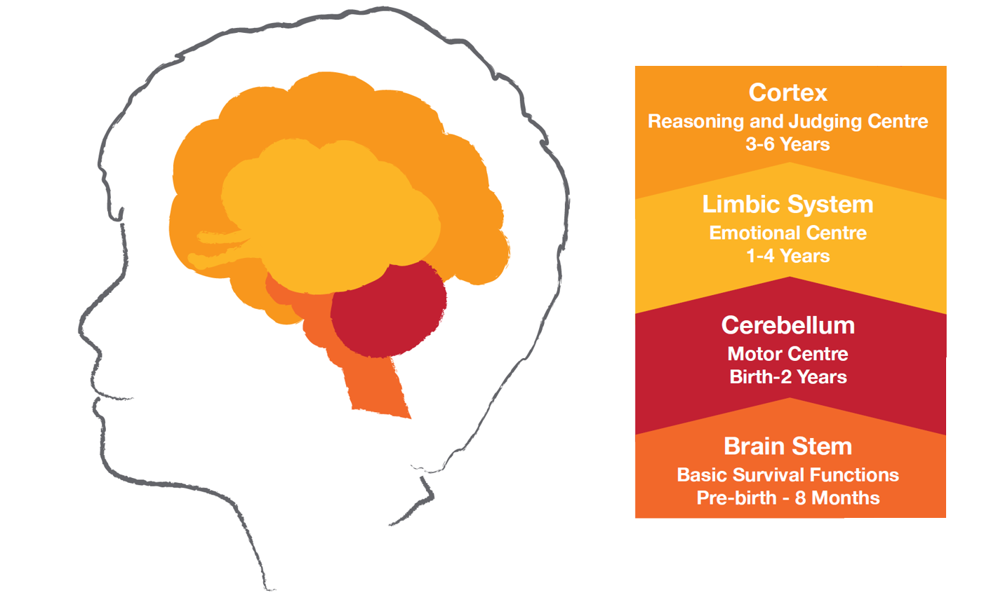
Staged
Brain development is sequential
One of the ways our brain develops is vertically, from the bottom to the top
Some neurodevelopmental delays such as those effected by trauma can cause brain changes. However with the right support the brain can be repaired through neuroplasticity.

Slide 28
Staged in the Session/Classroom
From a Teacher:
“Always meet the student where they are at (not where they 'should be' and work up from there)”
Action:
Breathing Exercises- Use breathing exercise such as 5 Finger Breathing (2 mins) at beginning and end of each lesson. Finding ourselves in the space, connecting to self.
Notes:
Staged - Always meet the student where they are at (not where they 'should be' and work up from there)

Slide 29
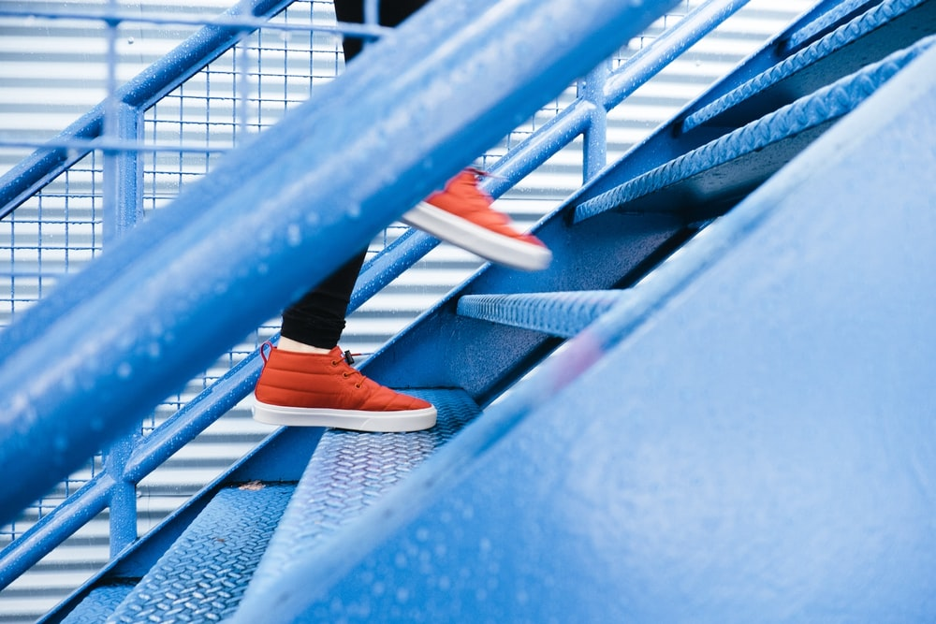
Predictable
Changes to routines and uncertainty can be a source of stress to student
Predictability in students' relationships and activities modulates their stress systems
This then promotes flexibility and adaptability
Notes:
I feel better when I know what is coming next

Slide 30
Predictable in the Session/Classroom
From a Teacher:
“Think about routines and patterns on macro and micro levels”
Action:
Planned transitions- Use images representing structure of current lesson or when moving from one activity to another. Have images for Individual Work, Pair Work, Small Group Work, Reflective Activity, Using Materials, Putting Materials Away etc.
Notes:
Predictable - routines and patterns on macro and micro levels,

Slide 31
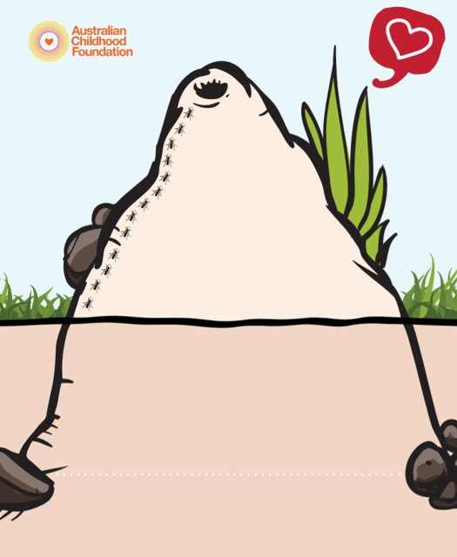
Adaptive
Most of us have a set of behavioural routines that we draw from to respond to challenges when they emerge. These routines are likely based in what has helped us get by in the past and the experiences of relationships through which these routines were interpreted and responded to.
To broaden children’s behavioural repertoires and promote increased adaptability we need to maintain multiple meanings for the behaviour and remain open to multiple options for interventions.
Notes:
Behaviour is communication
If we can understand what drives a behaviour, we can work out how to respond to it.
If we can meet the need that is driving a behaviour, the behaviour can start to reduce.
Behaviours are functional and almost always makes sense given their specific experiences of trauma.
Openness and curiosity about behaviour is an important response.

Slide 32
Adaptive in the Session/Classroom
From a Teacher:
“ground yourself ALWAYS in order to be adaptive and build adaptability in the students”
Action:
Prioritising Behaviour as Communication in being curious about what is happening for the student
Notes:
Adaptability - ground yourself ALWAYS in order to be adaptive and build adaptability in the students.

Slide 33

Adaptive -Building understanding of behaviour
Behaviour is communication
If we can understand what drives a behaviour, we can work out how to respond to it.
If we can meet the need that is driving a behaviour, the behaviour can start to reduce.
Behaviours are functional and almost always makes sense given their specific experiences of trauma.
Openness and curiosity about behaviour is an important response
Notes:
The image on this slide represents an anthill or termite mound and is a reflection that what we see above ground (the behaviour) is only the presenting tip of a more complex construction (like the termite mound where only about one sixth is visible above ground). The behaviour is a reflection of the underlying needs of a child, a young person or a caregiver and we want to open up genuine interest in understanding that underlying need rather than just responding to the visible behaviour.
Examples of common behaviours that parents or caregivers report as challenging:
Defiance – refusing to complete tasks when instructed
Clingy – wanting to be on or near them at all times
Brainstorm in groups: (breakout rooms) what are some different ways we could understand these behaviours? How might you wonder with a parent about the function underlying these behaviours? What would be some supportive responses to each of these behaviours, depending on how we have understood them?
Parents and caregivers need assistance to make sense of their life experience through a supportive, empathic emotional relationship which encourages authenticity, nurturing and direct communication
Often, accessing internal recollections can enable a parent or caregiver to develop a larger narrative of their life. This is not always comfortable but can assist in discovering new possibilities……

Slide 34
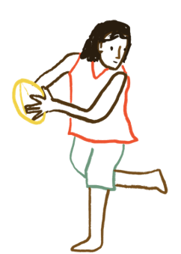
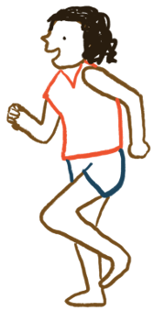
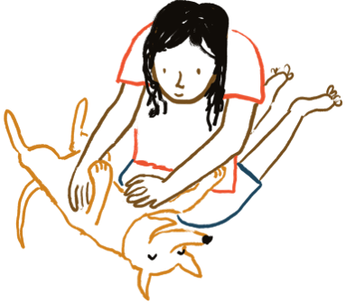
Connected
Children’s relational templates for forming and being in relationships take shape as they grow. They learn what to expect and how to navigate relationships through their experiences of connection with those around them.
We tend to expect things from relationships based on what we have known from past connections.
Strategies to support children as their relational templates continue to develop emphasise relationships with safe and consistent adults and peers as the foundation for healthy, strong social and emotional functioning.

Slide 35
Connected in the Session/Classroom
From a Tutor/Teacher:
“connect, connect, connect”
Action:
Getting to know one another rituals, saying goodbye, celebrations
Notes:
Connection - connect connect connect,

Slide 36
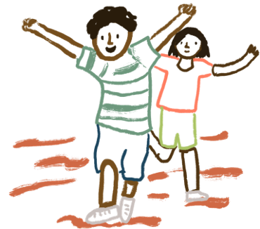
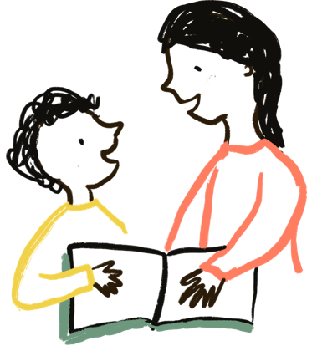
Enabled
Engaging students in the process of understanding themselves can build social and emotional learning.
When students know about their qualities, their attributes and their talents they can feel good about themselves.
Knowing about their own special story helps students to build a coherent self-narrative.

Slide 37
Enabled in the Session/Classroom
From a Teacher:
“See the strengths and potential in every student and reflect that back to them in bucket loads so that they come to know themselves as possessing those strengths and sense of worthiness”
Action:
As above
Notes:
Enabled - see the strengths and potential in every student and reflect that back to them in bucket loads so that they come to know themselves as possessing those strengths and sense of worthiness.

Slide 38
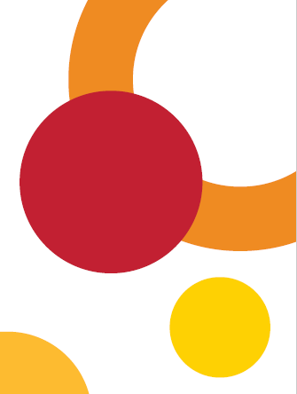
Domains | Translated into needs statements
Staged | Children’s brains need support to grow and learn My brain grows upwards step by step
Predictable | Children need to know what they can count on I feel better when I know what is coming next.
Adaptive | Children need support to grow up healthy and strong There are things I need to grow up healthy and strong.
Connected | Children need to feel like they are connected. I need to feel like I am connected.
 | Children need to feel safe and know about what makes a safe connection. I need to feel safe. I need safe connections in my life.
Enabled | Children need to know more about what makes them who they are. I grow stronger as I learn more about what makes me, me.

Slide 39
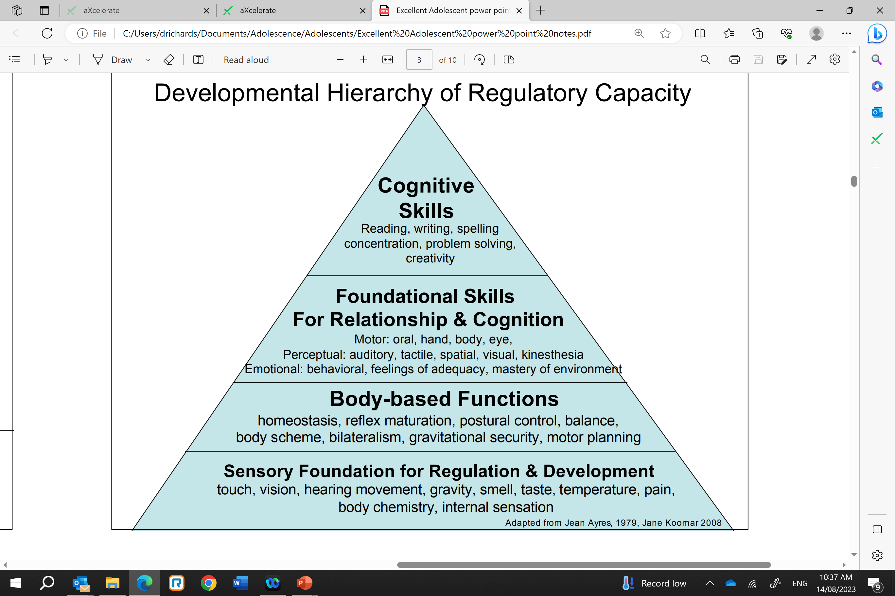
Making SPACE for Learning

Slide 40
Check out
What are you taking back to your school/site?
Strategy?
Activity?
New perspective?
Connection/collaboration?

Slide 41
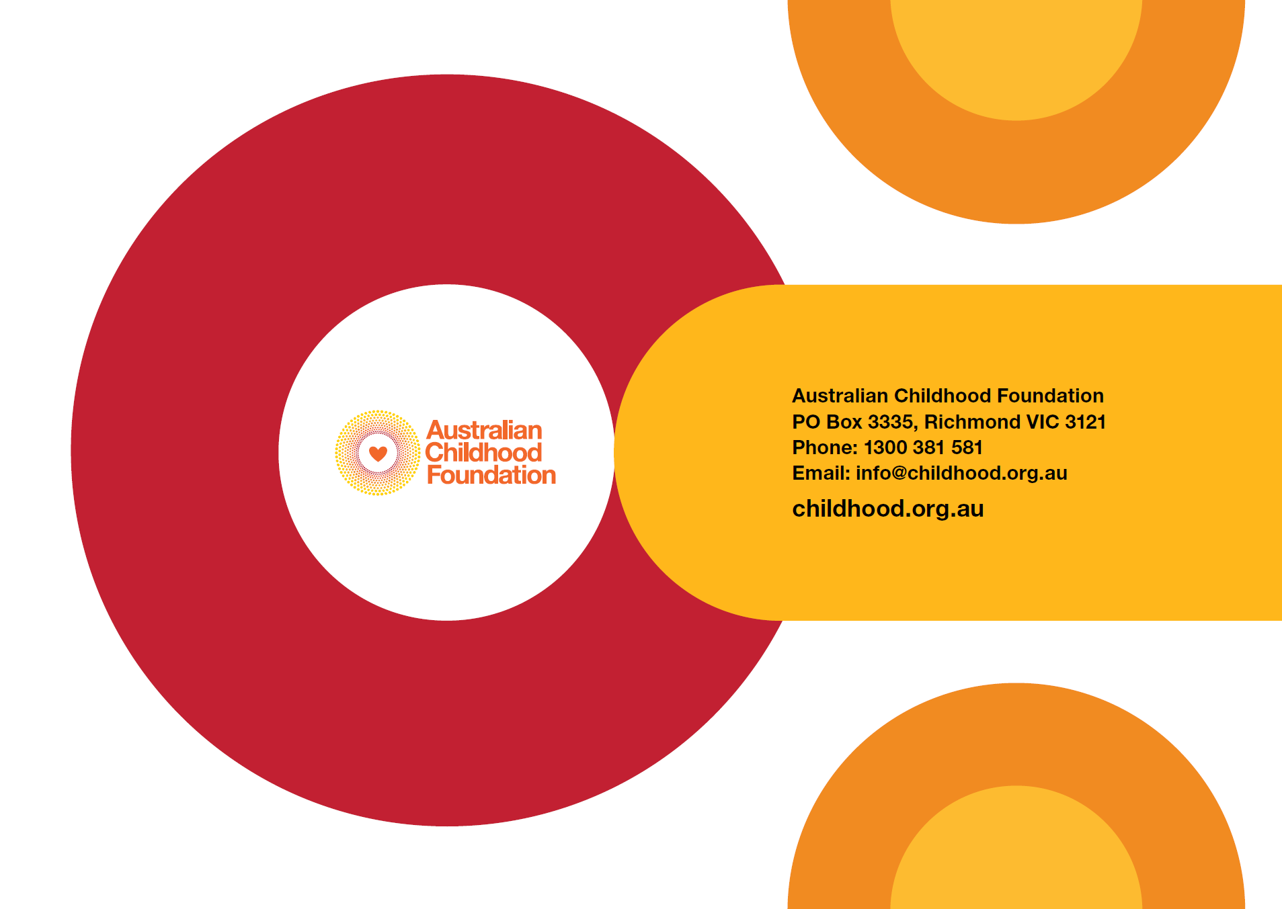
Questions?
Queries
Shared thoughts
Next session

Slide 42
Further Resources:
https://professionals.childhood.org.au/making-space-learning-resources/
Any questions?
drichards@childhood.org.au

