Slide 1
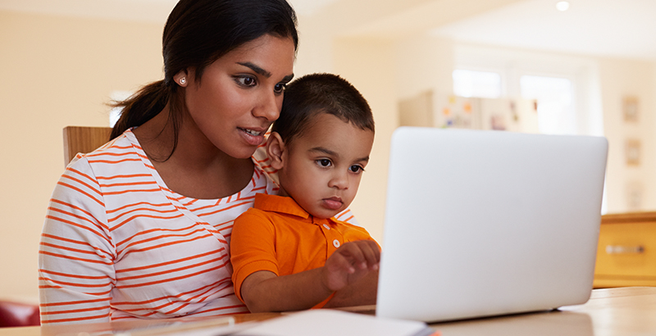
Bringing Up Great Kids (BUGK)
Facilitating respectful, reflective & effective
Online parenting groups
Notes:
Choice of banners

Slide 2
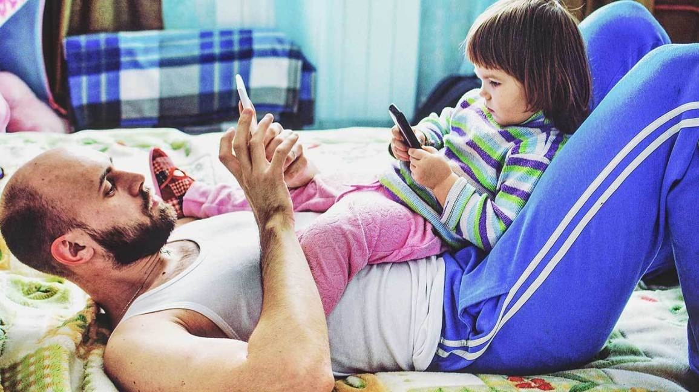
Bringing Up Great Kids (BUGK)
Facilitating respectful, reflective & effective
Online parenting groups
Notes:
Choice of banner

Slide 3
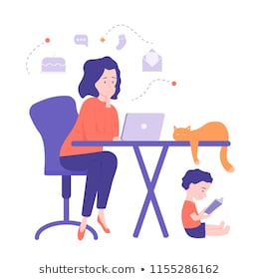
Housekeeping
Breaks
Use of mute and unmute
Online chat
You already know about and !
Let’s be aware of and accept that technology isn’t always working perfectly
From: Shutterstock.com
Notes:
Depending on your group you may only need this information

Slide 4
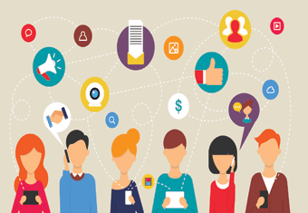
Group Rules
Use headphone (better sound and privacy)
Taking turns online
Nurture yourself
Take advantage of breaks
No recording
Confidentiality
Privacy
Use mute when not talking
Attend the group with maximum concentration
Rules about the chat (when we will respond to the chat)
When leaving the group, let the facilitator know
When sharing, be aware of the children around
Notes:
An excessive list – delete those not needed

Slide 5
Listen intentionally to the Music
1.
2.
3.
Notes:
1. PINK PANTHER
2. TITANIC
3. BANANAS in PYJAMAS
Choose a nostalgic piece of music that you think participants may have memories about (i.e. Music from the Titanic).
Ask participants to listen to the music and see what the music reminds them of.
Discuss their memories.
Play the music again, but this time ask them to listen to the actual music, not their memories!
Ask them what they heard the second time you played the music.
Through deep listening we can heal
… a quiet still awareness
… wanting to listen needing to listen

Slide 6
Chapter 1: The Message Centre Children’s Brain
1100 grams
1300-1400 grams
400 grams
Notes:
The aim is to illustrate the rapid growth of the brain in the first 3 years of life and the vital importance of nurturing respectful relationships to grow children’s brains.
Pass the brain models (balloons filled with rice) around the group one at a time beginning with the newborn brain, followed by the 3 year old brain and finally the adult brain. Ask parents to guess the weight of an average newborn’s brain first and discuss surprise at the weight, who guessed too much, who guessed too light and who was the closed to the correct weight. Use this same process for the brain of a 3 year old and then that of an adult.
Tell parents the average weight of a newborn brain as they pass around each brain.
newborn brain= 400 grams
3 year old brain =1100 grams
adult brain= 1300 grams

Slide 7
Neuronal connections
Traumatised brain
Notes:
Activity – Wool with trauma overlay
What sort of things are toxic to the developing brain?
How do they damage the brain?
How does this damage affect the parent’s ability to connect with the child

Slide 8
Neuronal connections
Traumatised brain
Notes:
Activity – Wool with trauma overlay

Slide 9
Neuronal connections
Nurtured brain
Notes:
Activity – repair process

Slide 10
Neuronal connections
Healing brain
Notes:
Activity – repair

Slide 11
Chapter 1: The Message Centre The brain story
Video from the folder or on BUGK website
Notes:
Show cartoon clip of brain story from Thoughtful Parenting

Slide 12
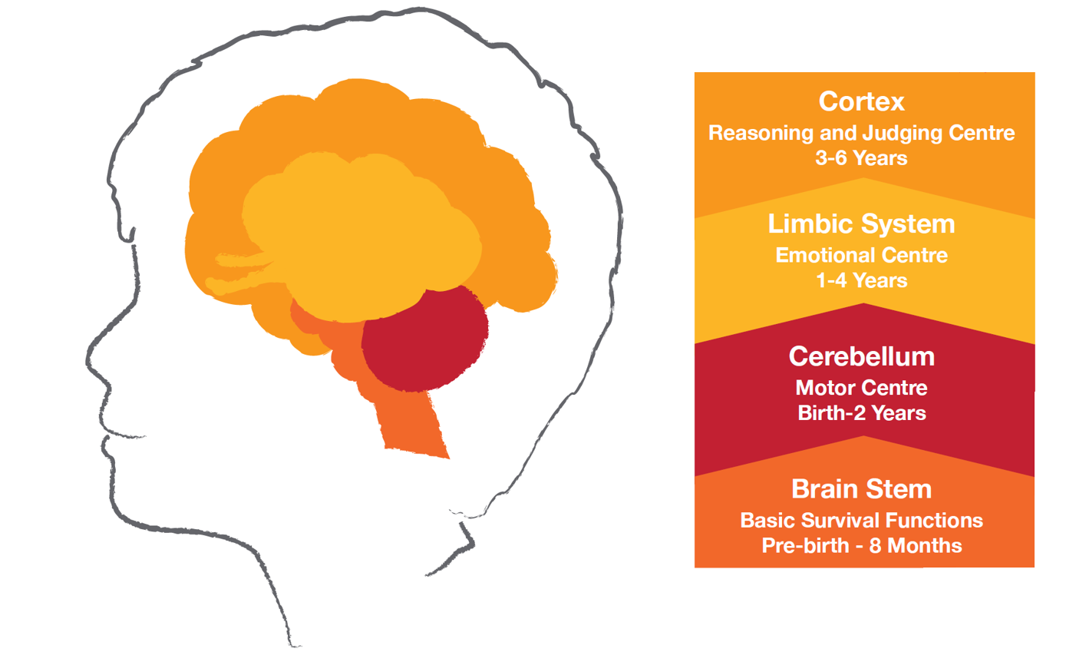
Chapter 1: The Message Centre Bottom up brain development
Notes:
The brain stem area of the brain develops first and is responsible for basic functions that keep us alive such as heart rate, breathing and regulating our body temperature. The brain stem is fully developed by birth. It is the part of the brain that is ‘hard wired’ and least susceptible to change.
Connected to the brain stem is the motor centre of the brain. This area is responsible for movement and develops over the first few years of life. Development is this area is seen in babies gaining head control, sitting, crawling and walking. In the next few years, children gain greater co-ordination, learn to skip, kick a ball, ride a bicycle, cut, draw and eat with cutlery.
The limbic system is the emotional centre of the brain and rules the lives of young children up to around four years. During the toddler years, the limbic system goes through a period of rapid development. This helps explain their bursts of irrational behaviour and tantrums. Toddlers need our help to manage their strong feelings. Young children feel then act, they don’t think then act. This is due to the emotional centre of their brain developing before the cortex, or the thinking part of their brain. Young children basically view the world through an emotional lens
The cortex, or the thinking part of the brain, is the last part to develop. This is the part of the brain responsible for reasoning, planning. This is the part of the brain that enables humans to think before they act. As children grow and develop, the cortex is gradually able to help us to pause when we are flooded by strong emotions, thus allowing us to feel, think, then act.
Unlike the brain stem, the limbic system and cortex are highly susceptible change due to experience and the environment in which the child lives.

Slide 13
Chapter 1: The Message Centre Hand model of the brain
https://www.youtube.com/watch?v=gm9CIJ74Oxw
Notes:
Dan Siegel – talking through hand brain

Slide 14
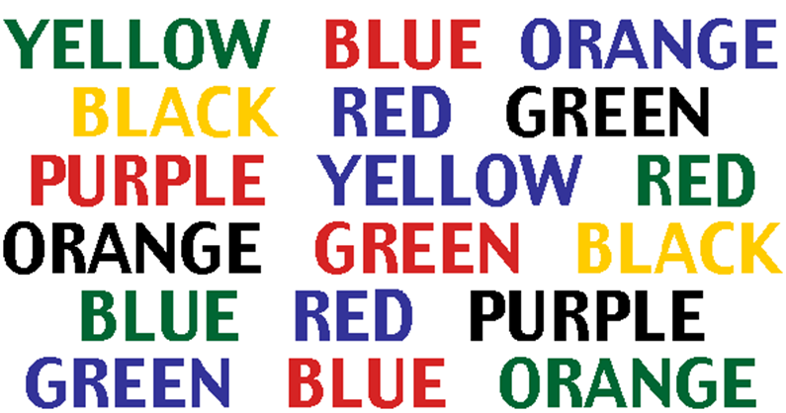
Chapter 1: The Message Centre Integrating the brain

Slide 15
Chapter 1: The Message Centre Self-care
https://www.youtube.com/watch?v=E9xt3_p4Ptg
Notes:
Daddy long legs

Slide 16
Chapter 2 Pass the Virtual Parcel
Notes:
Whatever messages you want to put in parcel can be added

Slide 17
Chapter 2 Pass the Virtual Parcel
It takes a village to raise a child
Notes:
Whatever messages you want to put in parcel can be added

Slide 18
Chapter 2 Pass the Virtual Parcel
Parents have all the resources they need
Notes:
Whatever messages you want to put in parcel can be added

Slide 19
Chapter 2 Pass the Virtual Parcel
All parents are role models for their children
Notes:
Whatever messages you want to put in parcel can be added

Slide 20
Chapter 2 Pass the Virtual Parcel
Parents are humans who make mistakes and learn from their mistakes
Notes:
Whatever messages you want to put in parcel can be added

Slide 21
Chapter 2 Pass the Virtual Parcel
Parents are supposed to be perfect
Notes:
Whatever messages you want to put in parcel can be added

Slide 22
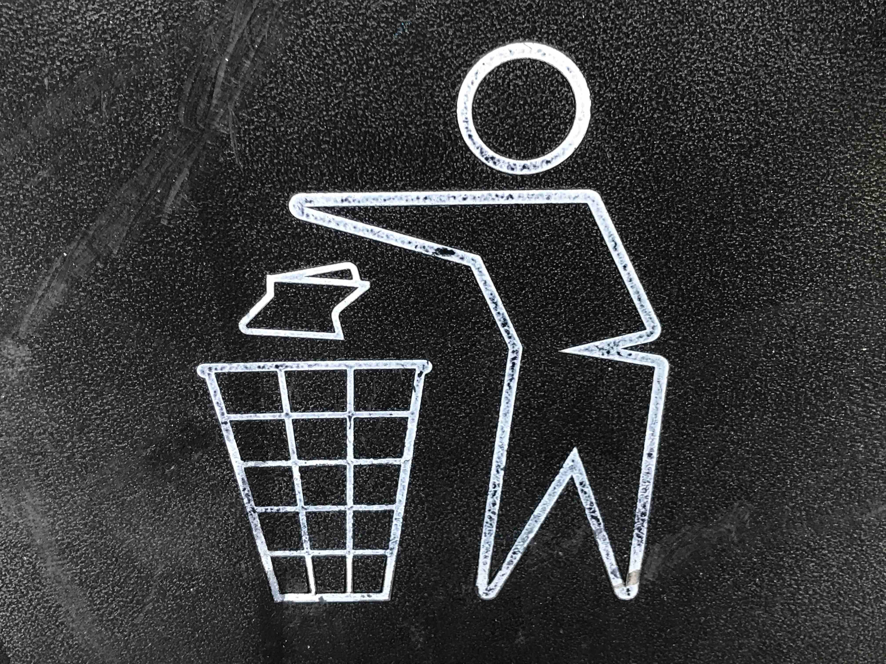
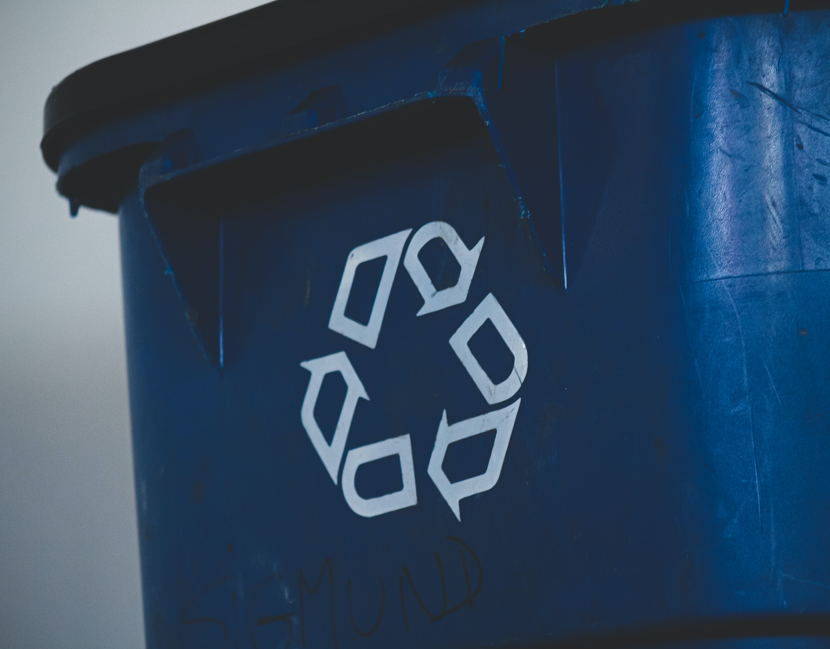
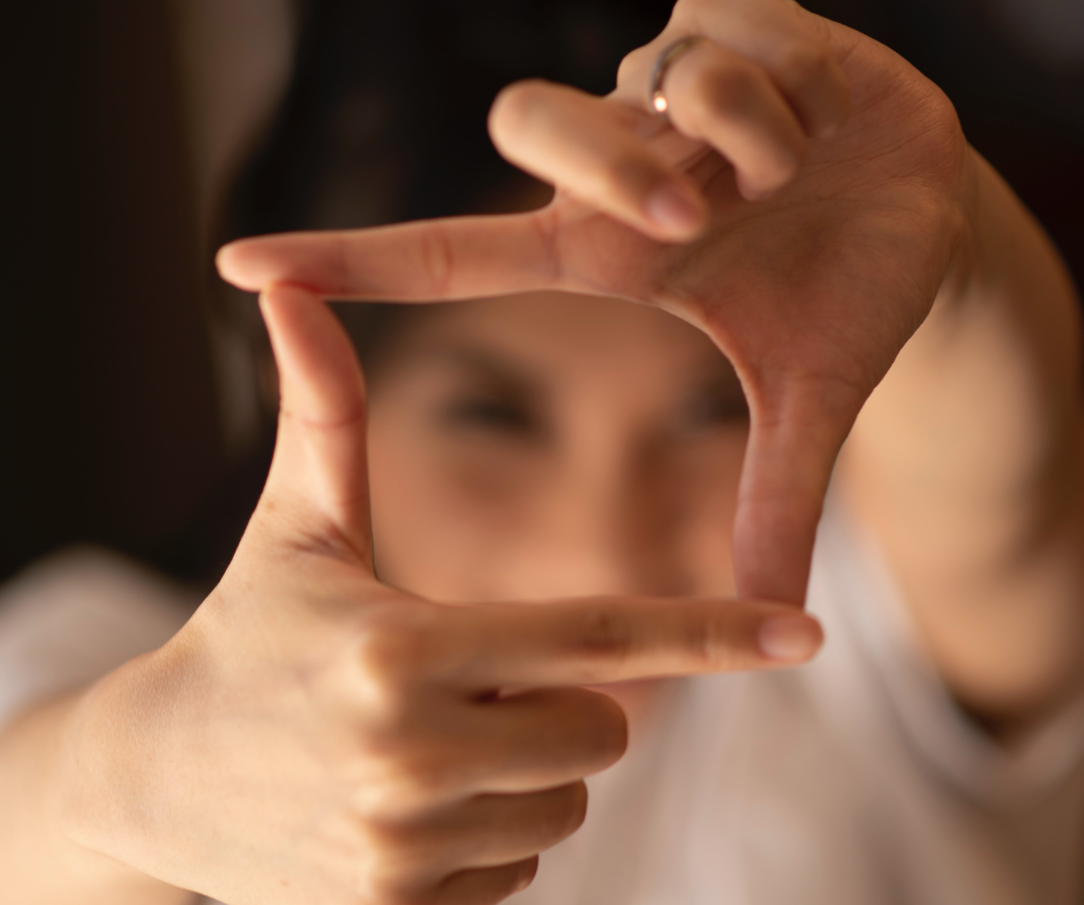
Chapter 2: Messages from the Past Activity: Rubbish, Recycle, Reframe
Notes:
Image: https://unsplash.com/photos/YzSZN3qvHeo
Image: https://unsplash.com/photos/aI4RJ--Mw4I
Image: https://unsplash.com/photos/LwCKyX-wr38
Invite parents to keep in mind those messages identified in previous activities which they have identified as coming from their own childhood experience of being parented.
Introduce the idea that when parents become aware of the messages they have received then there are choices that can be made about which of those messages are passed on to our own children and which are not..
Invite participants to write on coloured paper, those messages from childhood that they would choose to leave behind, and on paper of another colour, those messages they’d choose to recycle- give their own children.
Group stands in a circle around a rubbish bin and recycle bag/box for participants to throw their papers into- sharing with the group if they choose to.
The aim of this activity is to assist parents to identify the messages they have received about parenting and make decisions about the ongoing influence of these messages on their own parenting.
Allow parents some time to reflect upon or write on slips of paper those messages which they wish to keep and pass on to their children and those which they will discard. Different colored paper could be used here - one for messages to keep and the other for messages to discard.
Invite parents to stand in a circle. Place a rubbish bin and a recycle bag in the centre of the circle. Give people an opportunity to throw into the bin, either literally or symbolically, the messages they want to discard. Repeat the exercise, inviting parents to place into the recycle bag those messages they wish to pass on to their own children.
OR
Parents may choose to keep the messages they want to pass onto their children and add them to the blank pages at the end of Chapter 1 in My Story as a Parent.
Parents are invited to share what they have written as they place their messages in either bag /bin or to do it silently.
This is a very powerful activity and may evoke strong emotions in some parents
Ask parents how it felt for them to discard those messages they do not wish to pass on.
Acknowledge that it takes courage to make changes.

Slide 23
Chapter 3: Giving & Receiving Messages Non-verbal Communication
Video from the folder – Little girl in the rain

Slide 24
Chapter 3: Giving & Receiving Messages Self-care
https://www.youtube.com/watch?v=jFocDpvTZdw
Notes:
The boy who finally listened

Slide 25
Chapter 4: The Messages of Behaviour
Shark music video from the folder
Notes:
Shark music -

Slide 26
Chapter 4: The Messages of Behaviour Self-care
https://www.youtube.com/watch?v=MGWsXha28a4
Notes:
Dinky donkey story

Slide 27
Chapter 5: Messages about me Self-care
https://www.youtube.com/watch?v=YdiGEjz5b0Q
Notes:
The hungry caterpillar

