Slide 1
Exploring Polyvagal Theory and neurobiology
SMART 2021
Notes:
Instructions for use of this package to be inserted here
Please note the following points about the headings used in the notes page of each session
Key points – these are the main messages related to any particular slide and should be included in the training delivery
Background information – this is information for the trainer only and does not need to be shared with the training participants
Please note – these are important information points about a particular slide or content area. They should be reviewed prior to delivering the training to ensure the point is noted and followed as outlined
Activity – these provide suggested activities to be undertaken during the session. Trainers may choose which activities they include in the delivery of the session. There is no expectation that all activities would be completed. The selection is based on the trainers’ assessment on the group needs, the session facilitation and their own comfort with each activity. We would suggest that additional activities are not used as there is already more content and activity ideas than could be included in any one session.
Additional points – these are additional content points or questions for reflection and can be delivered to the participants in the session or just used for background information for trainers.
Handout – denotes where there is an additional resource available for distribution to participants. Ensuring that there are copies of these available is an important part of preparing for each session.
Optional handout and optional activity – these are included in some sessions and mean that there needs to be some trainer discretion with regard to their use. It is likely that this handout or activity may be too complex or too challenging for most groups and their use needs to be carefully considered. Feel free to discuss their use with other SMART trainers, the DfE team or the ACF team
This session should only be delivered after the foundational package has been delivered.
As a reminder, the additional sessions to the foundation training package are:
SMART PRACTICE – Strategies in action
Establishing and maintaining safe, supportive learning environments
Neurobiology of self-care and staff wellbeing
SMART audit tool – supporting trauma responsive school practices

Slide 3
Success criteria
Reviewed understanding of developmental, relational, trauma focusing on brain and body functioning;
Explored the key messages of Polyvagal Theory in the context of neurobiology
Connected these key messages to implications for children and young people’s functioning in education environments; and
Enhanced practice skills and strategies to enable effective support, healing and learning outcomes
Notes:
Background information
Specific additional learning outcomes may be identified for an individual site but these are the key areas to be covered over the 1 hour session. This can be delivered over 90 minutes if required, as a maximum timeframe.
Please note the wording of success criteria, as requested by the SMART Train the trainer group.
Key points
This session is focused on exploring Polyvagal Theory, as outlined by Dr Stephen Porges, and ensuring its relevance to work within schools and other education environments. It provides more theoretical understanding to support the implementation of trauma responsive practices. The session has been developed in response to queries from schools who want to know more about this knowledge area because it is so relevant to education practice in the context of being trauma responsive.

Slide 4
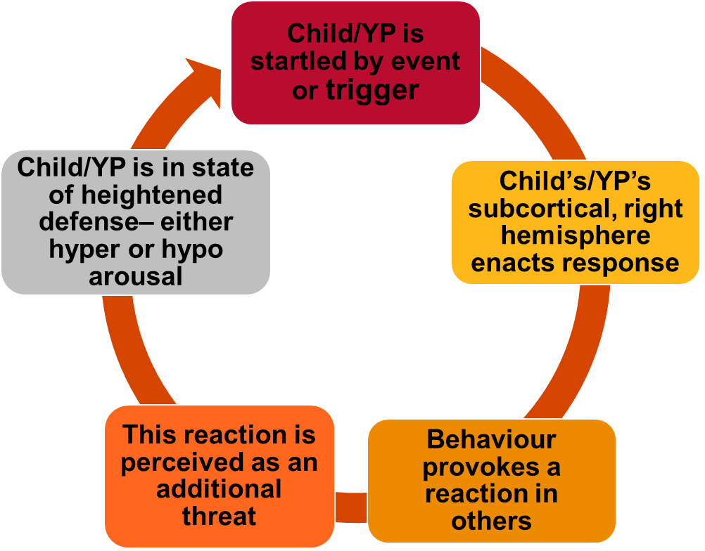
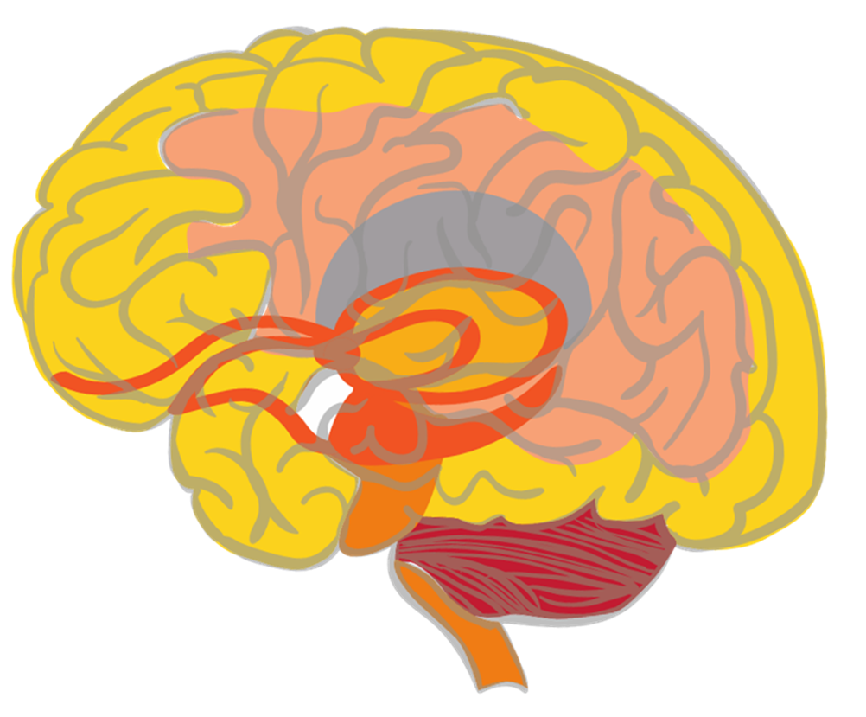
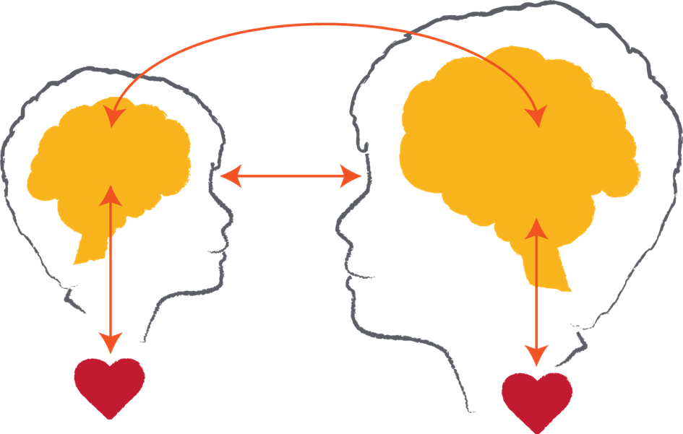
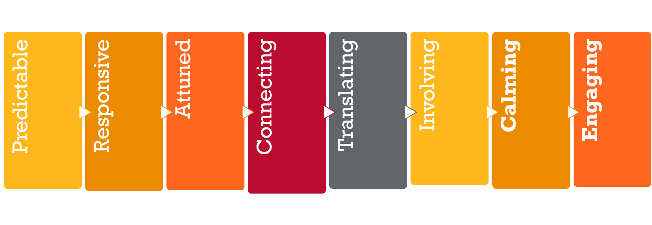
Key messages
Notes:
This slide provides an overview of some of the key messages from the foundational session and enables the trainer to review these and ensure a consistent understanding of the foundational content.
Please note: This slide and content is repeated in all of the modules that are available alongside the foundational training package. It is expected that you will provide the review as a discussion of the key points (below) and activity (see suggestions below) that best meets the needs of the session and the group to whom you are delivering.
Please note: The images included on this review slide are slightly different from those in the foundational package – particularly the brain summary and the relational exchange image. This is done to reduce the wordiness on this ‘busy’ slide and also to reinforce the message with a different visual. Reference can then be made to the foundational package and the key messages from that session.
Trainers might like to do a review activity, facilitate a Q & A session to ensure consistent knowledge or just provide a summary of the key points represented by the images on this slide.
Key points
Neurobiology – the brain develops in a set sequence and broad parts of the brain hold broad functions. This sequence and functioning is helpful in terms of understanding normative child development and also some the possible impacts of early childhood trauma. It is also helpful in terms of considering reparative strategies or actions as we need to integrate all of the brain areas and functions. You might like to remind participants about the brainstem, cerebellum, diencephalon, limbic system, amygdala, hippocampus, cortex and prefrontal cortex. This could be done again through an activity (see below), Q & A or in this key point summary.
The importance of relationships – in development and in learning. This also gives an opportunity to remind participants that relational trauma is particularly impactful because of the critical nature of relationships as an experience of survival, growth and thriving and a reminder that anything that threatens relationships can be experienced as a threat to survival. However, the counter to this that needs to be reinforced is that relationships are also a site of repair and healing that are important for all educators and other staff to focus on and value.
Understanding behavior – this cycle outlines many points about understanding children and young people’s behaviour. This includes the fact that often behaviours play out as cycles of previous experiences being retriggered, as well as the fact that many behaviours are not conscious/cortical choices but are subconscious/subcortical reactions to past experiences.
Repetition builds brains – it is useful to also remind participants of the concept of neurons and neuronal connections. This can be linked to the brain image as well as the behavioural cycle. And of course it also links to the repeated positive relational experiences that build templates of relationship for children represented in the relationship image.
Hypo and hyper-arousal – this helps us to remember that children and young people can experience different responses to experiences of trauma that are linked to their physiological arousal. These patterns tend to fall into hyper-arousal (or an ‘amped up’ arousal response that we might also know as the fight, flight or active freeze response) and hypo-arousal (or a ‘shut down’ arousal response that we might also know as the collapse and surrender response)
SMART PRACTICE – this is a response framework because the other message is one of hope. The more we understand trauma, the better able we are to respond in ways that are both helpful and reparative. This framework incorporates strategy ideas and actions that are: Predictable, Responsive, Attuned, Connecting, Translating, Involving, Calming and Engaging. It is an opportunity to remind participants that the core elements are calming and engaging as regulation and relationships are critical strategies to respond to the impacts of trauma.
Activity - Q and A session
You might like to ask the group to discuss in groups of 4 – 5, what are 3 questions we have about neurobiology and trauma still? You can then record them and work to answer them with the group and/or put any unknown questions on notice and work with the SMART Train the trainer group and Australian Childhood Foundation staff to find the answers.
The focus of this session is on getting participants to consider questions they have and the facilitator providing answers. The suggested activities below ask the participants to reflect on their own knowledge ie: provide their own answers!
Review activity suggestions
The following activity ideas are provided as suggestions. You may like to do your own review activity but its focus is only on key messages from the foundational training session and should not introduce new models of ways of working. Equally, it is suggested that facilitators only select 1 activity to enable the full session content to commence as soon as possible.
Activity 1 – Our top 5 messages
Break the participant group into groups of around 5 people. You may like to consider how groups are divided based on natural groups within the participant cohort or do random allocation or selection.
Ask the group to come up with their ‘top 5 messages about neurobiology and trauma we know’. This gives participants an opportunity to revisit the foundational session content to articulate the key things they remember of the session.
Ask each group to share their top 5 to look at themes and key learning. You can use the ‘key messages’ section included above to fill in any gaps as required.
Activity 2 – Brain puzzle
Use the brain picture provided in the foundational session slides to make a ‘puzzle’ which you can then cut out into the different parts of the brain. Break the participants into groups and get them to put the puzzle together and then discuss a) the function of each part of the brain, b) how it might be impacted by trauma and c) one activity or strategy that supports the healthy development or functioning of that part.
Again, you may need to fill in gaps in knowledge and understanding.
Activity 3 – Key terms and definitions
This activity could be done as a visual activity on slides, a verbal activity ie: read the definition and participants have to link it to the word written on the board or screen or a written activity ie: provide groups with separate words and definitions and ask them to match each. Or you may have your own idea about how to do it! Basically, it is just asking people to match the key term to its relevant definition. The list is included below: (you may like to use all or selected terms and their definitions)
Brainstem – Lowest part of the brain and responsible for basic physiological functioning
Cerebellum – A part of the brain particularly responsible for movement
Limbic lobe - A part of the brain particularly responsible for emotional processing. It includes the amygdala and hippocampus.
Diencephalon – An area of the brain that receives sensory information
Cortex – The largest part of the brain and particularly responsible for conscious thought
Sub-cortical – Refers to parts of the brain underneath the cortex (ie: brainstem, cerebellum, limbic lobe and diencephalon)
Neuronal connections – Pathways between neurons that enable activity and that are strengthened through repetition of activation
PRACTICE – An 8 element framework for responding to children and young people that is grounded in an understanding of neurobiology and trauma
Hemispheres – The 2 sides of the brain (right and left) that hold different and complementary functions
Hyperarousal – A physiological state characterised by fight, flight or freeze responses
Hypoarousal – A physiological state characterized by collapse and surrender responses
Activity 4 – Reflective activity
This asks the participants to think about the relevance of the foundational training session content to the children and young people with whom they work. This activity could be done individually, in pairs, small groups or as a whole group discussion.
The reflective question to be explored is: how has the information explored in the foundational training session helped you to understand and/or respond to a child or young person with whom you work?

Slide 5
Safety is essential – Understanding Regulated Arousal
Fight or Flight hyper-vigilant, action-orientated, impulsive, emotionally flooded, reactive, defensive, self-destructive
Freeze Physically frozen, tense musculature
Mobilisation
Hyper-arousal
Social
Engagement
Window
of Tolerance
AROUSAL
Submit Collapsed, weak, defeated, flat affect, numb, empty, helpless, hopeless
Immobilisation
Hypo-arousal
Image source – ©ACF 2018
Notes:
5
Background information
This slide reinforces the connection between Polyvagal Theory and the window of tolerance – 2 concepts introduced in the foundational package but explored in more detail here.
Key points
Our window of tolerance is what we would call social engagement in Polyvagal Theory terms. This is our optimal state – from a physiological, cognitive, relational and wellbeing perspective. We are best able to function, learn, relate and connect when we are in a social engagement state, or in our window of tolerance.
Staying within this state is predicated on us feeling and being safe. It is important to connect social engagement to safety because it is that sense of safety that enables us to engage in our optimal activity.
This slide also introduces the states of hyper-arousal and hypo-arousal and how they connect to mobilisation and immobilisation respectively – the language of Polyvagal Theory.
In trauma responsive practice, we are seeking to enable children and young people to experience safety enough to hold them within their window of tolerance and enable them to engage positively with learning and in relationships. We need to think about the experiences and environmental considerations that build a sense of safety for children and young people who don’t often experience safety.

Slide 6
Safety is essential – Understanding Dysregulated Arousal
Fight or Flight Hyper-vigilant, action-orientated, impulsive, emotionally flooded, reactive, defensive, self-destructive
Freeze Physically frozen, tense musculature
Mobilisation
Hyper-arousal
Social
Engagement
Window
of Tolerance
AROUSAL
Submit Collapsed, weak, defeated, flat affect, numb, empty, helpless, hopeless
Immobilisation
Hypo-arousal
Notes:
6
Background information
This content links concepts of safety as stems from an understanding of Polyvagal Theory with information about arousal levels and the window of tolerance.
You may like to start with the regulated arousal slide to discuss the key concepts or talk about the impacts of trauma on the window of tolerance.
Key points
This shows a child, young person or adult moving outside of their window of tolerance.
We know that they can move into 2 different states
Hyperarousal is linked to a mobilisation response as outlined in Polyvagal Theory. It is grounded in responses based on fight, flight or freeze. This is discussed in more detail on the next slide.
Hypoarousal is linked to an immobilisation response as outlined in Polyvagal Theory. It is grounded in responses based on collapse and surrender. This is also discussed in more detail on the next slide.
Children and young people can move in and out of their window of tolerance and are easily pushed up or down.
Children and young people can display both patterns of responding but may be more likely to display one or the other.
These responses are grounded in trying to survive threatening experiences and are seeking to support us to continue to survive. However, repeated activation of these response patterns mean it is quicker and easier for us to move into these states as a ‘default’ response. As we discuss throughout these modules, repetition builds brains.
What does this look like for the children we work with?
The lack of predictability makes transitions threatening – if I don’t know what is coming next and my amygdala is always switched on I’m going to appear either angry and aggressive or flat and withdrawn
Until I can learn to calm and quiet my mind I may over react in situations that would normally give me pleasure and I enjoy
Many abused children do not understand what they feel or why they act as they do. “ when asked why did you do that?” – it’s like asking yourself why you locked your keys in your house and pulled the front door shut, you just know you are preoccupied and thinking of something else. Traumatized children often do things that do not make any logical sense – they do not live in a world of logic or reason, their bodies are often on autopilot.
Activity
Think about the children and young people you have worked with. What activities do you do to increase their window of tolerance?
-Submit – raise physiological arousal to keep them engaged
-Freeze – stretching, massaging, hand wringing to stimulate blood flow and movement through body
-Fight or Flight – Calming activities to help bring the hyper response down and restore manageability.
The goal is to produce a manageable level of arousal in order to process trauma.
We want regulated arousal
Additional information
Chronic exposure to trauma increases cortisol
Cortisol increases the amygdala’s potential to be activated
As such, the amygdala becomes highly sensitized to any signal of potential threat
The amygdala keeps the adrenalin system turned on leaving the child in a constant state of readiness for threat
- The hippocampus is unable to provide context so the amygdala is unable to restrict threatening stimuli to specific examples
The amygdala then associates any change with threat

Slide 7
Polyvagal Theory
Notes:
Background information
The goal of this slide is to describe how Stephen Porges’ Polyvagal Theory helps us to understand the responses we see in children and young people
You may like to read for yourself, the chapter written by Australian Childhood Foundation staff members that focuses on the application of Polyvagal Theory in practice available at the following link: https://australianchildhoodfoundation.crackerhq.com/pvl/9b20e31a6fa3c43f414af2fcb00f1a52/pdf/9d6148d5-7ab5-4d5a-ac1e-78254bfdcbc4
Key points
Polyvagal Theory outlines stages that took place in the development of our autonomic nervous system. It proposes that the three stages are hierarchical in their use:
- We use one circuit to promote calm states, to self-soothe and to engage – we are able to slow down and speed up as required (social engagement)
- When this doesn’t work, we use the sympathetic system to mobilise for fight, flight or active freezing to address an assessed threat (mobilisation)
- When this doesn’t work we use the collapse and surrender, or shutdown, system. This can be particularly dangerous as people can faint/slip into unconsciousness when moving into this state that is only used when we assess the threat level as being at its highest (immobilisation).
The newer, social engagement system can only be expressed when the nervous system detects the environment as safe.
Trauma impacts the use of this branch of activation because it ‘tunes’ children and young people into scanning their environments for threat. This means they cannot apply their ‘vagal brake’ and they end up maintaining elevated heart rates which in turn inhibit the activation of the social engagement system.
The linkage between the facial nerves and the nerves that regulate the heart and lungs mean that using the facial muscles can work to calm us down/regulate.
Children and young people who present with little facial expression (eg: the face has no muscle tone, the eyelids droop and gaze averts) will also likely have auditory hypersensitivities and difficulty regulating his or her bodily state. Polyvagal Theory (or PVT) suggests that the neural system that regulates both bodily state and the muscles of the face has gone off-line because their nervous system is not providing the messages to help calm down (move back into the window of tolerance or social engagement state).
When children and young people are in a distressed state, their nervous system evaluates even neutral things as dangerous, rather than pleasant and/or safe. But, once they are able to regulate – often through the use of effective relationships – they see neutral as neutral again and can re-engage with others and with learning.
To assist children and young people with regulation, PVT helps us to understand what effective actions and strategies might be. These could include moving to a quiet environment, changing the intonation of your own voice (to mid-range and melodic), presenting familiar faces and familiar people (either in person or using photos), playing music, playing musical instruments, singing quietly, speaking softly. While what works may be unique to each child or group, what we are doing is activating the social engagement system, and turning off our stress responses.
Additional points (optional)
You may like to discuss the concept of neuroception – which is the subcortical/subconscious version of perception. It is the capacity and action of the lower parts of our brains and bodies to make an assessment of our environment and circumstances to see if it is threatening or not. Neuroception is a concept that is linked to PVT. This reminds us that children and young people’s responses are not a conscious choice but a physiological reaction to their situation.

Slide 8
Understanding the hierarchy – Still face experiment
Notes:
Background information
https://www.youtube.com/watch?v=apzXGEbZht0
This is the youtube link for the Still face experiment.
The purpose of showing this video is not to distress the participants but to demonstrate the hierarchical response.
Key points
Once the parent goes ‘still face’ – which could be perceived as a relational threat - you see the child trying to use the hierarchy to re-engage. They start with social engagement by reaching out and smiling but quickly move into a mobilisation response as they cry and scream and reach out and finally move into the immobilisation response as they go quiet and turn away. This shows the hierarchy in quick succession.
It is important to say that children are not traumatised by this experiment because the parent re-engages with the child ie: uses relationship as a therapeutic and reparative tool.
This also shows us ‘rupture and repair’ as a way of working with relationship again as a reparative tool.

Slide 9
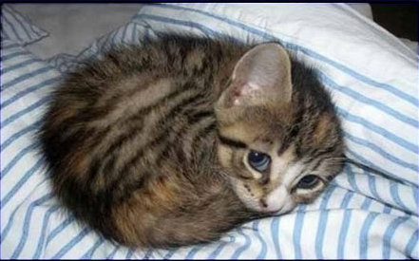
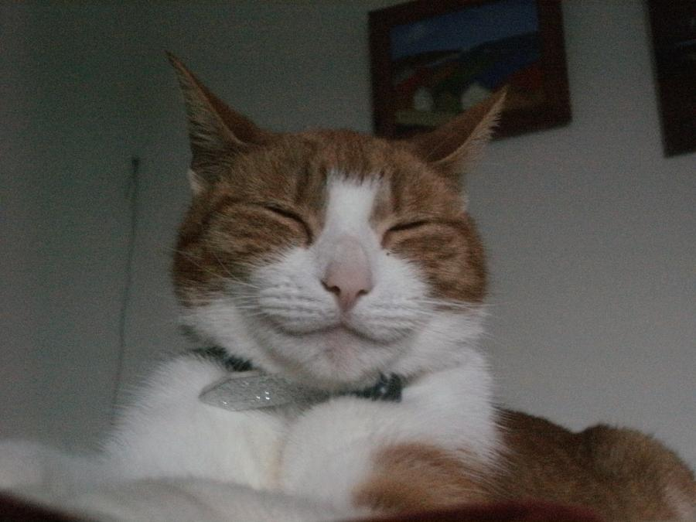
How does this present in our school or site?
Notes:
Activity
We have already asked the group to think about how these hierarchical responses can present in the school, or other site, environment but this provides another opportunity to link the theory to our understanding of this theory in practice.
In reflecting on the children and young people in the school or site, can participants share examples of these responses that have been demonstrated?
What have they found works to support the child or young person to regulate into the social engagement state (even though the staff may not have understood that is what they were doing!!)?
What have they found really does not work to support the child or young person to regulate? This is important to learn from as well.

Slide 10
Linking safety to Polyvagal Theory
Safety is a fundamental concept linked to our understanding of PVT
Safety is more than an absence of threat, it is about a felt sense of relational connection that evokes ‘deep’ safety
It is linked to the idea of neuroception which describes “...how neural circuits distinguish whether situations or people are safe, dangerous, or life threatening...” (Porges, 2011)
All of this tells us that the relationships we build with children and young people are fundamental to their experience of safety and, subsequently, their capacity to learn
Notes:
Background information
It is expected that this slide reinforces points already made in this session.
The final point in the slide is likely to have been reinforced with the activity discussion incorporated in the previous slide ie: what worked to help children and young people regulate?
As has been suggested previously, it will be helpful to delivering this session if trainers read the article at the following link to build their understanding of these concepts.
https://australianchildhoodfoundation.crackerhq.com/pvl/9b20e31a6fa3c43f414af2fcb00f1a52/pdf/9d6148d5-7ab5-4d5a-ac1e-78254bfdcbc4

Slide 11
Exploring safety – a personal reflection
Think about your answers to these questions:
How do you know you feel safe with someone? (What do you sense in your body that tells you that?)
When you are not sure about things in your life, who do you turn to? What is it about the way that this person relates to you that lets you know that you can turn to them?
How can you provide some of that experience to the children and young people you work with?
Notes:
Activity
Please note: Please consider carefully whether you want to use this activity with the staff group. This can evoke reactions in people as they reflect on the meaning of safe relationships to them in their world. It is worth giving a heads-up prior to doing the activity that this can sometimes evoke strong responses in people and that, if that happens, they should do whatever they need to do to keep themselves safe. This might include needing to leave the room, passing on the activity or debriefing with a trusted colleague after the session.
Please note: We strongly suggest that you consider your own responses to these questions prior to undertaking the activity during the delivery of training. What does it raise for you? What are your responses? Can you use those responses as examples in your training?
Ask participants to reflect on their answers to these 3 questions individually.
Then – discuss their responses in pairs or groups of 3. This discussion only needs to be the aspects of the answers to the questions that people feel OK to share.
The purpose of the activity is to really think about what safety actually means for us all as it can be easy to intellectualise this concept rather than ‘feel’ it.
Then – there can be a whole group discussion about some of the themes that emerged from the conversation and then a focus on the responses to the final question. How do we provide something of the experience of safety to the children and young people in the school or site.

Slide 12
Reflective questions
What does this knowledge help us understand?
How can we use this knowledge for our students?
What do we already do to build relational safety across our school/site?
What else can we do to build relational safety?
This Photo
Notes:
Activity
This final discussion activity supports the integration of the session content into the learning and practice of the participant group.
You might like to also suggest further training sessions to underpin the learning around Polyvagal Theory in the context of schools and other learning environments.
Remind the group about the additional SMART resources available, which may help with further learning:
Other sessions available in the Train the trainer suite
SMART training calendar
Trauma Aware Schools initiative
The broader series of DfE initiatives – outlined in the summary slide available in the foundational session content.
Discussion papers – available at https://professionals.childhood.org.au/making-space-learning-resources/
Further Australian Childhood Foundation resources - https://professionals.childhood.org.au/resources/

