Slide 1
Neurobiology of self care and staff wellbeing
SMART 2021
Notes:
Instructions for use of this package to be inserted here
Please note the following points about the headings used in the notes page of each session
Key points – these are the main messages related to any particular slide and should be included in the training delivery
Background information – this is information for the trainer only and does not need to be shared with the training participants
Please note – these are important information points about a particular slide or content area. They should be reviewed prior to delivering the training to ensure the point is noted and followed as outlined
Activity – these provide suggested activities to be undertaken during the session. Trainers may choose which activities they include in the delivery of the session. There is no expectation that all activities would be completed. The selection is based on the trainers’ assessment on the group needs, the session facilitation and their own comfort with each activity. We would suggest that additional activities are not used as there is already more content and activity ideas than could be included in any one session.
Additional points – these are additional content points or questions for reflection and can be delivered to the participants in the session or just used for background information for trainers.
Handout – denotes where there is an additional resource available for distribution to participants. Ensuring that there are copies of these available is an important part of preparing for each session.
Optional handout and optional activity – these are included in some sessions and mean that there needs to be some trainer discretion with regard to their use. It is likely that this handout or activity may be too complex or too challenging for most groups and their use needs to be carefully considered. Feel free to discuss their use with other SMART trainers, the DfE team or the ACF team
This session should only be delivered after the foundational package has been delivered.
As a reminder, the additional sessions to the foundation training package are:
SMART PRACTICE – Strategies in action
Establishing and maintaining safe, supportive learning environments
SMART audit tool – supporting trauma responsive school practices
Exploring Polyvagal Theory and neurobiology

Slide 3
Your wellbeing
Please know that your emotional safety is paramount during this session.
Talking about the impact of our work and our own wellbeing can be challenging for us for a range of ways.
Please do whatever you need to do to keep yourself safe during the session.
One strategy is to leave this session or find someone to debrief with if you would find that helpful.
Notes:
Key points
We need to be clear that talking about trauma can trigger things for people with their own trauma histories and we want to be available to support them as needed.. It is also the case that individuals can find their own ways to care for themselves and that is fine in the context of this training session.
Remind participants that they may want to discuss issues raised with their leadership team members or access the Employee Assistance Program.

Slide 4
Success criteria
Linked an understanding of developmental, relational, trauma focusing on brain and body functioning to professional practice;
Explored the possible impacts of trauma on professionals working in education environments;
Built skills and strategies to enable effective self-care and wellbeing at an individual and site level; and
Identified areas for further learning and development
Notes:
Background information
Specific additional learning outcomes may be identified for an individual site but these are the key areas to be covered over the 1 hour session. This can be delivered over 90 minutes if required, as a maximum timeframe.
Please note the wording of success criteria, as requested by the SMART Train the trainer group.
Key points
This session is focused on the importance of looking after ourselves as education professionals – to enable us to best work effectively and relationally with children and young people, including those who have experienced trauma. It connects self-care to our understanding of neurobiology as this theoretical information has relevance for us as professionals as much as it does to our understanding of the children, young people and families with whom we work.

Slide 5
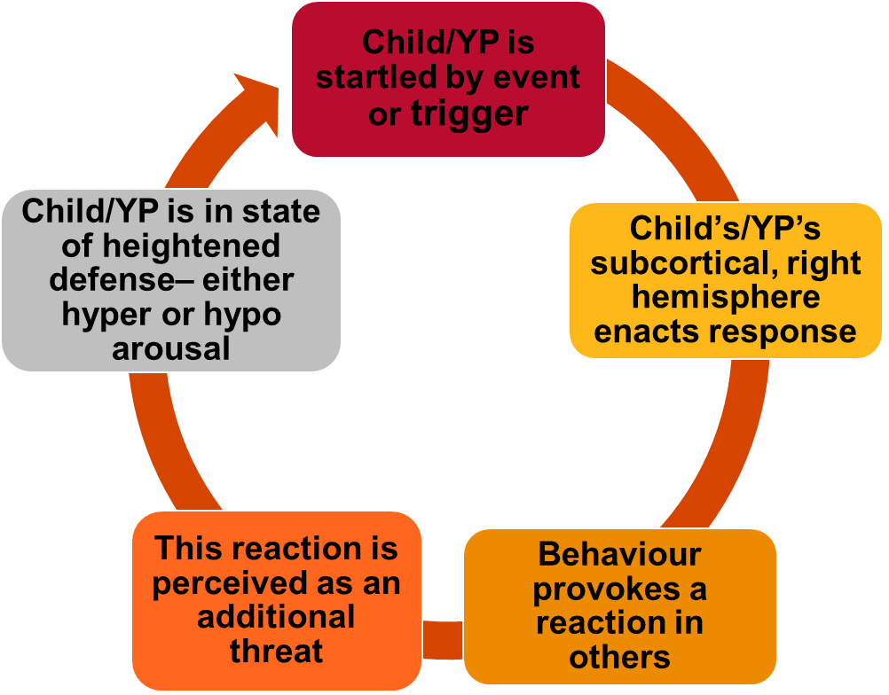
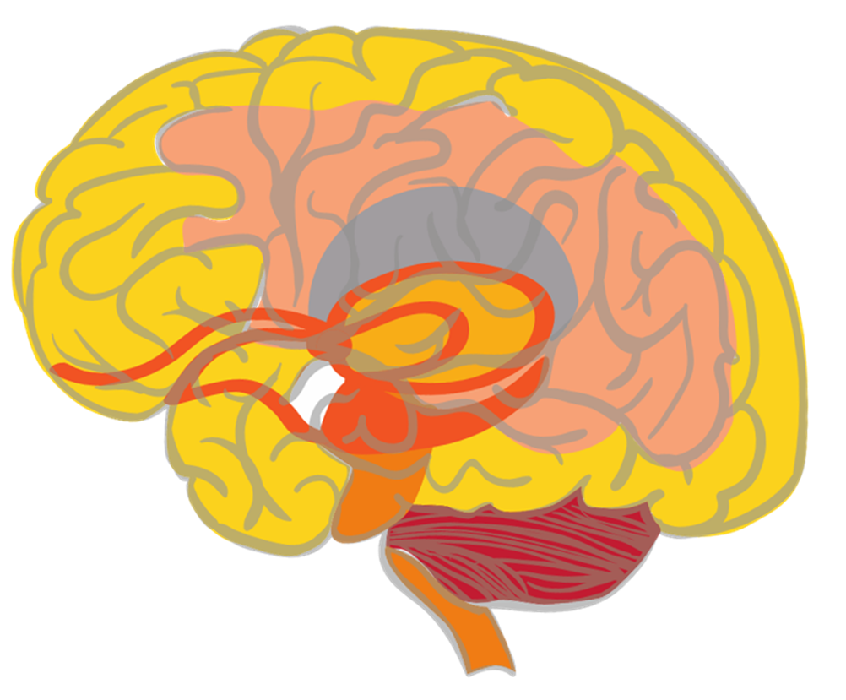
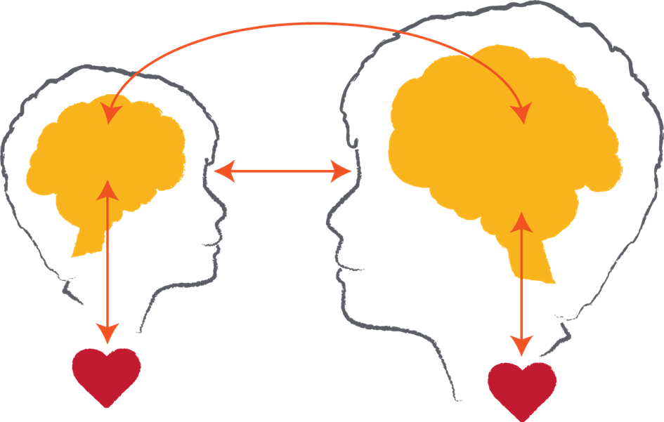
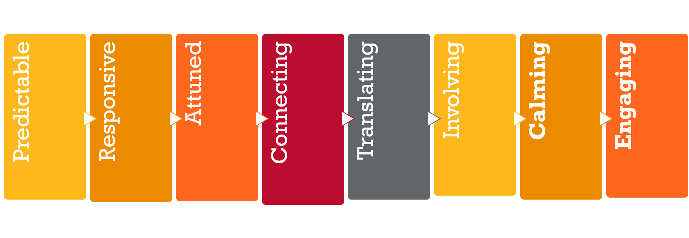
Key messages
Notes:
This slide provides an overview of some of the key messages from the foundational session and enables the trainer to review these and ensure a consistent understanding of the foundational content.
Please note: This slide and content is repeated in all of the modules that are available alongside the foundational training package. It is expected that you will provide the review as a discussion of the key points (below) and activity (see suggestions below) that best meets the needs of the session and the group to whom you are delivering.
Please note: The images included on this review slide are slightly different from those in the foundational package – particularly the brain summary and the relational exchange image. This is done to reduce the wordiness on this ‘busy’ slide and also to reinforce the message with a different visual. Reference can then be made to the foundational package and the key messages from that session.
Trainers might like to do a review activity, facilitate a Q & A session to ensure consistent knowledge or just provide a summary of the key points represented by the images on this slide.
Key points
Neurobiology – the brain develops in a set sequence and broad parts of the brain hold broad functions. This sequence and functioning is helpful in terms of understanding normative child development and also some the possible impacts of early childhood trauma. It is also helpful in terms of considering reparative strategies or actions as we need to integrate all of the brain areas and functions. You might like to remind participants about the brainstem, cerebellum, diencephalon, limbic system, amygdala, hippocampus, cortex and prefrontal cortex. This could be done again through an activity (see below), Q & A or in this key point summary.
The importance of relationships – in development and in learning. This also gives an opportunity to remind participants that relational trauma is particularly impactful because of the critical nature of relationships as an experience of survival, growth and thriving and a reminder that anything that threatens relationships can be experienced as a threat to survival. However, the counter to this that needs to be reinforced is that relationships are also a site of repair and healing that are important for all educators and other staff to focus on and value.
Understanding behavior – this cycle outlines many points about understanding children and young people’s behaviour. This includes the fact that often behaviours play out as cycles of previous experiences being retriggered, as well as the fact that many behaviours are not conscious/cortical choices but are subconscious/subcortical reactions to past experiences.
Repetition builds brains – it is useful to also remind participants of the concept of neurons and neuronal connections. This can be linked to the brain image as well as the behavioural cycle. And of course it also links to the repeated positive relational experiences that build templates of relationship for children represented in the relationship image.
Hypo and hyper-arousal – this helps us to remember that children and young people can experience different responses to experiences of trauma that are linked to their physiological arousal. These patterns tend to fall into hyper-arousal (or an ‘amped up’ arousal response that we might also know as the fight, flight or active freeze response) and hypo-arousal (or a ‘shut down’ arousal response that we might also know as the collapse and surrender response)
SMART PRACTICE – this is a response framework because the other message is one of hope. The more we understand trauma, the better able we are to respond in ways that are both helpful and reparative. This framework incorporates strategy ideas and actions that are: Predictable, Responsive, Attuned, Connecting, Translating, Involving, Calming and Engaging. It is an opportunity to remind participants that the core elements are calming and engaging as regulation and relationships are critical strategies to respond to the impacts of trauma.
Activity - Q and A session
You might like to ask the group to discuss in groups of 4 – 5, what are 3 questions we have about neurobiology and trauma still? You can then record them and work to answer them with the group and/or put any unknown questions on notice and work with the SMART Train the trainer group and Australian Childhood Foundation staff to find the answers.
The focus of this session is on getting participants to consider questions they have and the facilitator providing answers. The suggested activities below ask the participants to reflect on their own knowledge ie: provide their own answers!
Review activity suggestions
The following activity ideas are provided as suggestions. You may like to do your own review activity but its focus is only on key messages from the foundational training session and should not introduce new models of ways of working. Equally, it is suggested that facilitators only select 1 activity to enable the full session content to commence as soon as possible.
Activity 1 – Our top 5 messages
Break the participant group into groups of around 5 people. You may like to consider how groups are divided based on natural groups within the participant cohort or do random allocation or selection.
Ask the group to come up with their ‘top 5 messages about neurobiology and trauma we know’. This gives participants an opportunity to revisit the foundational session content to articulate the key things they remember of the session.
Ask each group to share their top 5 to look at themes and key learning. You can use the ‘key messages’ section included above to fill in any gaps as required.
Activity 2 – Brain puzzle
Use the brain picture provided in the foundational session slides to make a ‘puzzle’ which you can then cut out into the different parts of the brain. Break the participants into groups and get them to put the puzzle together and then discuss a) the function of each part of the brain, b) how it might be impacted by trauma and c) one activity or strategy that supports the healthy development or functioning of that part.
Again, you may need to fill in gaps in knowledge and understanding.
Activity 3 – Key terms and definitions
This activity could be done as a visual activity on slides, a verbal activity ie: read the definition and participants have to link it to the word written on the board or screen or a written activity ie: provide groups with separate words and definitions and ask them to match each. Or you may have your own idea about how to do it! Basically, it is just asking people to match the key term to its relevant definition. The list is included below: (you may like to use all or selected terms and their definitions)
Brainstem – Lowest part of the brain and responsible for basic physiological functioning
Cerebellum – A part of the brain particularly responsible for movement
Limbic lobe - A part of the brain particularly responsible for emotional processing. It includes the amygdala and hippocampus.
Diencephalon – An area of the brain that receives sensory information
Cortex – The largest part of the brain and particularly responsible for conscious thought
Sub-cortical – Refers to parts of the brain underneath the cortex (ie: brainstem, cerebellum, limbic lobe and diencephalon)
Neuronal connections – Pathways between neurons that enable activity and that are strengthened through repetition of activation
PRACTICE – An 8 element framework for responding to children and young people that is grounded in an understanding of neurobiology and trauma
Hemispheres – The 2 sides of the brain (right and left) that hold different and complementary functions
Hyperarousal – A physiological state characterised by fight, flight or freeze responses
Hypoarousal – A physiological state characterized by collapse and surrender responses
Activity 4 – Reflective activity
This asks the participants to think about the relevance of the foundational training session content to the children and young people with whom they work. This activity could be done individually, in pairs, small groups or as a whole group discussion.
The reflective question to be explored is: how has the information explored in the foundational training session helped you to understand and/or respond to a child or young person with whom you work?
This can be expanded on and linked to the ‘Tree of life’ activity that was available for the foundational training session – or you may like to introduce it at the commencement of this session instead. (see the Tree of life activity instructions in the appendix of the foundational training session)

Slide 6
Why talk about the neurobiology of self-care?
Notes:
Key points
Because how I am doing matters in terms of my capacity to most effectively support the learning of the children and young people with whom I work.
Because I have a window of tolerance as well and I need to say within my window of tolerance to be able to support others to access theirs. This is best explained by saying that I cannot yell at someone to calm down!
Because taking care of myself helps me to say within my window of tolerance because self-care is about regulating my own emotional and physiological state.
Because children and young people will often go outside of their window of tolerance, particularly when they have experienced trauma, and this is challenging so I need to look after myself to maintain my own wellbeing in the face of what can be challenging work in a challenging role.
Because understanding neurobiology helps me understand myself as much as those with whom I work.

Slide 7
Thinking about the impacts, defining the terminology
Stress
Something that challenges our capacity to cope
Related to a feeling of being overloaded which is primary to client problems of chronicity and complexity, but can occur in any profession
Something that overwhelms our capacity to cope
Burnout
Trauma
Terms
A state of exhaustion & dysfunction – biologically, psychologically, & socially – as a result of prolonged exposure to compassion stress (Figley)
Adverse reactions to clients’ (students’) traumatic material which brings about change in the professional’s inner experiences, core beliefs.
Compassion
Fatigue
Vicarious Trauma
Secondary Traumatic Stress
‘Compassion fatigue’, ‘Secondary Traumatic Stress’ & ‘Vicarious Trauma’ are often used interchangeably. (Figley 1995; McCann & Saakvitne, 1995)
Adverse reactions to clients’ (students’) traumatic material with symptoms that parallel PTSD.
Notes:
Key points
Researchers in this area may differ in their focus or what term they use to describe the phenomenon, but one common theme emerges; work that is focused on the relief of clients’ emotional suffering typically results in the absorption of information about human suffering (Figley, 1995)
Stress and Burnout can be found in all workplaces but the bottom three develop through exposure to specific kinds of client/student problems and experiences, particularly trauma.
As noted on the slide, the bottom three terms are often used interchangeably but all refer to the impacts of working with traumatized clients or students.
Additional points
In 2003 a study was published titled ‘Vicarious Traumatization, Secondary Traumatic Stress, and Burnout in Sexual Assault and Domestic Violence Agency Staff’ and it found that among 101 trauma counselors, client exposure workload and being paid as a staff member (vs. volunteer) were related to burnout sub-scales, but not as expected to overall burnout or vicarious trauma, secondary traumatic stress, or general distress. More educated counselors and those seeing more clients reported less vicarious trauma. Younger counselors and those with more trauma counseling experience reported more emotional exhaustion.
What can this tell us about the impacts of teaching?

Slide 8
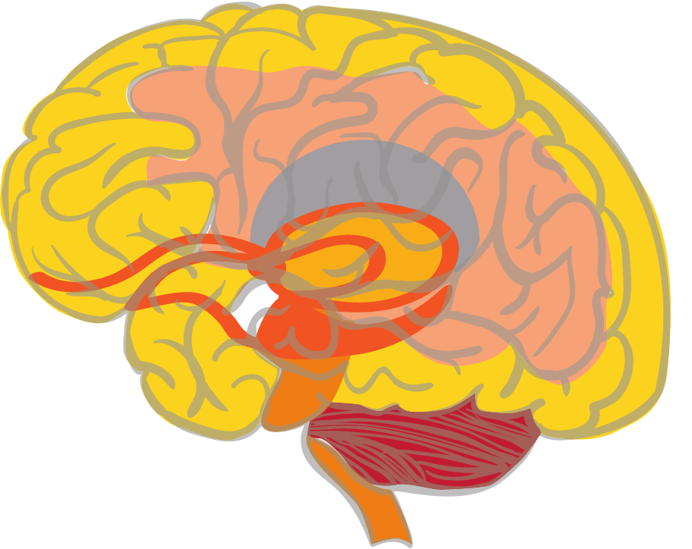
We all have a brain!!
Hypothalamus
Links the nervous system to the endocrine system via the pituitary gland. It synthesizes and secretes hormones to control body temperature, hunger, thirst, fatigue, sleep, and circadian cycles.
Corpus Callosum
Bridge between the 2 hemispheres. Chronic stress can damage and thin down this bundle of neurons
Prefrontal cortex
Responsible for executive functions, such as judgement, reasoning, and self awareness. Final part of the brain to mature in one’s mid 20s.
Thalamus
Sensory receptor within the diencephalon. Receives and passes on sensory data to be further processed by other areas of the brain
Amygdala
Survival response centre within the limbic lobe that becomes enlarged and more sensitive the more it is activated through responding to threats
Hippocampus
Consolidates memory by providing the context/ sequential data for episodic memories. Goes offline if trauma overwhelms and disrupts cortex.
Cerebellum
Balance and coordination, motor skills may be impacted by trauma
Image source: ©2018 ACF
Notes:
Key points
Discussion of this slide could link back to the review of the key messages of neurobiology that were explored earlier in the session. However, the key points that relate to this slide are a reminder that the principles of neurobiology apply to us as much as to the children and young people in the school or site. For example:
We have cortical and subcortical parts of our brain that also function consciously and subconsciously respectively. We often only focus on cortical functioning as the professional but need to understand that the emotional, sensory and physiological impacts of our work are also being recorded.
We also learn through repetition of experience. For example, if we hear a sad story of a child once we are likely to be able to manage that effectively. However, repeated exposure to traumatic stories and experiences will start to build new neuronal connections in our brain that can mirror the experience of the trauma of the children and young people. We need to understand that and try to mitigate the impacts of repeated exposure…..through self-care strategies.
We know that we all store and recall memories but that memory is not a perfect function and our brains can start to believe that others’ experiences are our own if they are repeated enough times.
What other principles of brain development and neurobiology do you think are important to highlight for this group?

Slide 9
Activity : Impacts of trauma
Notes:
Activity
Ask the group to review their understanding of the impacts of trauma and start to make a list of all of the possible impacts of trauma on children and young people (that is the smaller figure on the slide!)
They might start to list things like:
Hyperarousal responses, such as an elevated heart rate, being hypervigilant, aggressiveness, ‘fight or flight’, running out of the room
Hypoarousal responses, such as being shut down, having a flat affect, quiet and withdrawn, collapsed in posture, lethargic
Having learning challenges such as struggling to retain information, finding it hard to concentrate
Poor self-esteem with a sense of oneself as being ‘useless’, ‘hopeless’ or ‘just stupid’ etc etc.
Then – having made that list, ask the group to start thinking about what the impacts of working with traumatised students might be, including what the impact of vicarious trauma might be.
What is likely to emerge is that is a very similar list – but may have a slightly different presentation. For example, a child might run out of the room to avoid a threat whereas a staff member may just not turn up to a meeting!
The purpose of this is to gently help the staff group to understand that the impacts of working with traumatised students can be quite significant, and look like trauma, if we don’t look after ourselves and equally if we don’t understand these impacts.

Slide 10
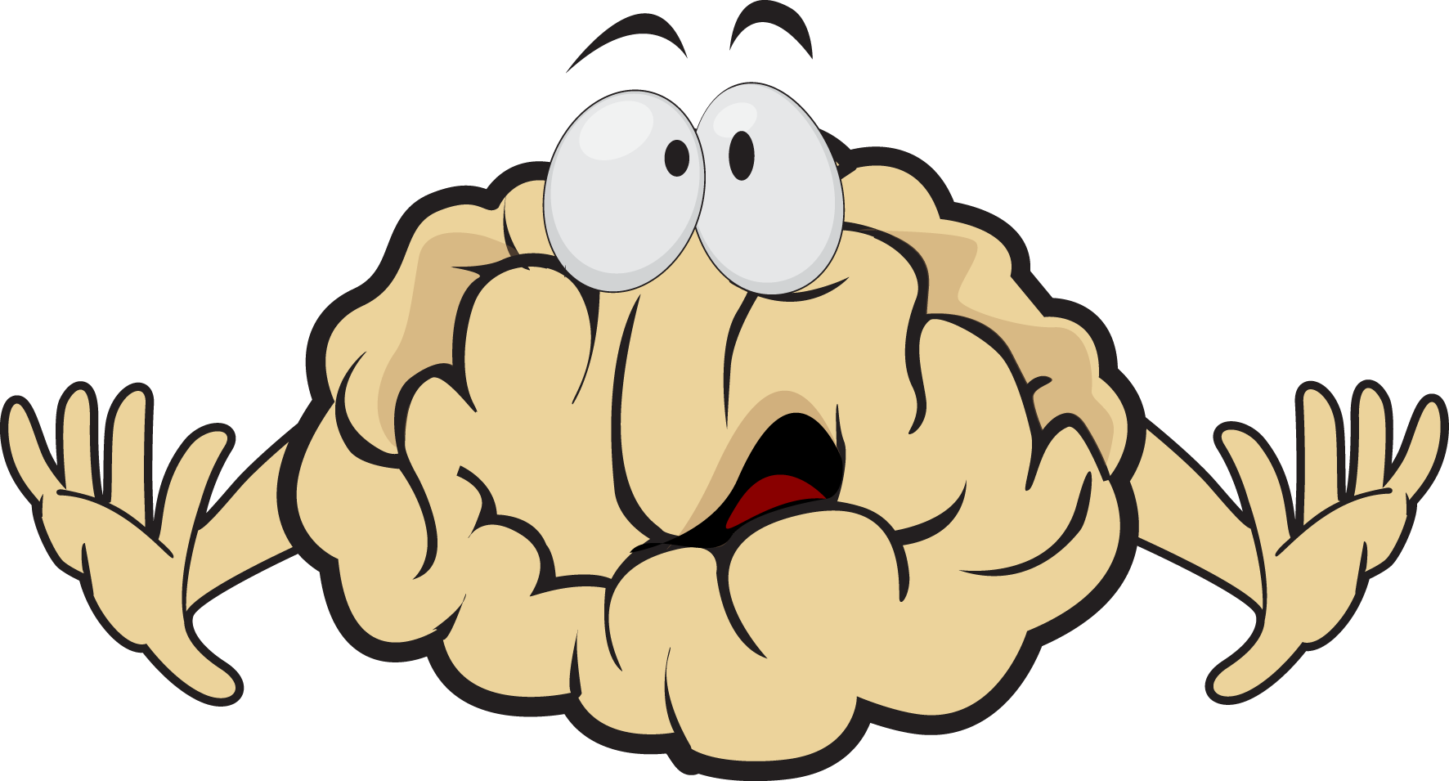
Possible indicators of vicarious trauma
Notes:
Handout: Possible indicators of vicarious trauma
So….this enables you to distribute this handout that outlines some of the possible indicators of vicarious trauma.
It is important to reinforce that these are possible indicators – just because you recognise one or two of these it does not mean that you are vicariously traumatised, but it is worth monitoring your own state of wellbeing.
Please note: the categories are linked to the parts of the brain ie: physically – brainstem and cerebellum; sensorily – diencephalon; emotionally – limbic; cognitively – cortex; reflectively – prefrontal cortex.

Slide 11
How do I know how I am doing?
Useful to monitor impact on the educator or practitioner
A useful tool to monitor your own wellbeing is the ProQol (Professional Quality of Life)
https://www.proqol.org/
This tool provides a snapshot in time of how an educator is travelling re: their sense of self in the work.
Consider ways you might use this tool or other ideas from the department myWellbeing intranet page in your school or site and across your team?
Notes:
Optional handout: ProQol schedule available at the website listed on this slide.
It is strongly suggested that you mention this tool and then suggest that participants if they are interested complete the tool in their own time as there are alternative department approved resources that they can use.
Please note: It is important that you review this resource prior to delivering the training and it is strongly suggested that you complete the ProQoL schedule as well to experience it and note any responses or challenges you have in using the tool. We will reinforce here that it is only ever a snapshot of how anyone is feeling at the time and this should be taken into account. It is also important to note that neither DfE nor ACF are endorsing this tool in any way but just suggesting that it is a self-assessment measure available freely if people want to use it.
Please note: It is also important at this point that both trainers and participants should check the Department for Education’s intranet for the Department’s myWellbeing page and the tools there. E.g. the wellbeing checklist. It is also important to consider the usefulness of the employee assistance programme tools. Trainers should explicitly make this point in the delivery of this session.

Slide 12
Self-care wheel
Self-care
Emotional
Physical
Spiritual
Professional
Psychological
Social
Notes:
Activity
The final activity of this session asks participants to build a self-care plan for themselves.
The self-care wheel outlines that there are 6 areas of self-care and it is helpful to have strategies and activities that support each of the 6. It is suggested that participants work in small groups to discuss, record and add to possible self-care strategies in each of the 6 areas.
Emotional self-care: thinking about strategies and activities that bring joy, calm or peacefulness
Physical self-care: physical activities that can focus on all or any of movement, relaxation or strenuous activity
Spiritual self-care: this is not just about religion but about those things that ‘make our spirit soar’.
Professional self-care: thinking about how we look after ourselves in the context of our role. Examples might be supervision, reflective practice, informal support from colleagues etc.
Psychological self-care: focuses on cognitive activities that we enjoy. This could be crosswords, sudokus, long conversations with friends, reading books or professional journals etc.
Social self-care: these are the relational experiences that help us to take care of ourselves.

Slide 13
Key points about self-care
We need multiple self-care strategies available to us
What works for us may be different from what works for someone else
Many self-care strategies focus on the lower parts of the brain and body
Many self-care strategies we use are also valuable for the children and young people with whom we work
Repetition is required – keep working on your own wellbeing!
Notes:
Key points (related to each key point ☺)
Just having a couple of strategies will not help us as much because they may not be accessible and may not meet our self-care needs in that moment
We need to understand that we can’t always suggest what will work for others because one person’s self-care is another person’s stress! For example: massage can be a dividing strategy, some people love it and find it is very nurturing while others would rather anything but!
It is interesting that many self-care strategies do support the lower parts of the brain and body because that impacts our overall wellbeing – and addresses some of the impacts of our work, as has been discussed previously
It is a helpful point that self-care strategies can be valuable as reparative strategies for children and young people who have experienced trauma. This is because many are sub-cortical (as discussed above) and also are relationally based. Thinking about what works for us as a staff group can be helpful in terms of translating into activities that are trauma responsive (while holding the second point in mind!)
Repetition builds brains but also repairs brains so repetition of self-care is critical to ensure its value and efficacy.

Slide 14
Reflective questions
What can I do?
What can we do?
What do we need to do right now?
This Photo
Notes:
Activity
This final discussion activity supports the capacity to continue the discussion regarding self-care straight away. It also provides an opportunity for checking in with the participant group to see how they are doing by using the question – what do we need to do right now?
Before finishing the session, remind the group about the additional SMART resources available, which may help with further learning:
Other sessions available in the Train the trainer suite
SMART training calendar
Trauma Aware Schools initiative
The broader series of DfE initiatives – outlined in the summary slide available in the foundational session content.
Discussion papers – available at https://professionals.childhood.org.au/making-space-learning-resources/
Further Australian Childhood Foundation resources - https://professionals.childhood.org.au/resources/

