Slide 1
SMART audit tool – supporting trauma responsive school practices
SMART 2021
Notes:
Instructions for use of this package to be inserted here.
Please note the following points about the headings used in the notes page of each session
Key points – these are the main messages related to any particular slide and should be included in the training delivery
Background information – this is information for the trainer only and does not need to be shared with the training participants
Please note – these are important information points about a particular slide or content area. They should be reviewed prior to delivering the training to ensure the point is noted and followed as outlined
Activity – these provide suggested activities to be undertaken during the session. Trainers may choose which activities they include in the delivery of the session. There is no expectation that all activities would be completed. The selection is based on the trainers’ assessment on the group needs, the session facilitation and their own comfort with each activity. We would suggest that additional activities are not used as there is already more content and activity ideas than could be included in any one session.
Additional points – these are additional content points or questions for reflection and can be delivered to the participants in the session or just used for background information for trainers.
Handout – denotes where there is an additional resource available for distribution to participants. Ensuring that there are copies of these available is an important part of preparing for each session.
Optional handout and optional activity – these are included in some sessions and mean that there needs to be some trainer discretion with regard to their use. It is likely that this handout or activity may be too complex or too challenging for most groups and their use needs to be carefully considered. Feel free to discuss their use with other SMART trainers, the DfE team or the ACF team
This session should only be delivered after the foundational package has been delivered. It is also strongly suggested that the session ‘SMART PRACTICE – Strategies in action’ also be delivered prior to this session but this is not a requirement.
As a reminder, the additional sessions to the foundation training package are:
SMART PRACTICE – Strategies in action
Establishing and maintaining safe, supportive learning environments
Neurobiology of self-care and staff wellbeing
Exploring Polyvagal Theory and neurobiology

Slide 3
Success criteria
Ensured a solid understanding of developmental, relational, trauma focusing on brain and body functioning;
Completed a review of current trauma responsive practices using the SMART audit tool;
Built a plan of action for practice skills and strategies to enable effective support and healing outcomes; and
Developed a plan for ongoing monitoring and review
Notes:
Background information
Specific additional learning outcomes may be identified for an individual site but these are the key areas to be covered over the 1 hour session. This can be delivered over 90 minutes if required, as a maximum timeframe.
Please note the wording of success criteria, as requested by the SMART Train the trainer group.
Key points
This session is focused on embedding trauma responsive practice in the school or site. After completing a review of the key messages of trauma responsive practice, we will then ask the staff group to reflect on what they already are doing in terms of their practice – through a reflective activity and then completing an audit process – and subsequently build a plan of action that integrates current practice with future additions to practice based on identified gaps.

Slide 4
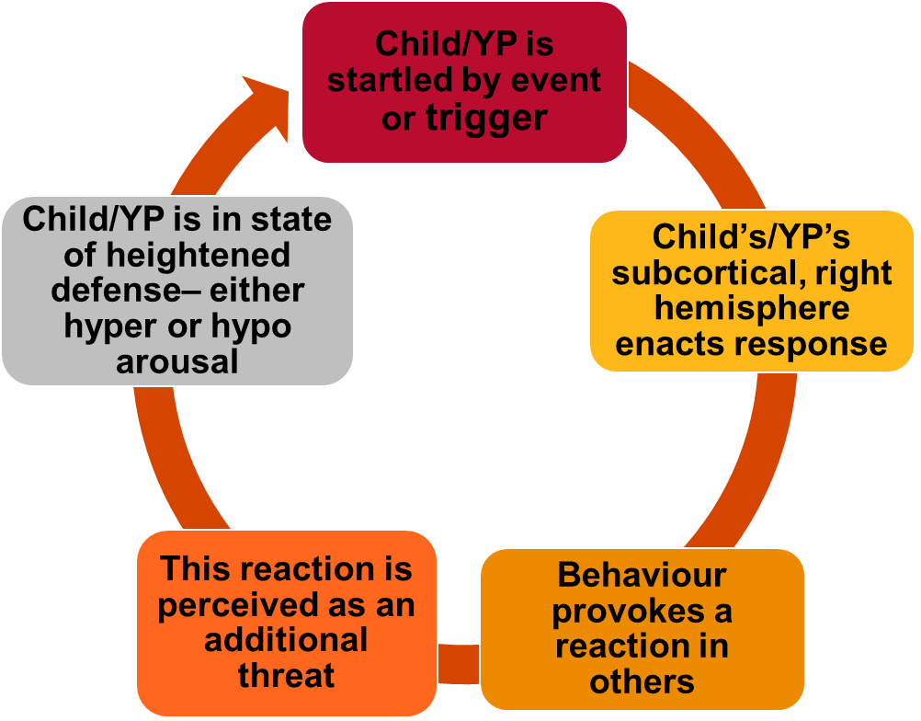
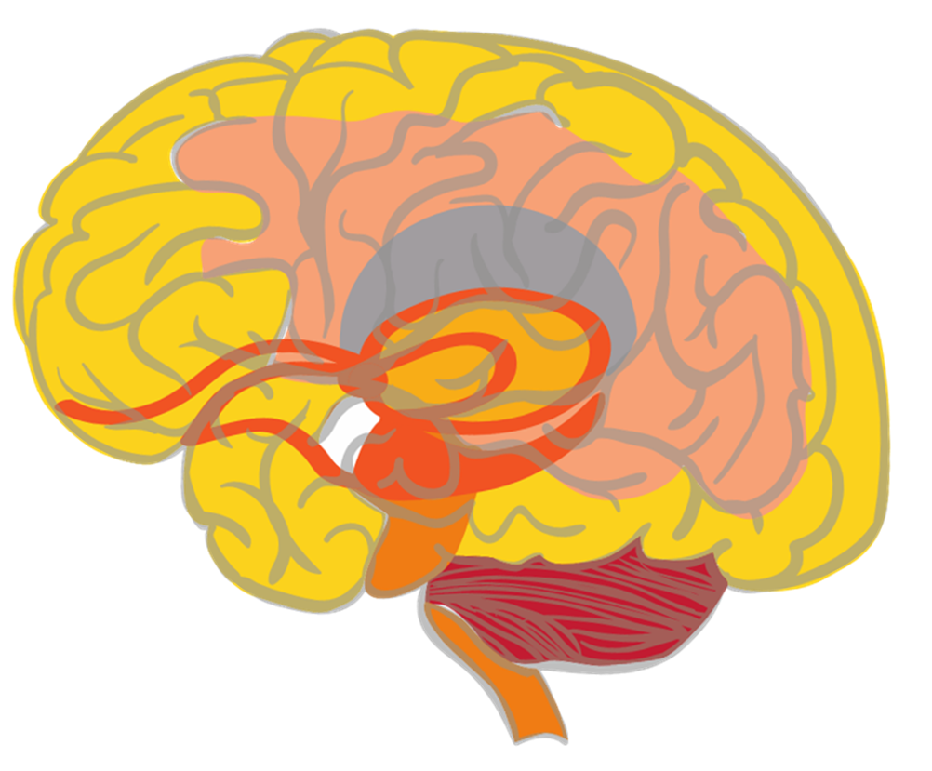
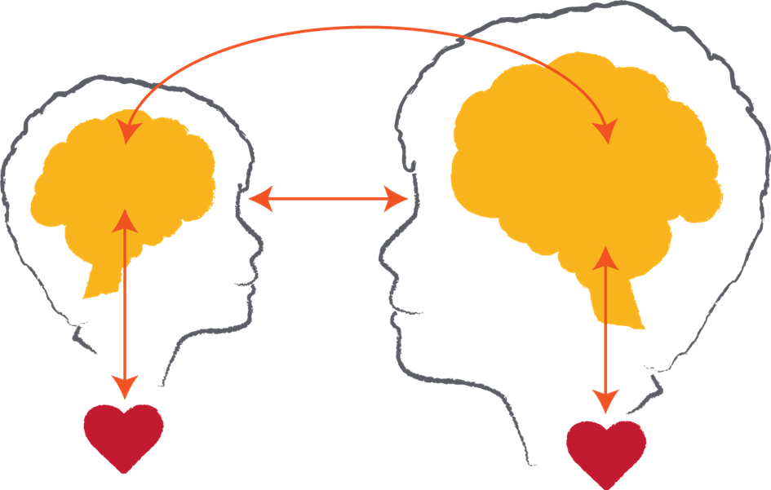
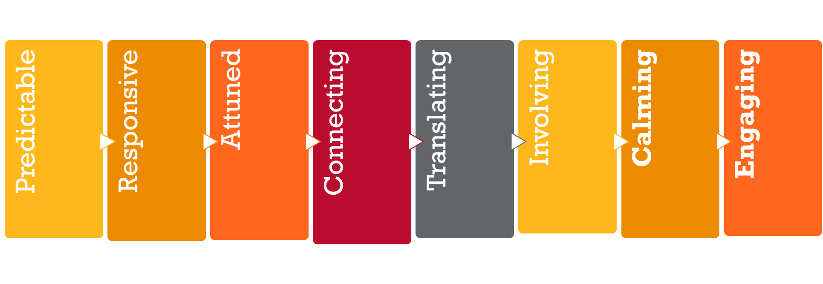
Key messages
Notes:
This slide provides an overview of some of the key messages from the foundational session and enables the trainer to review these and ensure a consistent understanding of the foundational content.
Please note: This slide and content is repeated in all of the modules that are available alongside the foundational training package. It is expected that you will provide the review as a discussion of the key points (below) and activity (see suggestions below) that best meets the needs of the session and the group to whom you are delivering.
Please note: The images included on this review slide are slightly different from those in the foundational package – particularly the brain summary and the relational exchange image. This is done to reduce the wordiness on this ‘busy’ slide and also to reinforce the message with a different visual. Reference can then be made to the foundational package and the key messages from that session.
Trainers might like to do a review activity, facilitate a Q & A session to ensure consistent knowledge or just provide a summary of the key points represented by the images on this slide.
Key points
Neurobiology – the brain develops in a set sequence and broad parts of the brain hold broad functions. This sequence and functioning is helpful in terms of understanding normative child development and also some the possible impacts of early childhood trauma. It is also helpful in terms of considering reparative strategies or actions as we need to integrate all of the brain areas and functions. You might like to remind participants about the brainstem, cerebellum, diencephalon, limbic system, amygdala, hippocampus, cortex and prefrontal cortex. This could be done again through an activity (see below), Q & A or in this key point summary.
The importance of relationships – in development and in learning. This also gives an opportunity to remind participants that relational trauma is particularly impactful because of the critical nature of relationships as an experience of survival, growth and thriving and a reminder that anything that threatens relationships can be experienced as a threat to survival. However, the counter to this that needs to be reinforced is that relationships are also a site of repair and healing that are important for all educators and other staff to focus on and value.
Understanding behavior – this cycle outlines many points about understanding children and young people’s behaviour. This includes the fact that often behaviours play out as cycles of previous experiences being retriggered, as well as the fact that many behaviours are not conscious/cortical choices but are subconscious/subcortical reactions to past experiences.
Repetition builds brains – it is useful to also remind participants of the concept of neurons and neuronal connections. This can be linked to the brain image as well as the behavioural cycle. And of course it also links to the repeated positive relational experiences that build templates of relationship for children represented in the relationship image.
Hypo and hyper-arousal – this helps us to remember that children and young people can experience different responses to experiences of trauma that are linked to their physiological arousal. These patterns tend to fall into hyper-arousal (or an ‘amped up’ arousal response that we might also know as the fight, flight or active freeze response) and hypo-arousal (or a ‘shut down’ arousal response that we might also know as the collapse and surrender response)
SMART PRACTICE – this is a response framework because the other message is one of hope. The more we understand trauma, the better able we are to respond in ways that are both helpful and reparative. This framework incorporates strategy ideas and actions that are: Predictable, Responsive, Attuned, Connecting, Translating, Involving, Calming and Engaging. It is an opportunity to remind participants that the core elements are calming and engaging as regulation and relationships are critical strategies to respond to the impacts of trauma.
Activity - Q and A session
You might like to ask the group to discuss in groups of 4 – 5, what are 3 questions we have about neurobiology and trauma still? You can then record them and work to answer them with the group and/or put any unknown questions on notice and work with the SMART Train the trainer group and Australian Childhood Foundation staff to find the answers.
The focus of this session is on getting participants to consider questions they have and the facilitator providing answers. The suggested activities below ask the participants to reflect on their own knowledge ie: provide their own answers!
Review activity suggestions
The following activity ideas are provided as suggestions. You may like to do your own review activity but its focus is only on key messages from the foundational training session and should not introduce new models of ways of working. Equally, it is suggested that facilitators only select 1 activity to enable the full session content to commence as soon as possible.
Activity 1 – Our top 5 messages
Break the participant group into groups of around 5 people. You may like to consider how groups are divided based on natural groups within the participant cohort or do random allocation or selection.
Ask the group to come up with their ‘top 5 messages about neurobiology and trauma we know’. This gives participants an opportunity to revisit the foundational session content to articulate the key things they remember of the session.
Ask each group to share their top 5 to look at themes and key learning. You can use the ‘key messages’ section included above to fill in any gaps as required.
Activity 2 – Brain puzzle
Use the brain picture provided in the foundational session slides to make a ‘puzzle’ which you can then cut out into the different parts of the brain. Break the participants into groups and get them to put the puzzle together and then discuss a) the function of each part of the brain, b) how it might be impacted by trauma and c) one activity or strategy that supports the healthy development or functioning of that part.
Again, you may need to fill in gaps in knowledge and understanding.
Activity 3 – Key terms and definitions
This activity could be done as a visual activity on slides, a verbal activity ie: read the definition and participants have to link it to the word written on the board or screen or a written activity ie: provide groups with separate words and definitions and ask them to match each. Or you may have your own idea about how to do it! Basically, it is just asking people to match the key term to its relevant definition. The list is included below: (you may like to use all or selected terms and their definitions)
Brainstem – Lowest part of the brain and responsible for basic physiological functioning
Cerebellum – A part of the brain particularly responsible for movement
Limbic lobe - A part of the brain particularly responsible for emotional processing. It includes the amygdala and hippocampus.
Diencephalon – An area of the brain that receives sensory information
Cortex – The largest part of the brain and particularly responsible for conscious thought
Sub-cortical – Refers to parts of the brain underneath the cortex (ie: brainstem, cerebellum, limbic lobe and diencephalon)
Neuronal connections – Pathways between neurons that enable activity and that are strengthened through repetition of activation
PRACTICE – An 8 element framework for responding to children and young people that is grounded in an understanding of neurobiology and trauma
Hemispheres – The 2 sides of the brain (right and left) that hold different and complementary functions
Hyperarousal – A physiological state characterised by fight, flight or freeze responses
Hypoarousal – A physiological state characterized by collapse and surrender responses
Activity 4 – Reflective activity
This asks the participants to think about the relevance of the foundational training session content to the children and young people with whom they work. This activity could be done individually, in pairs, small groups or as a whole group discussion.
The reflective question to be explored is: how has the information explored in the foundational training session helped you to understand and/or respond to a child or young person with whom you work?
This can be expanded on and linked to the ‘Tree of life’ activity that was available for the foundational training session – or you may like to introduce it at the commencement of this session instead. (see the Tree of life activity instructions in the appendix of the foundational training session)

Slide 5
Implementing trauma responsive practice
What do you already do well across your school/site in terms of trauma responsive practice?
Is the focus of that practice on individual students, small groups, classroom groups, year levels or whole of school?
In thinking about these practices, we know that:
- many are already being implemented
- these practices are relationally based
- these actions are not always reflected in policies and procedures
- consistent application is key
Notes:
Activity
The focus of this slide is to have a whole of group (or small group) discussion about what is already in place and how it is targeted – as per the first 2 questions on the slide.
Ask for feedback about the discussion to reinforce what is already being implemented.
As the final point outlines, it is important to acknowledge that often teachers and other education professionals are already implementing trauma responsive practice without necessarily calling it that. That is because the focus of so many interactions, actions and strategies is the relationships that are built between the adults and children in the school or site. Education professionals are invariably good at relationships – which is why they choose this career! We need to acknowledge and validate these practices as they are so important for all children and young people, but especially those who have experienced trauma.
It is also the case that, as trauma responsive practice is more understood and implemented, the school or site’s policies and procedures may not be reflective of the actions and strategies being put in place. An example we often see is that there are relational responses to behaviour being utilised – addressing the child or young person’s underlying needs – but the site’s policies and procedures are still reflective of a behavioural, or even punitive, approach.
The final point reminds us that repetition and predictability are critical aspects of trauma responsive practice as children and young people need to experience safety through consistency. This means that a shared approach across the school or site is really important to ensure everyone is ‘on the same page’.

Slide 6
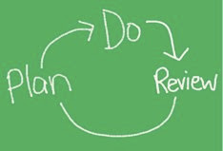
Opportunity for review and planning
This session provides an opportunity to consider what is already being done and how it can be enhanced or improved
Notes:
Key points
This simple cycle is a reminder of the process of change – and that it can start at any point in the cycle. In this session, we are actually starting with a review (as per the discussion completed based on the previous slide), that will enable a plan of action that can be put into action – or done – and then reviewed again.

Slide 7
Linking our understanding of neurobiology to leading change
We react physiologically to social situations (and social pain) the same way as we react to the physical environment (and physical pain)
Our workplace is viewed as a social environment where we constantly assess interactions and situations as threats or rewards
Notes:
Background information
This section can be hidden if needed but it supports an underpinning capacity to review each site’s practices, what is being done well and what can be improved or added to.
It is important to acknowledge that, while some trauma responsive practices are already being implemented, change may be required in terms of how everyone across the school or site can better implement responses that support the needs of children and young people who have experienced trauma.
However, what is also clear is that any change can be challenging and that – actually – our understanding of neurobiology can help us to understand why. We keep reinforcing that this knowledge is valuable for us as adults and professionals as much as it is for the children and young people with whom we work. We all have a brain!
We often talk about how children and young people who have experienced trauma struggle with change. However, when you think about it, they are not the only ones! Most of us struggle with change because we work well with repetition and working on the familiar – both consciously and subconsciously (or cortically and sub-cortically). For example, think about brushing your teeth. You tend to brush your teeth in the same sequence every time. Consider that the next time you are brushing and then try to change the order in which you brush. How does that feel???
This slide explores the link between our understanding of Polyvagal Theory and the experience of change. (Remember that you can review the content of the session ‘Exploring Polyvagal Theory and neurobiology’ to reinforce your understanding of this relevant theoretical framework.)
It tells us that there is a link between social pain and physical pain – as there is between social safety and physical safety. It also tells us that our environment is a critical aspect of safety and that, because we spend so much time in the school environment, we sub-consciously experience this as a social environment where we are constantly evaluating threats and rewards within that environment. This constant evaluation can mean that we experience change as threatening within that consistent environment. This is explored further on the next slide.

Slide 8
The experience of change
The brain craves consistency and predictability
Change or proposed change takes more energy to deal with
It moves the brain into a survival mode, creating an ‘alert’
We all have a different definition or experience of what change is
For example, managing the challenges of any given day in a school may not be seen as a change but a restructure of year level coordinators might be
Notes:
Key points
And so, this slide tells us about the neurobiology of change. Why is this important? Because, implementing trauma responsive practice can ask us to change things that we have done in the past – and maintain that change despite it being easier to go back to old patterns of behavior and responding. If we understand why we might respond in the way we do it can help us to maintain our commitment to change. This understanding of the neurobiology is also helpful in understanding the children and young people we work with – and why they often fall back into old patterns of responding when things get challenging. An example that might explain this is where I might say that ‘I am never going to do or say (whatever it is) that which my mother did or said’ and you don’t, until you are put under stress. All of a sudden you realise that the words you were ‘never’ going to use are coming out of your mouth! It is likely we will fall back into old patterns when put under stress.
As the slide tells us, change or proposed change takes more energy to deal with. This energy comes from having to do more work to make sense of what is going on –by using a range of different parts of the brain, particularly the prefrontal cortex.
Ask the group to consider what this might mean for implementing new trauma responsive practices.

Slide 9
Building predictability and safety
Managing transitions
Daily routines
Calming activities for managing change
Finding and accessing a safe place, safe activity, safe person
Responding from a relational perspective
Ensuring a collective response that focuses on self-care, prevention, support and management
Notes:
Please note: As mentioned previously, this section can be hidden if you would prefer not to work though the importance of building predictability and safety in implementing change processes.
Key points
In a statement that seems counter intuitive, it is important to acknowledge that it is easier to deal with change if we have a stable platform of predictability and safety from which to step into that change. This is the case for the children and young people as much as it is for us. For example, we can often manage if things are going awry at work if things are predictable and safe in our home life. However, if there is a lot of change and challenge in both our work and home life that is when we can feel more overwhelmed and stressed.
This slide addresses this issue as both an important step in implementing trauma responsive practices as well as providing some ideas for working with children and young people who have experienced trauma. The relevance to each group is summarised in the information below:
Managing transitions
Implementing change: The change to new strategies needs to be considered carefully. How do we involve everyone in the transition? What do they need to implement a new approach or strategy?
Working with children and young people: Think about all the transitions during the day (home-school, outside-inside, subject-subject, classroom- playground, school-home etc etc). These are points of change for children and they often need clear guidelines and routines to manage those changes.
Daily routines
Implementing change: When implementing new strategies or approaches, it is important to break it down into doable steps that are repeated each day.
Working with children and young people: As outlined in the previous point, consistent routines are an important strategy for supporting children and young people to feel safe in the learning environments. These give children and young people that platform of stability that eventually enables them to manage change without evoking the same level of threat response as we might see in current situations.
Calming activities for managing change
Implementing change: We know that when we are calm (or in our window of tolerance) we are best able to think, best able to engage in relationships, best able to respond not react and best able to function physiologically. Thus, ensuring we are calm is an important step in being able to make changes to how we might respond to traumatised children and young people. We need to build calming activities into our day to enable us to work most effectively. Some might call this self-care! This point links to the session ‘Neurobiology of self-care and staff wellbeing’.
Working with children and young people: Supporting children and young people to experience calm is a fundamental component of trauma responsive practice. That is covered in more detail in the ‘SMART PRACTICE – strategies in action’ session.
Finding and accessing a safe place, safe activity, safe person
Implementing change: This is linked to the above point but reminds us that safety can be found environmentally, in action and in relationships. Staff might need to access these experiences of safety to support the implementation of trauma responsive practices.
Working with children and young people: This point is reinforced for children and young people. They need multiple experiences of safety throughout each day to help their physiological system to reset to a baseline of calm – or to stay within their window of tolerance.
Responding from a relational perspective
Implementing change: We are also aware that relationships are fundamental to all human beings because they support our very survival. This doesn’t change when we become professionals and do our work. Any change needs to be implemented in a relational way to ensure that everyone involved feels connected, supported and safe in the midst of doing things differently.
Working with children and young people: Supporting children and young people to experience positive and repeated relational exchanges is a fundamental component of trauma responsive practice. That is covered in more detail in the ‘SMART PRACTICE – strategies in action’ session.
Ensuring a collective response that focuses on self-care, prevention, support and management
Implementing change: The more we are all able to implement the selected practices, the better able we are to implement it in a way that is inclusive and safe because no one feels like they are ‘going it alone’. It is also the case that we all need to take care of each other as a staff group to ensure that everyone’s wellbeing is considered and maintained. This is covered in more detail in the ‘Neurobiology of self-care and staff wellbeing’ session.
Working with children and young people: If we are able to take care of ourselves we are better able to meet the needs of all children and young people, including those who have experienced trauma.

Slide 10
SMART audit tool
Notes:
Handout: SMART audit tool
Activity
Firstly, you may need to remind the participants again about each of the elements of SMART PRACTICE (if not already done in the key messages review section of this session).
Then, work in small groups or as a whole group discussion.
Start with – completing the audit table based on what we as a staff group already do in terms of trauma responsive practice.
Then – discuss and celebrate those successes. How has that happened? Why do we do this well? What can we learn from what we do well?
Then – identify if there are any gaps in the audit responses. This identifies where to from here.
Then – build a plan for how we can address those gaps moving forward.
Please note: the reflective questions on the next slide could also be used for the discussion activity.

Slide 11
Reflective questions
In reviewing the audit tool, what can we include regarding what we already do?
Where are the gaps or areas for improvement based on the audit tool?
What do we need to be able to reinforce what we already do, address the identified gaps or work on the areas for improvement?
What is our action plan?
This Photo
Notes:
Activity
These questions will form much of the content of the rest of the session as it gives the school or site staff group an opportunity to consider: Where to from here?
Key points
Remind the group about the additional SMART resources available, which may help with implementing the plan developed:
Other sessions available in the Train the trainer suite
SMART training calendar
Trauma Aware Schools initiative
The broader series of DfE initiatives – outlined in the summary slide available in the foundational session content.
Discussion papers – available at https://professionals.childhood.org.au/making-space-learning-resources/
Further Australian Childhood Foundation resources - https://professionals.childhood.org.au/resources/

