Slide 1
SMART PRACTICE – Strategies in action
SMART 2021
Notes:
Instructions for use of this package to be inserted here
Please note the following points about the headings used in the notes page of each session
Key points – these are the main messages related to any particular slide and should be included in the training delivery
Background information – this is information for the trainer only and does not need to be shared with the training participants
Please note – these are important information points about a particular slide or content area. They should be reviewed prior to delivering the training to ensure the point is noted and followed as outlined
Activity – these provide suggested activities to be undertaken during the session. Trainers may choose which activities they include in the delivery of the session. There is no expectation that all activities would be completed. The selection is based on the trainers’ assessment on the group needs, the session facilitation and their own comfort with each activity. We would suggest that additional activities are not used as there is already more content and activity ideas than could be included in any one session.
Additional points – these are additional content points or questions for reflection and can be delivered to the participants in the session or just used for background information for trainers.
Handout – denotes where there is an additional resource available for distribution to participants. Ensuring that there are copies of these available is an important part of preparing for each session.
Optional handout and optional activity – these are included in some sessions and mean that there needs to be some trainer discretion with regard to their use. It is likely that this handout or activity may be too complex or too challenging for most groups and their use needs to be carefully considered. Feel free to discuss their use with other SMART trainers, the Department for Education team or the ACF team
This session should only be delivered after the foundational package has been delivered.
As a reminder, the additional sessions to the foundation training package are:
Neurobiology of self-care and staff wellbeing
Establishing and maintaining safe, supportive learning environments
SMART audit tool – supporting trauma responsive school practices
Exploring Polyvagal Theory and neurobiology

Slide 3
Success criteria
Review understanding of developmental, relational, trauma focusing on brain and body functioning;
Enhanced practice skills and strategies to enable effective support and healing outcomes using the PRACTICE framework; and
Identified areas for implementation and further action
Notes:
Background information
Specific additional learning outcomes may be identified for an individual site but these are the key areas to be covered over the 1 hour session. This can be delivered over 90 minutes if required, as a maximum timeframe.
Please note the wording of success criteria, as requested by the SMART Train the trainer group.
Key points
This session is focused on the specifics of the PRACTICE framework and outlines how each element links to an understanding of trauma and its impacts, strategies and activities that fit each element and what the outcomes of these activities and strategies will be.

Slide 4
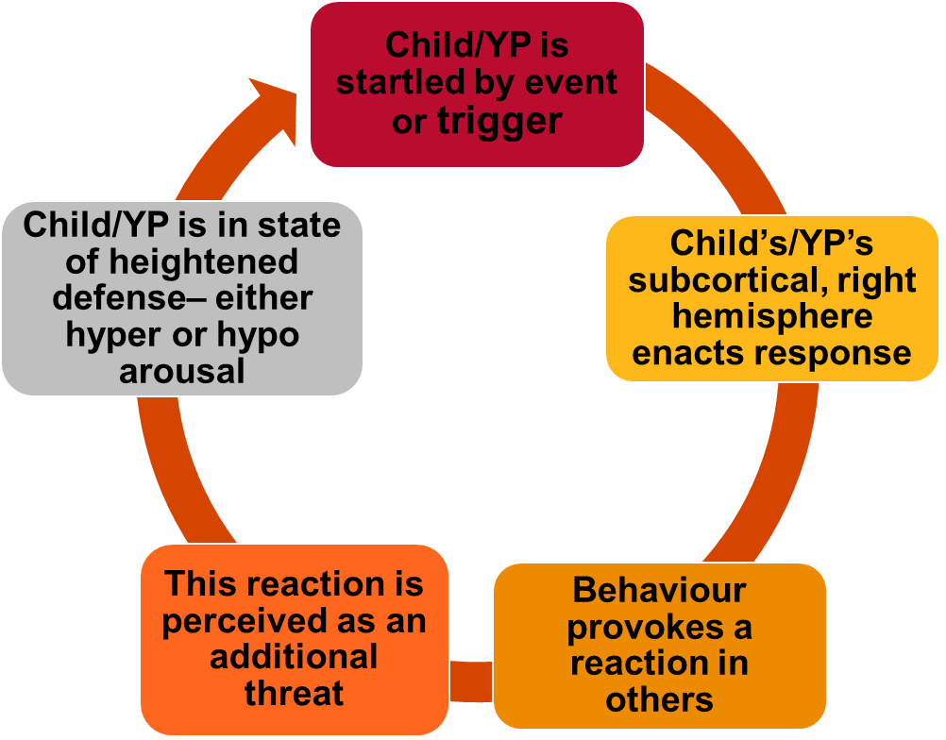
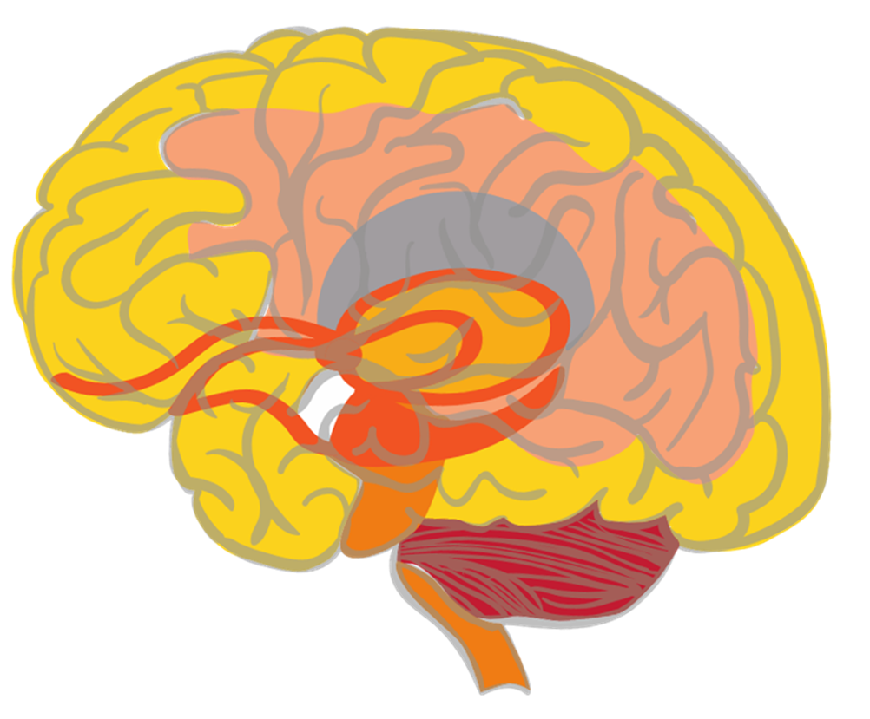
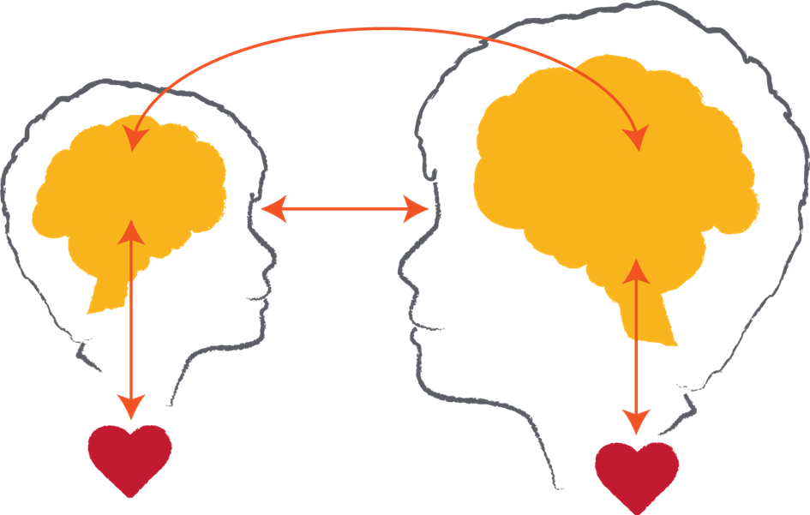
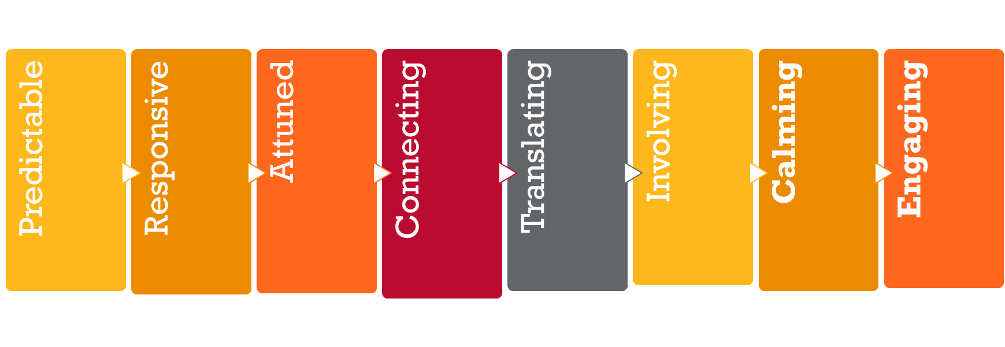
Key messages
Notes:
This slide provides an overview of some of the key messages from the foundational session and enables the trainer to review these and ensure a consistent understanding of the foundational content.
Please note: This slide and content is repeated in all of the modules that are available alongside the foundational training package. It is expected that you will provide the review as a discussion of the key points (below) and activity (see suggestions below) that best meets the needs of the session and the group to whom you are delivering.
Please note: The images included on this review slide are slightly different from those in the foundational package – particularly the brain summary and the relational exchange image. This is done to reduce the wordiness on this ‘busy’ slide and also to reinforce the message with a different visual. Reference can then be made to the foundational package and the key messages from that session.
Trainers might like to do a review activity, facilitate a Q & A session to ensure consistent knowledge or just provide a summary of the key points represented by the images on this slide.
Key points
Neurobiology – the brain develops in a set sequence and broad parts of the brain hold broad functions. This sequence and functioning is helpful in terms of understanding normative child development and also some the possible impacts of early childhood trauma. It is also helpful in terms of considering reparative strategies or actions as we need to integrate all of the brain areas and functions. You might like to remind participants about the brainstem, cerebellum, diencephalon, limbic system, amygdala, hippocampus, cortex and prefrontal cortex. This could be done again through an activity (see below), Q & A or in this key point summary.
The importance of relationships – in development and in learning. This also gives an opportunity to remind participants that relational trauma is particularly impactful because of the critical nature of relationships as an experience of survival, growth and thriving and a reminder that anything that threatens relationships can be experienced as a threat to survival. However, the counter to this that needs to be reinforced is that relationships are also a site of repair and healing that are important for all educators and other staff to focus on and value.
Understanding behaviour – this cycle outlines many points about understanding children and young people’s behavior. This includes the fact that often behaviours play out as cycles of previous experiences being retriggered, as well as the fact that many behaviours are not conscious/cortical choices but are subconscious/subcortical reactions to past experiences.
Repetition builds brains – it is useful to also remind participants of the concept of neurons and neuronal connections. This can be linked to the brain image as well as the behavioural cycle. And of course it also links to the repeated positive relational experiences that build templates of relationship for children represented in the relationship image.
Hypo and hyper-arousal – this helps us to remember that children and young people can experience different responses to experiences of trauma that are linked to their physiological arousal. These patterns tend to fall into hyper-arousal (or an ‘amped up’ arousal response that we might also know as the fight, flight or active freeze response) and hypo-arousal (or a ‘shut down’ arousal response that we might also know as the collapse and surrender response)
SMART PRACTICE – this is a response framework because the other message is one of hope. The more we understand trauma, the better able we are to respond in ways that are both helpful and reparative. This framework incorporates strategy ideas and actions that are: Predictable, Responsive, Attuned, Connecting, Translating, Involving, Calming and Engaging. It is an opportunity to remind participants that the core elements are calming and engaging as regulation and relationships are critical strategies to respond to the impacts of trauma.
Activity - Q and A session
You might like to ask the group to discuss in groups of 4 – 5, what are 3 questions we have about neurobiology and trauma still? You can then record them and work to answer them with the group and/or put any unknown questions on notice and work with the SMART Train the trainer group and Australian Childhood Foundation staff to find the answers.
The focus of this session is on getting participants to consider questions they have and the facilitator providing answers. The suggested activities below ask the participants to reflect on their own knowledge i.e.: provide their own answers!
Review activity suggestions
The following activity ideas are provided as suggestions. You may like to do your own review activity but its focus is only on key messages from the foundational training session and should not introduce new models of ways of working. Equally, it is suggested that facilitators only select 1 activity to enable the full session content to commence as soon as possible.
Activity 1 – Our top 5 messages
Break the participant group into groups of around 5 people. You may like to consider how groups are divided based on natural groups within the participant cohort or do random allocation or selection.
Ask the group to come up with their ‘top 5 messages about neurobiology and trauma we know’. This gives participants an opportunity to revisit the foundational session content to articulate the key things they remember of the session.
Ask each group to share their top 5 to look at themes and key learning. You can use the ‘key messages’ section included above to fill in any gaps as required.
Activity 2 – Brain puzzle
Use the brain picture provided in the foundational session slides to make a ‘puzzle’ which you can then cut out into the different parts of the brain. Break the participants into groups and get them to put the puzzle together and then discuss a) the function of each part of the brain, b) how it might be impacted by trauma and c) one activity or strategy that supports the healthy development or functioning of that part.
Again, you may need to fill in gaps in knowledge and understanding.
Activity 3 – Key terms and definitions
This activity could be done as a visual activity on slides, a verbal activity i.e.: read the definition and participants have to link it to the word written on the board or screen or a written activity i.e.: provide groups with separate words and definitions and ask them to match each. Or you may have your own idea about how to do it! Basically, it is just asking people to match the key term to its relevant definition. The list is included below: (you may like to use all or selected terms and their definitions)
Brainstem – Lowest part of the brain and responsible for basic physiological functioning
Cerebellum – A part of the brain particularly responsible for movement
Limbic lobe - A part of the brain particularly responsible for emotional processing. It includes the amygdala and hippocampus.
Diencephalon – An area of the brain that receives sensory information
Cortex – The largest part of the brain and particularly responsible for conscious thought
Sub-cortical – Refers to parts of the brain underneath the cortex (i.e.: brainstem, cerebellum, limbic lobe and diencephalon)
Neuronal connections – Pathways between neurons that enable activity and that are strengthened through repetition of activation
PRACTICE – An 8 element framework for responding to children and young people that is grounded in an understanding of neurobiology and trauma
Hemispheres – The 2 sides of the brain (right and left) that hold different and complementary functions
Hyperarousal – A physiological state characterised by fight, flight or freeze responses
Hypoarousal – A physiological state characterized by collapse and surrender responses
Activity 4 – Reflective activity
This asks the participants to think about the relevance of the foundational training session content to the children and young people with whom they work. This activity could be done individually, in pairs, small groups or as a whole group discussion.
The reflective question to be explored is: how has the information explored in the foundational training session helped you to understand and/or respond to a child or young person with whom you work?
This can be expanded on and linked to the ‘Tree of life’ activity that was available for the foundational training session – or you may like to introduce it at the commencement of this session instead. (see the Tree of life activity instructions in the appendix of the foundational training session)

Slide 5
SMART PRACTICE
This provides the framework for selecting strategies and activities to best meet the needs of children and young people.
SMART PRACTICE is grounded in our understanding of neurobiology and trauma.
The strategies can be used with individual children, small groups, classrooms, whole year levels or whole school.
It is a reminder that repetition is key to building change.
You can select any or all elements based on the needs of children and young people in the education environment.
Notes:
Background information
The remainder of this session will work through each element of SMART PRACTICE and look at the purpose, strategies and outcomes for each one.
Please note: You might like to ask participants what they would add to each element or do an activity toward the end of the session to work through the whole of the PRACTICE Framework, depending on the time you have available and the experience of the group completing the training.
It is good if you an add additional ideas of strategies and activities that you use in your practice as well as examples of how it has been successful. This will be unique to each facilitator and their own practice wisdom.
You will see that there are not many notes through this session because it is a reinforcement of what you already know in terms of SMART PRACTICE and it gives scope for you to add your own examples and experience.

Slide 6
Predictable – Why?
Children and young people who experience trauma often struggle with change as it induces a threat response
Building predictability builds a platform for managing change
Predictability comes through routines, consistency and preparing children and young people for upcoming change

Slide 7
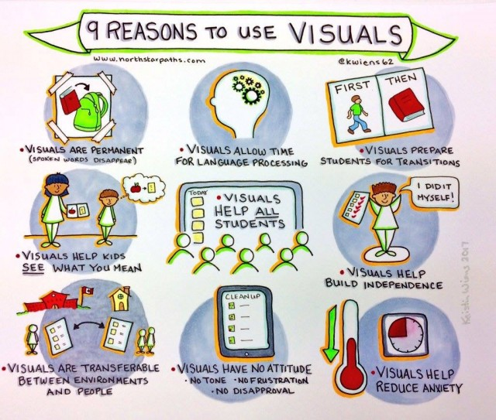
Predictable – How?
Build routines and predictability wherever possible
Prepare children and young people for what is coming next eg: giving countdowns to transitions
Visual timetables are useful – as long as children are reminded to access them
Think about how to do transitions throughout the day
Give plenty of information and time building up to big events, such as excursions and camps
This Photo by Unknown Author is licensed under CC BY-ND
Notes:
Key points
Reminding children about visual timetables demonstrates an understanding of the possible impact of trauma on memory function. For example, you can develop a lovely visual timetable and have it stuck up on the wall but you may need to repeatedly remind the child that that wall is where the visual timetable is accessed, rather than just expect they will remember that is where they need to look.
Thinking about transitions asks us to consider some of the sensory experiences in the environment. For example, what noise is used to move children and young people from inside to outside.
We know that even experiences that children and young people are looking forward too can still be challenging for them to manage because they are different from the everyday. Building a countdown timetable or preparation timetable helps them to work toward managing the change.

Slide 8
Predictable – What happens?
Children and young people come to see staff as a safe resource to help them
Children and young people respond in less volatile ways to change
They start to learn how to navigate change themselves

Slide 9
Responsive – Why?
We need to respond to a child or young person’s behavior from a starting point of trying to understand the meaning behind the behavior
Our responses can either increase or decrease the child’s distress
We also can help children and young people internalize rules and consequences (or whatever language we use)
This

Slide 10
Responsive – How?
Keep asking yourself what the child’s behavior might mean
Separate the child from the behavior in your responses i.e.: ‘that behavior is not OK but you are and I am hanging in there with you’
Reinforce the rules during times of low stress – when the child is in their window of tolerance
Use responses that reinforce the relationship, rather than removing it
Help the child see when they have done well
Build a script for responding that is consistent across the school
Notes:
Key points:
Children and young people who have experienced trauma often have a negative sense of self. They may need as much ‘debriefing’ when they have done something well as they do when their behaviour has been challenging.
The script for responding may include elements such as ‘words to use’ and ‘words to avoid’, ‘gestures to use’ and ‘gestures to avoid’ to ensure that multiple staff across the site know what works best and what really doesn’t work when the child or young person’s behaviour is escalating. This incorporates the shared responsibility for each child or young person across the school/site.

Slide 11
Responsive – What happens?
Children and young people will experience a consistency of response to their behaviour
They will be able to internalise behavioural expectations
Children and young people will experience the staff as affirming, consistent and helpful
Eventually, their behaviour will adjust to the expectations of the site

Slide 12
Attuned – Why?
Children and young people who have experienced trauma, do not easily know how they feel and have often had limited experience of having their feelings recognised by others
They often experience their feelings as separate from themselves and need help to link their internal responses to a cortical or conscious label
They need the staff to support them in understanding and regulating their emotional responses

Slide 13
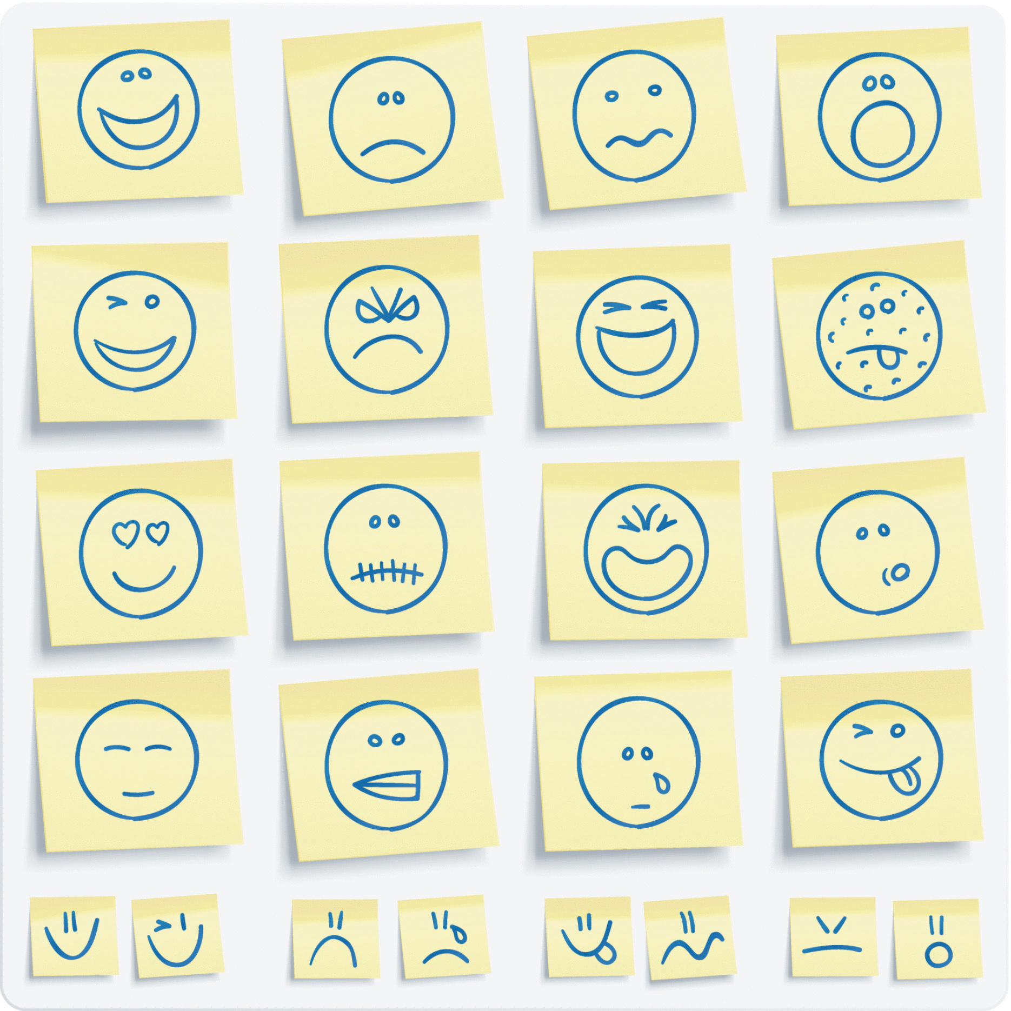
Attuned – How?
Reflect back the child or young person’s emotional state and associated physiology eg: your hands are looking like wiggly worms, your legs seem to be having trouble staying still
Give words, or another cortical label, to the child’s experience
Find ways to track the child or young person’s emotional state during the day. Are there any patterns?
Explore the intensity of feelings as much as the labels for them.
Play feelings games such as feelings bingo, feelings charades or the alphabet of feelings
This Photo by Unknown Author is licensed under CC BY-SA-NC
Notes:
Key points:
Another cortical label for the child or young person’s experience, or emotional response, can be anything. It could be a colour, a piece of music, a texture or even an item. These are cortical labels because they are consciously selected by the child or young person to represent their internal experience. For example, we might talk about them feeling pink, blue or green because they have associated those colours with specific physiological reactions.
Tracking tools may be as simple as a series of 5 faces and the teacher and/or the child or young person can circle which one they are feeling at different points during each day. Over time, they can provide a better picture of particular patterns. For example, does it show that the child or young person is always angry when they come in from lunch, always sad after Art or always happy when they have had a session working in smaller groups?
Exploring the intensity of a feeling is as important as labelling it. Finding ways for children and young people to be able to explore how ‘big’ or ‘little’ a feeling is and whether they want more or less of it is as important as recognising the physiology of the feeling.

Slide 14
Attuned – What happens?
Children and young people will be able to connect their internal states with an external label
This will help them to connect experiences of the past with their feelings in the present
They will continue to experience their emotions as being validated
The staff team can work to find patterns to identify possible triggers of past trauma

Slide 15
Connecting – Why?
This links to being attuned by building even more capacity for children and young people to understand how they are feeling, what they are feeling and how those feelings might be linked to their past and present experiences. This is what we might call emotional literacy
Children and young people need the adults in their world to legitimise their feelings so they can learn to trust their own responses

Slide 16
Connecting – How?
Understand that positive feelings might be just as confusing for a child to experience eg: think about the physiology of excitement and fear.
Continue to build a vocabulary for the child’s feelings, which could use words, colours, music or textures. The goal is to find a cortical label for a sub-cortical experience.
Use physical activities as an emotional release.
Integrate discussion about character’s emotional states through books or movies.
This Photo

Slide 17
Connecting – What happens?
The child is better able to link internal emotional states with conscious cognitive processes
They develop trust in their own emotional responses and in themselves more broadly
This capacity supports them feeling safer in the learning environment

Slide 18
Translating – Why?
Children and young people’s memory and interpretive functions can be impacted by trauma
This makes it difficult for them to build stories of understanding about themselves, and about learning concepts
They often need support to practice remembering events, experiences and blocks of learning

Slide 19
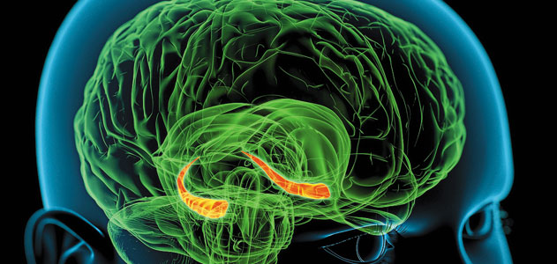
Translating – How?
Create regular opportunities to review with the child or young person what they have done in their day or week
Develop creative activities that record children’s memories and experiences, and review those records regularly
Support children and young people to construct stories about themselves that project them into the future with positive qualities about themselves
Gently challenge some of the negative narratives children or young people might hold about themselves
Notes:
Key points:
Firstly, just a reminder that the area of the brain highlighted in the image on this slide is the hippocampus – which is involved in memory formation
Creative activities to record children and young people’s memories can be things like folios of work, storying activities and mementos or photo based records. The key aspect to these is not just building the records but reviewing them regularly to help reinforce the stories for children and young people.

Slide 20
Translating – What happens?
Children and young people build better memory for events and experiences
This supports their capacity to learn and retain information
This also enables them to engage with qualities about themselves that are positive and linked to their present and future, not defined by their traumatic past
This

Slide 21
Involving – Why?
Involving children and young people in participation in relational activities with their peers is a crucial therapeutic tool
Children and young people who have experienced trauma often struggle with peer relationships because they are focused more on their own survival
These children and young people often feel isolated and different from their peers

Slide 22
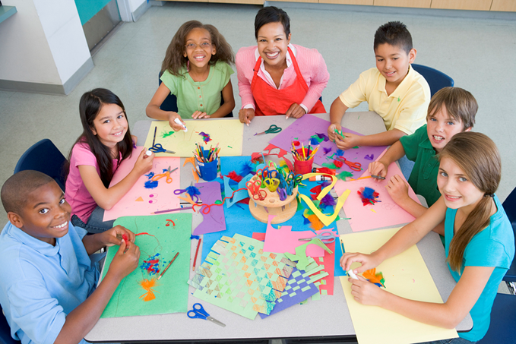
Involving – How?
Build groups around areas of interest, rather than capacity
Consider the developmental sequence of play and enable parallel play
Structured activities – linking to regulation and control – work better than unstructured time
Repetition of experience builds safety and capacity
Notes:
Key points:
This point clarifies that it is better that children and young people are in a group because they all enjoy coding (for example) rather than having a group of children and young people who struggle with social skills being placed together.
When we think about play development, we move from individual play to parallel play and finally to cooperative play. However, cooperative play may be too challenging for some children and young people who have experienced trauma as it is too intense for them. Thus, think about how they might be able to engage in parallel play (playing alongside rather than with).
Unstructured time with peers is often when traumatised children and young people get into trouble because they are not sure how to fill their time. If we can provide structured activities that support them experiencing regulation (calming) that is a better option and leads to less challenging behaviours.

Slide 23
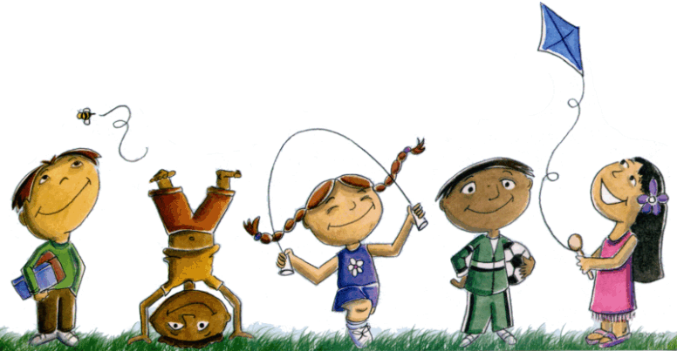
Involving – What happens?
Children and young people start to feel that they belong.
They don’t have to engage in inappropriate behaviour as attempts to be part of a social group and will learn to understand social cues more clearly
This Photo by Unknown Author is licensed under CC BY-NC-ND

Slide 24
Calming – Why?
Calming and engaging are the foundational pillars of SMART PRACTICE
Children and young people struggle with experiencing calm, which is an important state because it is our optimal state
Reflective and cognitive capacity is at its peak when we are calm

Slide 25
Calming – How?
Develop a repertoire of calming strategies and activities for children and young people to experience repeatedly. Examples might include drumming, music, physical activity, breathing activities or guided imagery.
Ensure that educators remain calm through self-care because it is hard to support someone else to be calm if we are not!
Support children and young people to connect the physiological experience of calm to the positive context of a regulated state
Notes:
Key points:
The more of a repertoire of calming activities we can provide for children and young people the better it is for them in terms of being able to regulate their emotional state and stay within their window of tolerance. This was also explored in the ‘Neurobiology of self-care and staff wellbeing’ session so you may be able to refer staff back to that (or link your own delivery to this session)

Slide 26
Calming – What happens?
Children and young people will reset their internal stress levels and are less likely to respond in volatile ways
They will feel more connected and better able to learn
These activities also support all children and ensure that those who have experienced trauma do not feel singled out or isolated.

Slide 27
Engaging – Why?
Children and young people who have experienced trauma need repeated opportunities of positive relational exchanges with adults to change their experience of relationships.
Every relational exchange is an opportunity for understanding and an opportunity for healing and repair.

Slide 28
Engaging – How?
Find key adults within the school or site with whom the child or young person feels some affinity. Reinforce these relationships through consistent and repeated exchanges.
Ensure a consistency of response from all adults across the school.
Support those identified key adults to be able to ‘hang in there’ with the child or young person as this relationship can be challenging.

Slide 29
Engaging – What happens?
The child or young person will learn to tolerate different levels of relationships with adults at school and practice maintaining connection with important adults – supporting them to feel safe.

Slide 30
Reflective questions
What would we add to these lists of SMART PRACTICE strategies that we already do to support children and young people who have experienced trauma?
Which area of SMART PRACTICE do we do best?
Which area of SMART PRACTICE will we work on tomorrow?
This Photo
Notes:
Activity
This final discussion activity supports the capacity to continue to build strategies and activities that are able to be used across the school or site and at an individual, small group, classroom or whole school context. These reflective questions can also lead into the introduction of the SMART audit tool and may lead to the staff group seeking delivery of the ‘SMART audit tool – supporting trauma responsive school practices’ session.
Before finishing the session, remind the group about the additional SMART resources available, which may help with further learning:
Other sessions available in the Train the trainer suite
SMART training calendar
Trauma Aware Schools initiative
The broader series of Department for Education initiatives – outlined in the summary slide available in the foundational session content.
Discussion papers – available at https://professionals.childhood.org.au/making-space-learning-resources/
Further Australian Childhood Foundation resources - https://professionals.childhood.org.au/resources/

